Slide 1
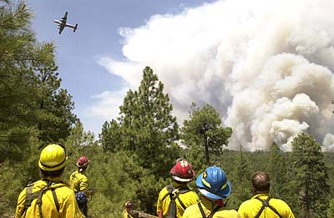
Inferno Arizona
Community Responses to the Rodeo-Chediski Fire of 2002

Slide 2
Extreme Natural Events
What is an Extreme Natural Event?
  Short term change in the weather or environment that can have long term effects.
Slideshow from National Geographic.

Slide 3
Extreme Natural Events
What types of extreme natural events could happen where you live?
What could your community do to prepare for this type of emergency?

Slide 4
Where in the World?
We will be learning about an extreme natural event that happened in Arizona in 2002.
You can find information about the parts of Arizona we will be studying on this story map:
http://arcg.is/2dGmtzf

Slide 5
Background
Take notes on each pass-around card.
Use the numbered boxes on your notes sheet.
Create a visual representation for each card. Just something quick to remind you of the topic.

Slide 6
Simulation Phase 1
Read your role card. Introduce yourself to the group.
Lay all the resource cards out so all students can see. Individually, make predictions about which resources will be most important and which your group could discard. Write your ideas in your notes.
Your budget only allows for ten cards. As a group, decide on ten resources to discard.

Slide 7
Simulation Phase 2
Introduce yourselves to your community group using your role.
Read the community scenario cards.
Gather everyone’s resources and decide which scenario to try to complete.
Get the resources you need by trading with other communities. You can trade or gift resources. No stealing resources.

Slide 8

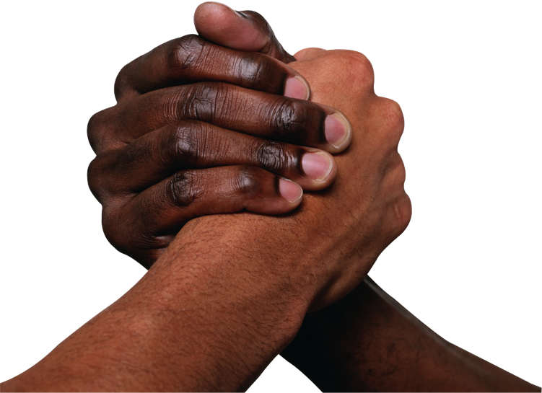
Competition and Cooperation
Competition: a struggle by two or more groups that want to own or control the same thing
Cooperation: people working together

Slide 9
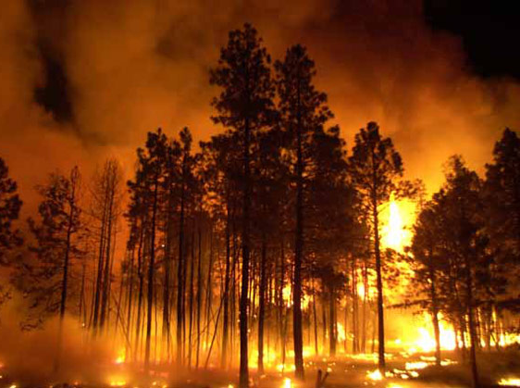
The Actual Inferno
The fire burned from June 18-July 6, 2002.
It started as two separate fires which joined to create one fire.
Communities throughout Arizona and from many other states sent firefighters and resources.
See this slideshow of photos from the fire.
Photo Source: National Park Service (2010)

Slide 10
The Actual Inferno
468,638: Acres burned
60: Days before the fire was declared out
481: Structures destroyed (465 homes)
43: Millions of dollars in firefighting costs
50,000: People evacuated
6,600: Total firefighters and support
44: Aerial tankers and helicopters used
345: Fire engines used
81: Bulldozers used
300-500: Estimates in feet of highest flames
http://archive.azcentral.com/news/articles/2012/06/18/20120618rodeo-chediski-numbers.html

Slide 11
The Actual Inferno
Until the Wallow fire in 2011, the Rodeo-Chediski fire was the largest wildfire in Arizona history.
The lessons learned in the Rodeo-Chediski fire were used to fight the Wallow fire and other large fires all across the country.
Photo Source: National Park Service (2010)

Slide 12
Emergency Preparation
Look back at your ideas from the discussion we had earlier. What else would you add?
  What types of extreme natural events could happen where you live?
  What could your community do to prepare for this type of emergency?
Do a little research. Can you find information about your community’s emergency preparedness plan?

Slide 13
Writing Assignment
Think about the scenarios faced by communities during the Rodeo-Chediski Fire in 2002.
Propose one strategy that one of the communities could use to prepare for the next fire.
Make sure to support your idea with relevant facts from your notes.
Write an organized paragraph to make your proposal.

Slide 14
Writing Assignment

