Slide 1
Operation Yellow Ribbon: Canada and 9/11
There are moments in history that bring countries and people together. The events of September 11, 2001, was one of those moments.

Slide 2
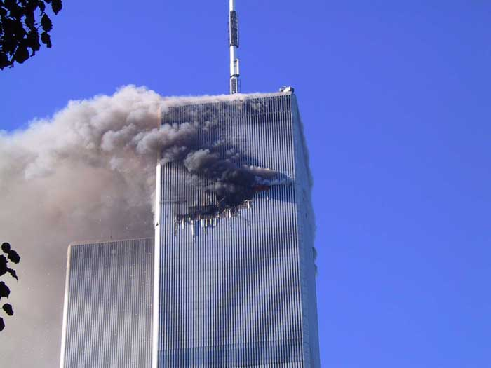
At 8:46 A.M. on September 11, the World Trade Center in New York City was hit by an airplane. It was American Airlines Flight 11, which had been hijacked after takeoff from Boston.

Slide 3
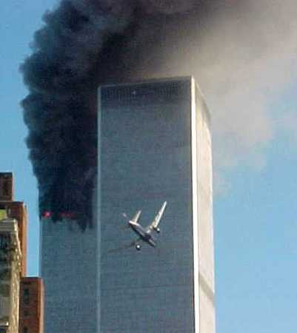
At 9:03 A.M., a second hijacked airliner, United Airlines Flight 175, also originating in Boston, struck the World Trade Center.

Slide 4
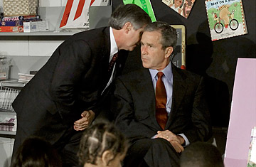
President Bush, who was visiting an elementary school in Florida, was told at 9:05 A.M. that, “America is under attack”.

Slide 5
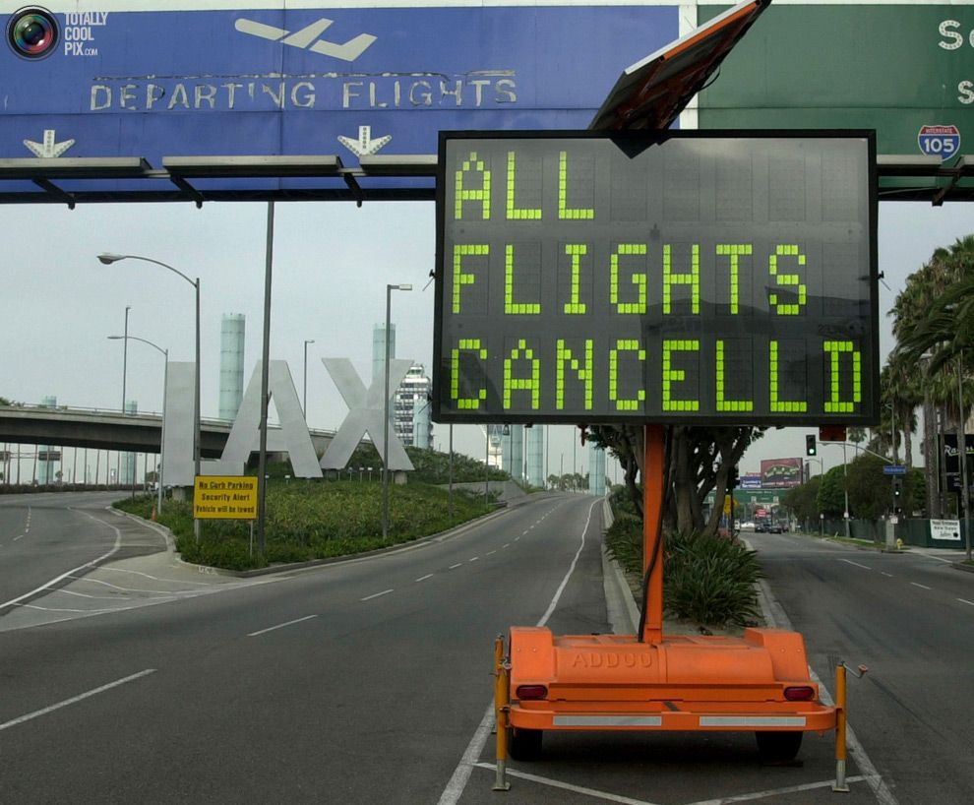
At 9:26 A.M., the Federal Aviation Administration (FAA) banned all commercial flights within the United States and ordered all airplanes to land at the nearest facility.

Slide 6
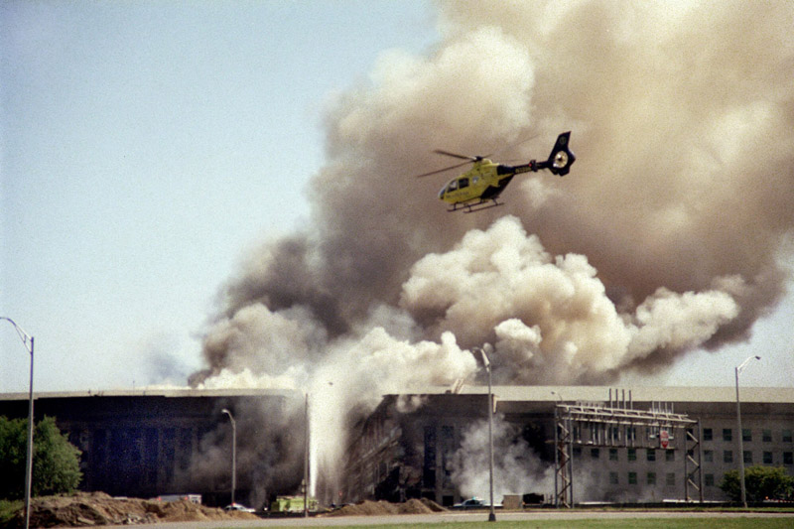
A third hijacked airplane, American Airlines Flight 77 originating in Washington, D.C., crashed into the Pentagon at 9:37 A.M.

Slide 7
At 9:45 A.M., the FAA closed the United States airspace to all domestic and international air traffic. International flights headed to the United States were told to divert to Canadian airports.

Slide 8
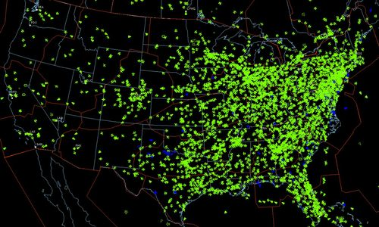
This is what US airspace looked like prior to closure.

Slide 9
You will now watch a short clip of how the US airspace was cleared that day.

Slide 10
September 11: FAA Closure of U.S. Airspace (.22 min)
http://www.youtube.com/watch?v=bo1ZtpKqlYw

Slide 11
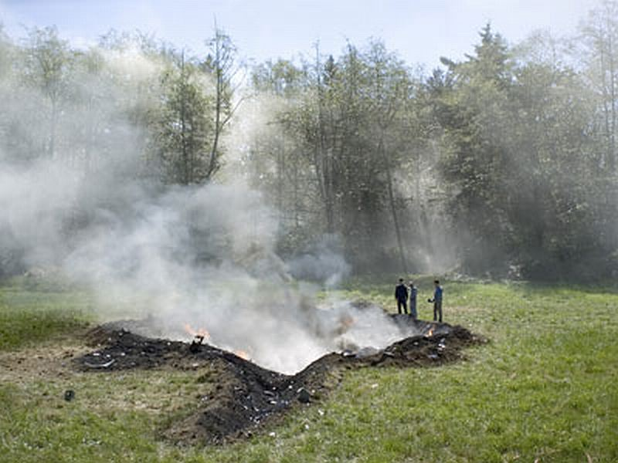
At 10:03 A.M., the last hijacked airliner, United Airlines Flight 93 originating out of Newark, New Jersey, crashed into a field in Pennsylvania.

Slide 12
With the closure of US airspace, Canada also closed its airspace and began implementation of Operation Yellow Ribbon. International flights bound for the United States were given instructions as to which Canadian airport to land.

Slide 13
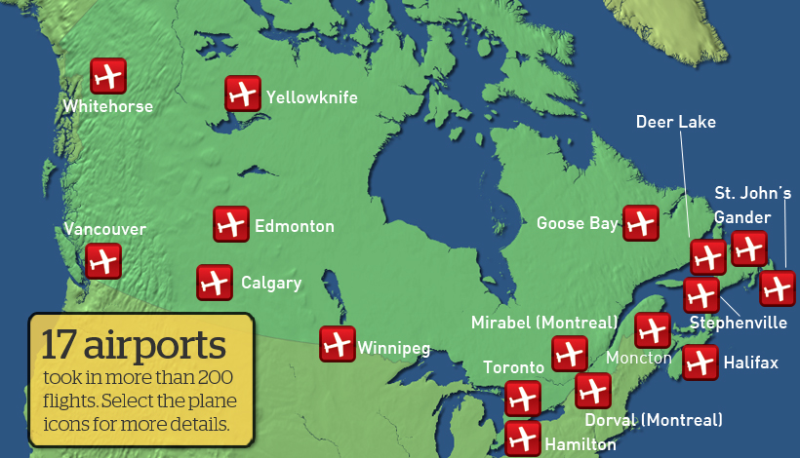

Slide 14
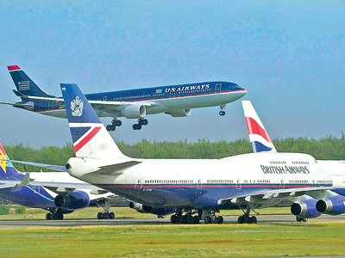
As flights poured in, these airports soon became parking lots for the diverted flights.

Slide 15
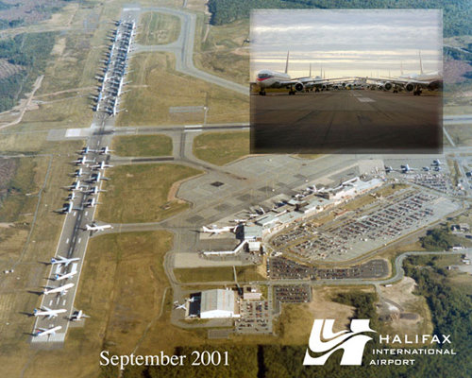

Slide 16
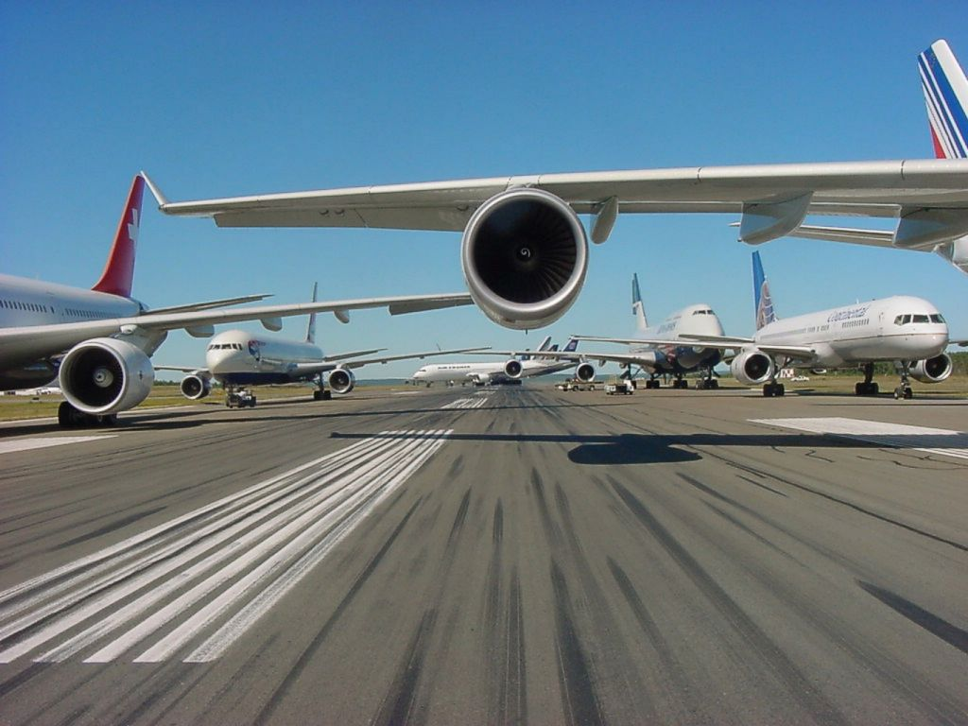
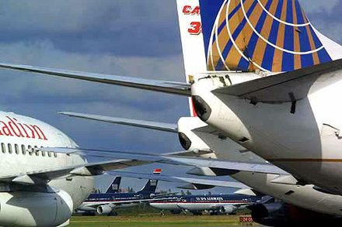

Slide 17
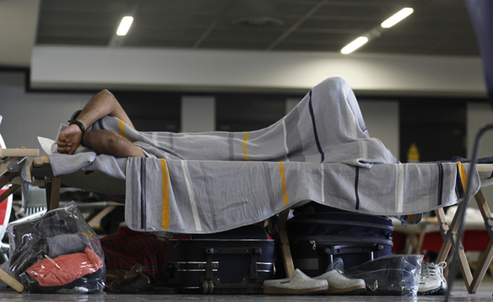
It is estimated that between 30,000 and 45,000 passengers and crew arrived that day. Many were housed in airport terminals. Other were sent to hotels and shelters. Local residents even opened their homes.

Slide 18
There were a few tense moments. In Whitehorse, Yukon, a Korean Air flight was escorted in by fighter jets after sending the message, “hijacked”. When on the ground, it was discovered that the message was sent by mistake due to a communications equipment malfunction.

Slide 19
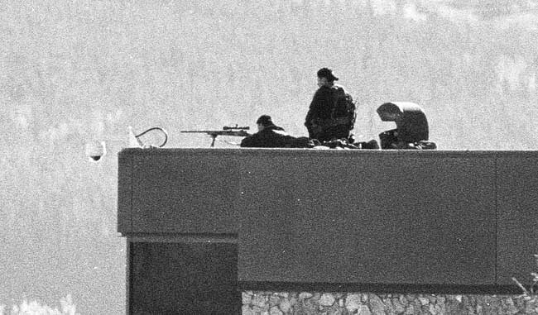
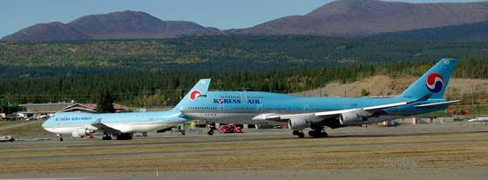

Slide 20
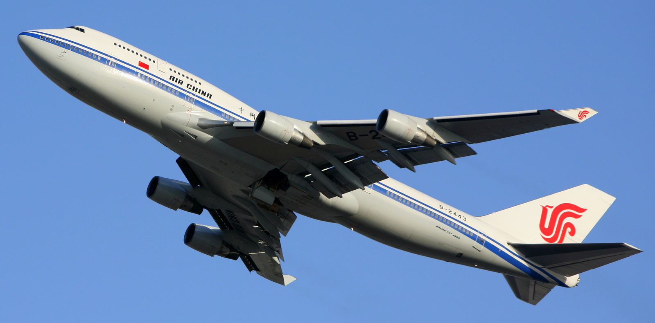
In Vancouver, British Columbia, an Air China flight was escorted in by fighter jets due to a communications problem as well.

Slide 21
In the small town of Gander, Newfoundland, Operation Yellow Ribbon took on new meaning. This community became a shining example of what people will do for those in need. On September 11, 38 airplanes landed at the small airport and the town’s population nearly doubled due to the stranded passengers and crew.

Slide 22
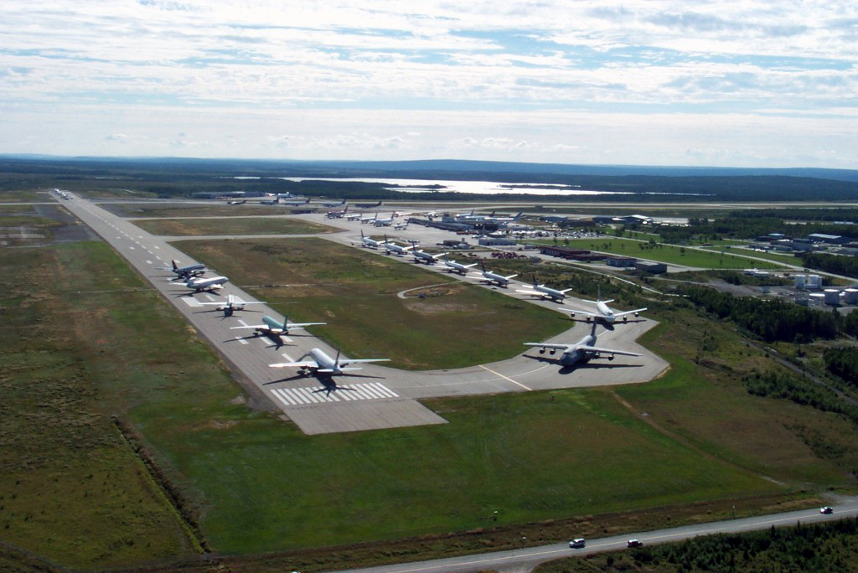

Slide 23
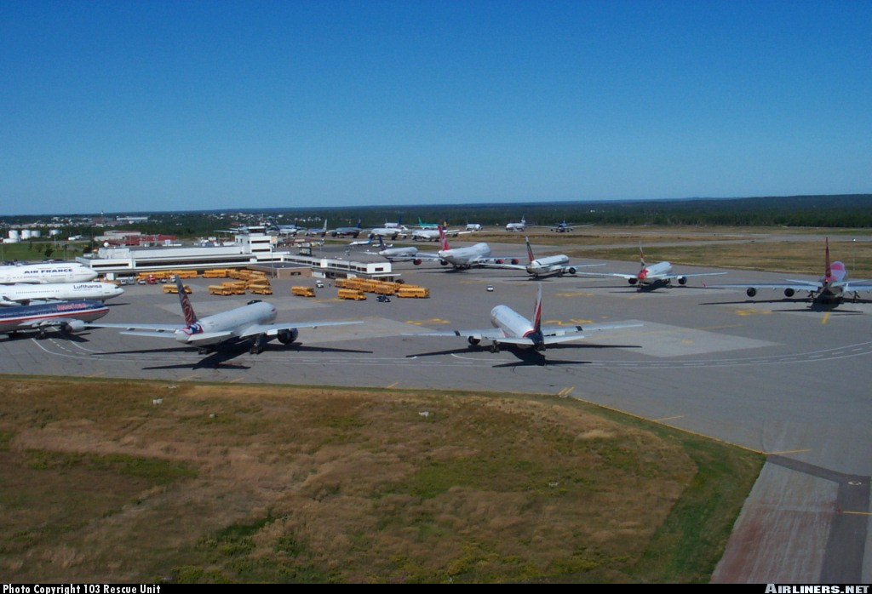
Buses transported passengers and crew to shelters that had been set up in local schools and meeting halls.

Slide 24
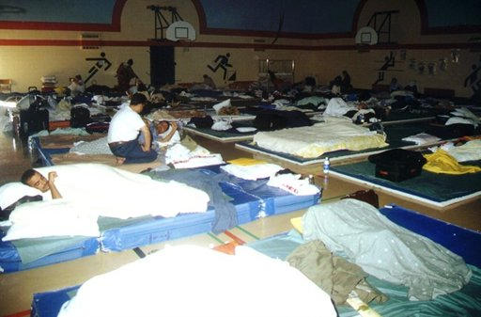
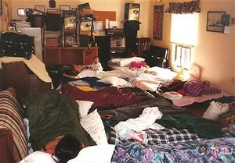

Slide 25
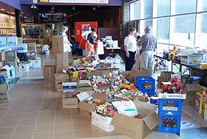
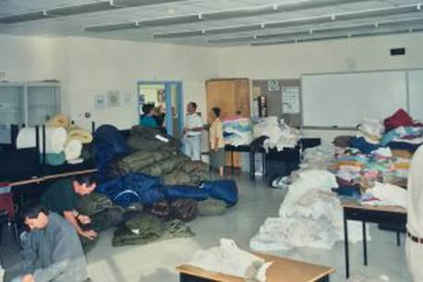
Donations poured in to help provide the stranded travelers with food, water, and other necessities.

Slide 26
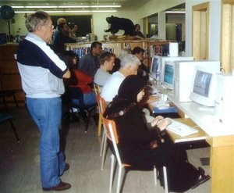
People were also given access to computers so they could communicate with family and friends back home.

Slide 27
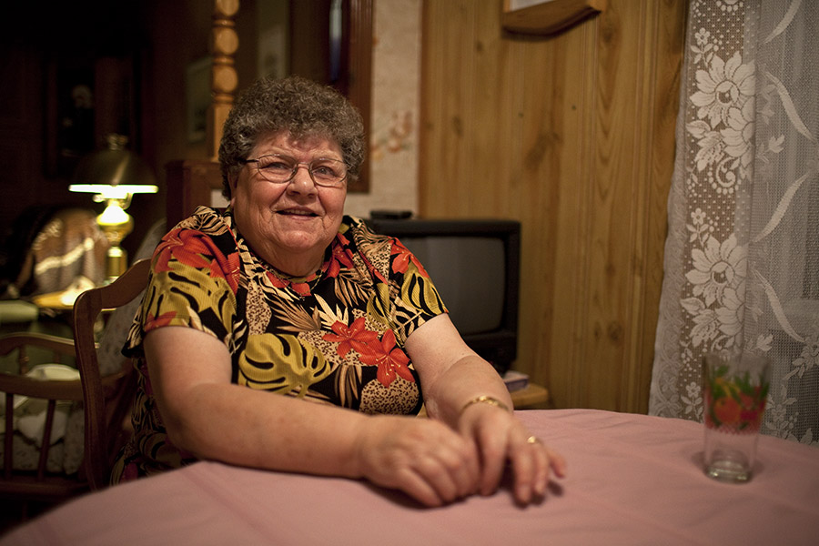
Even local residents took people into their homes.

Slide 28


What took place in Gander has been recorded in both print and film.

Slide 29
The following two videos show the events that took place in Gander over the six days Operation Yellow Ribbon was taking place.

Slide 30
Gander-Newfoundland 9-11 (5.57 min)
https://www.youtube.com/watch?v=PUmCgQp5iNg

Slide 31
9/11 Refuge Revisited Gander Airport (4.37 min)
https://www.youtube.com/watch?v=OmuhQcqRztE

Slide 32
On September 13, the United States reopened its airspace and stranded airplanes began to leave. On September 16, the last of the diverted flights left Canada and Operation Yellow Ribbon ended.

Slide 33
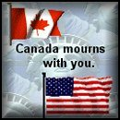
Throughout this ordeal, Canada stood by the United States.

Slide 34
To quote then Prime Minister Jean Chretien, “9/11 will live long in memory as a day of terror and grief. But thanks to the countless acts of kindness and compassion done for those stranded visitors here in Gander and right across Canada it will live forever in memory as a day of comfort and of healing. You did yourselves proud, ladies and gentlemen, and you did Canada proud.”

Slide 35
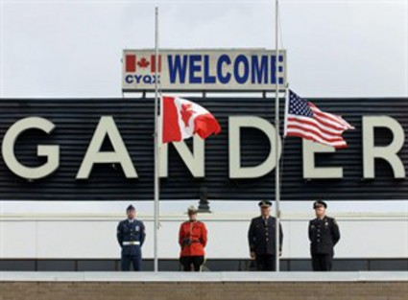
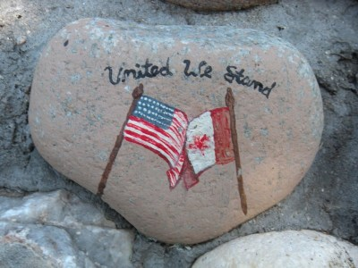

Slide 36
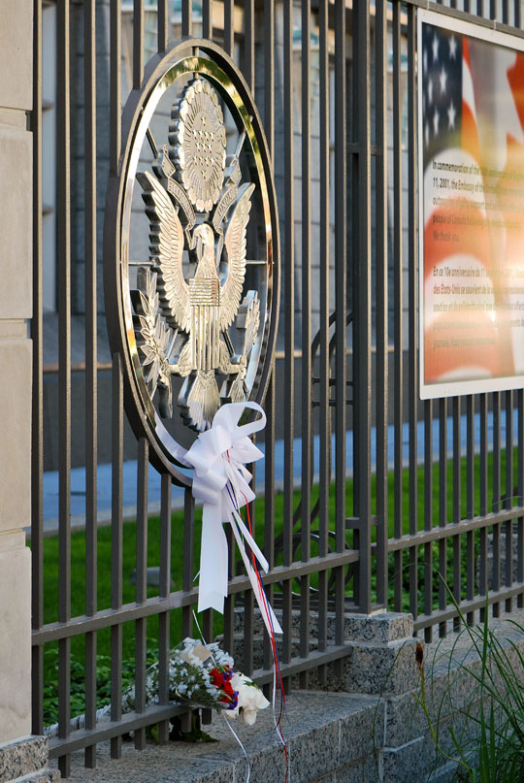


Slide 37
Photo Credits:
Slide 2: www.seykota.com
Slide 3: www.icbs-stresscert.org
Slide 4: http://content.time.com/
Slide 5: www.atvn.org
Slide 6: www.pollsb.com
Slide 8: www.whitehouse.gov
Slide 11: www.911review.org
Slide 13-14: www.cbc.ca
Slide 15: www.redbubble.com
Slide 16: www.cbc.ca
Slide 17: www.canada.com
Slide 19: www.yukon-news.com
Slide 20: www.wikipedia.org

Slide 38
Slide 22: www.forums.canadiancontent.net
Slide 23: www.airliners.net
Slide 24: www.news.ca
www.cbc.ca
Slide 25: www.ganderbeacon.ca
Slide 26: www.stuff.co.nz
Slide 27: www.walrusmagazine.com
Slide 28: www.tidespoint.com
www.imdb.com
Slide 33: www.canada.com
Slide 35: www.cbc.ca
Slide 36: www.ottawa.usembassy.gov
www.channel9store.com

