Slide 1
Picture Canada: Learning About Canada’s Physical Regions Through Pictures
Dennis Rees
Teacher-Consultant
Arizona Geographic Alliance
K-12 Study Canada Teacher Associate

Slide 2
Canada is composed of six physical regions. Each has its own unique geography, history, culture, and economy.

Slide 3
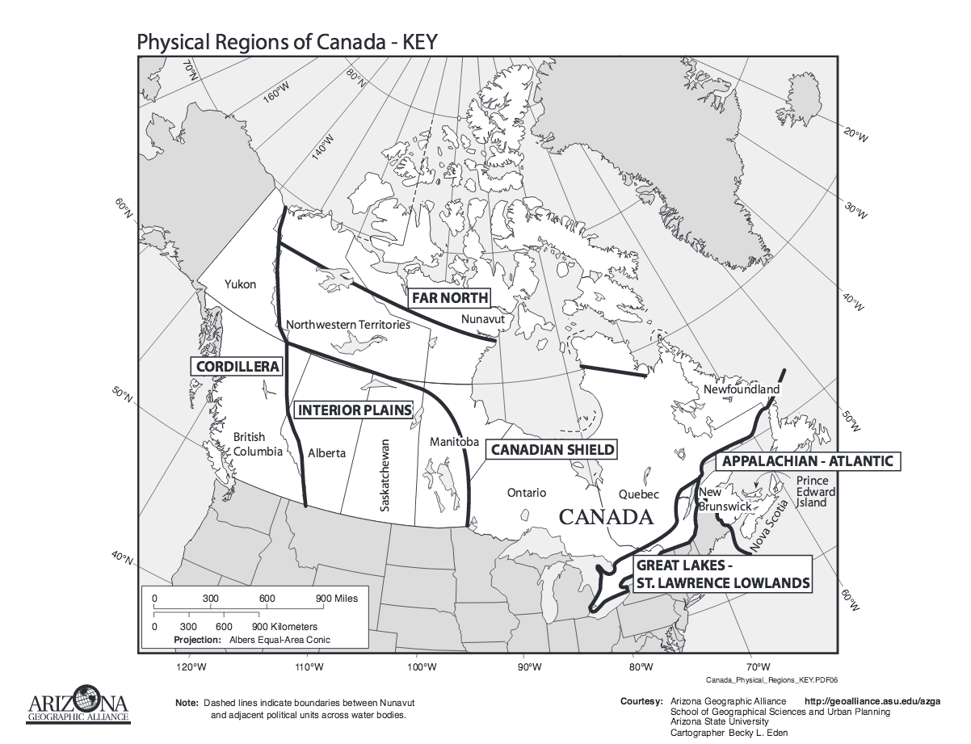

Slide 4
The Canadian Shield Region
This region is located in northern Quebec, Ontario, and Manitoba; Labrador; and southern Nunavut and the Northwest Territories. It is the largest of the six physical regions.

Slide 5
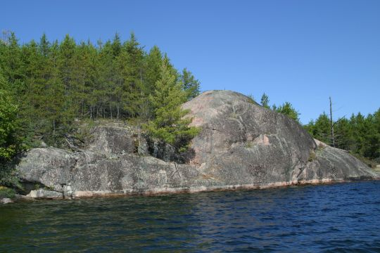
This region has the oldest rock formations in Canada. It was also the most affected by glaciers. There are large areas of exposed rock, and, sand and gravel ridges.
www.northwestontariomaps.ca
Notes:
www.northwestontariomaps.ca

Slide 6
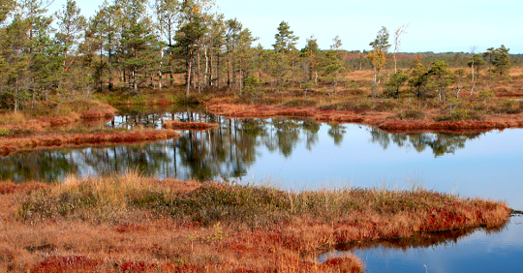
It is also known for its peatlands.
www.geog.mcgill.ca
Notes:
www.ontariobassfishing.ca

Slide 7
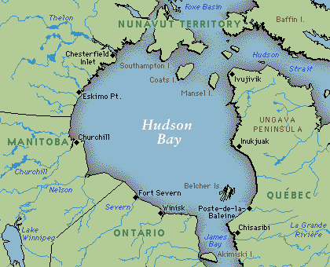
The Hudson Bay is located in this region.
www.mrpolino.pbworks.com
Notes:
www.mrpolino.pbworks.com

Slide 8
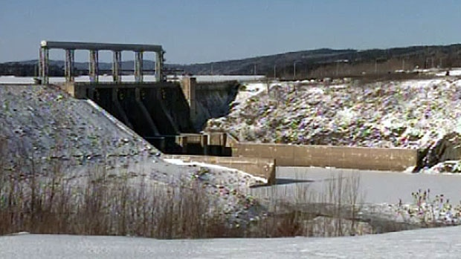
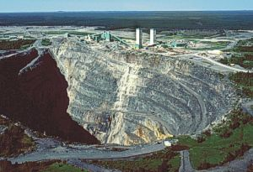
The economy of the region is based on hydroelectric power, mining, lumber, and fur.
www.atlantic.ctvnews.ca
www.agu.org
Notes:
www.blogs.agu.org

Slide 9
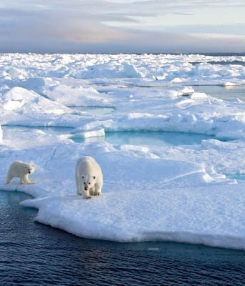
Churchill, Manitoba is called the Polar Bear Capital of Canada due to the large number of these animals who live in the area. It is a popular tourist attraction.
http://www.naturalworldsafaris.com/~/media/Images/Destinations/Arctic%20and%20Antarctic/Svalbard/Generic/Polar%20Quest/POLAR%20QUEST%20SVALBARD%20Polar%20Bears%20on%20the%20ice%20Adam%20Rheborg.ashx?crop=1
Notes:
www.flickr.com

Slide 10
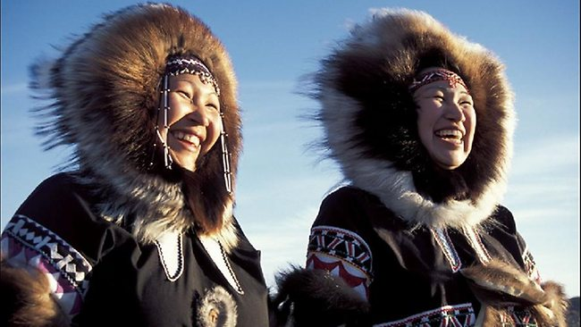
This is also one of the regions where the Inuit First Nations live.
www.news.com.au
Notes:
www.news.com.au

Slide 11
The harvesting of natural resources will continue to help this region develop and add to the standard of living for the people living there.

Slide 12
The Appalachian-Atlantic Region
This region is located in eastern Quebec; New Brunswick, Nova Scotia, Newfoundland, and Prince Edward Island. It is also known as the Maritime Provinces.

Slide 13
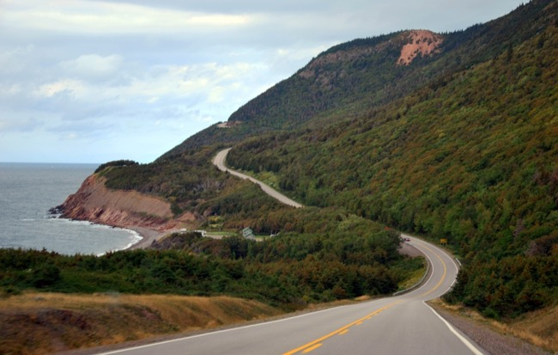
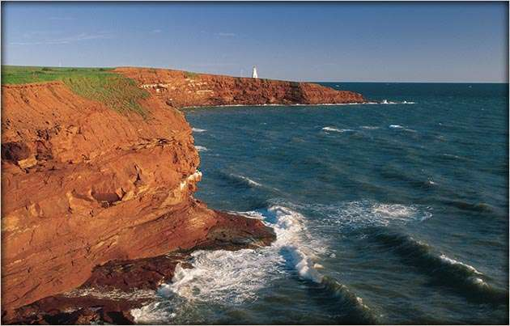
The region is known for its low mountains and rugged coast.
www.commons.wikimedia.org
www.tourismpei.com
Notes:
www.tourismpei.com

Slide 14
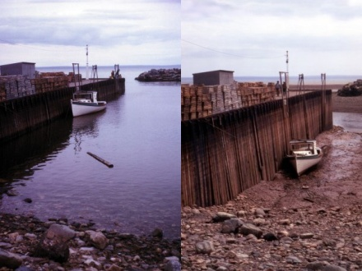
The Bay of Fundy experiences the greatest flucuation in daily tides of any place in the world.
www.ecogirlcosmoboy.wordpress.com
Notes:
www.ecogirlcosmoboy.wordpress.com

Slide 15
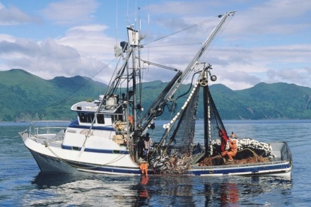
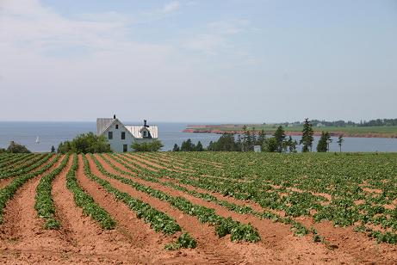
The region’s economy is based on lumber, fishing, agriculture, and shipping.
www.crowley.com
www.sites.google.com
Notes:
www.sites.google.com

Slide 16
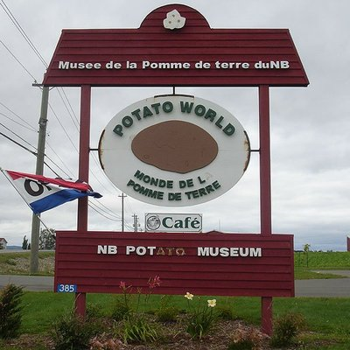
In fact, it is the Potato Capital of Canada.
www.yelp.com
Notes:
www.yelp.com

Slide 17
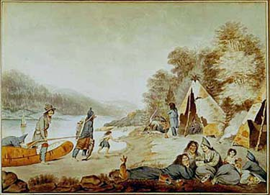
The region is home to the Micmac and Maliseet First Nations.
www.turtletrack.org
Notes:
www.turtletrack.org

Slide 18
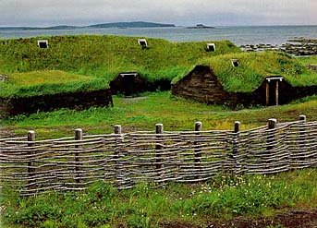
The first Europeans to arrive were the Vikings. They had a settlement at L’Anse aux Meadows, Newfoundland.
www.abroadintheyard.com
Notes:
www.abroadintheyard.com

Slide 19
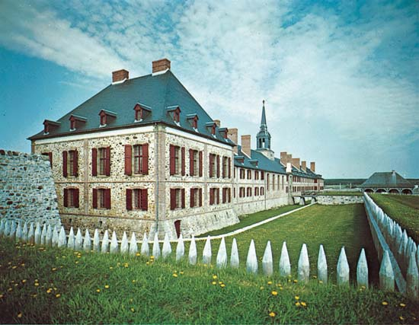
They were followed by the French, and then the British.
www.kids.britannica.com
Notes:
www.kids.britannica.com

Slide 20


Anne of Green Gables and Evangeline are both set here.
www.epicdvdmania.com
www.iamoceansroar.wordpress.com
Notes:
www.iamoceansroar.wordpress.com

Slide 21
A decline in the fishing industry has been offset with a rise in manufacturing and tourism, thus benefiting the region.

Slide 22
The Interior Plains Region
This region is located in Alberta, Saskatchewan, and southern Manitoba. It is an area of extreme temperatures-hot summers and cold winters.

Slide 23
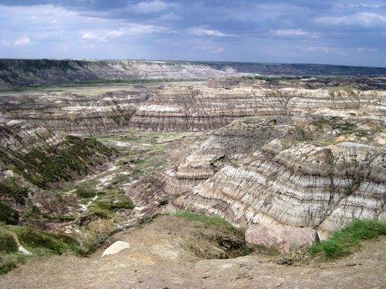
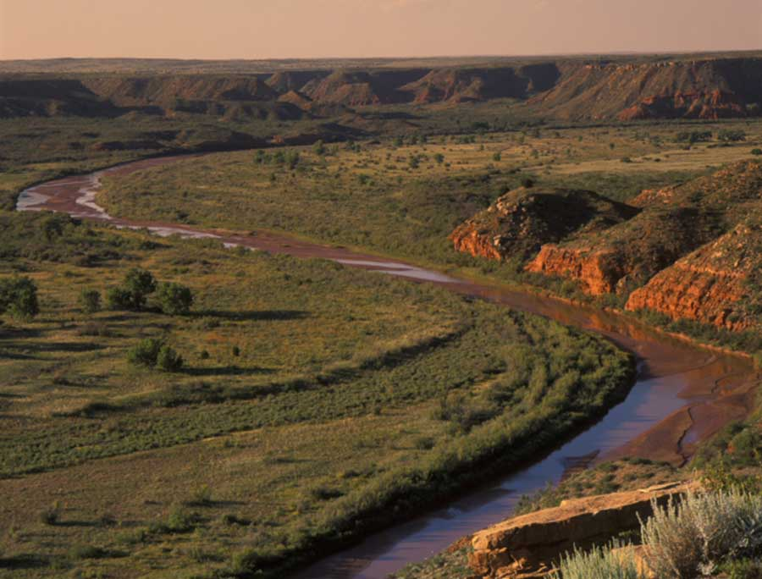
The region is flat with areas of badlands and river valleys.
www.pinterest.com
www.chassmiddleton.com
Notes:
www.chassmiddleton.com

Slide 24
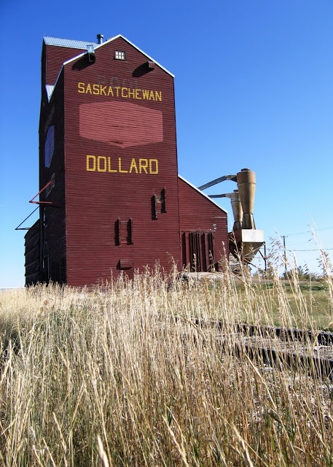
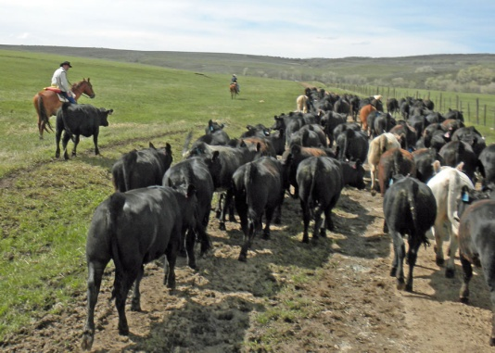
The economy is based on agriculture, cattle,
www.lenaweepaint.com
www.pinterest.com
Notes:
www.lenaweepaint.com

Slide 25
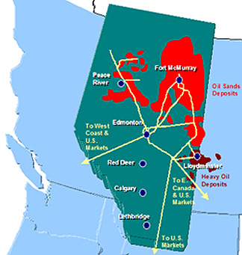
and oil and natural gas. It is a major supplier of these fuels to the United States.
www.ellimckean.com
Notes:
www.ellimckean.com

Slide 26
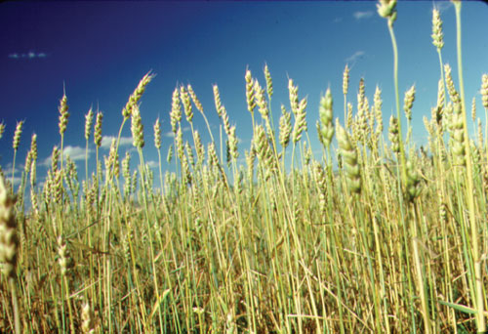
It is also known as the Breadbasket of Canada as it contains 75% of the nation’s farmland.
www.esack.uregina.ca
Notes:
www.esack.uregina.ca

Slide 27
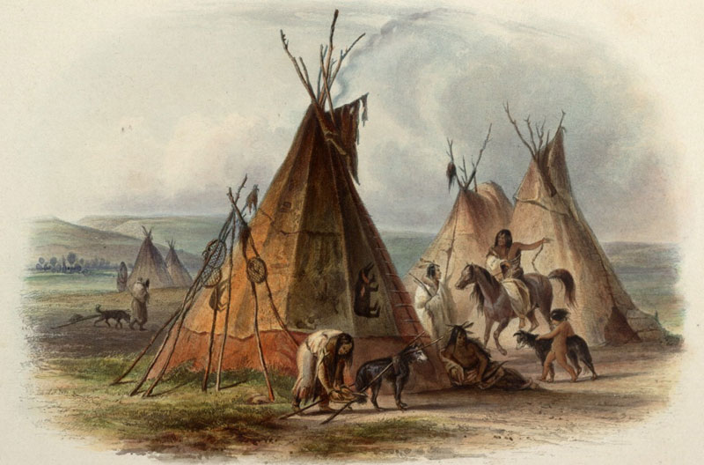
The region is home to the Cree, Blackfoot, and Assiniboine First Nations.
www.publications.newberry.org
Notes:
www.publications.newberry.org

Slide 28
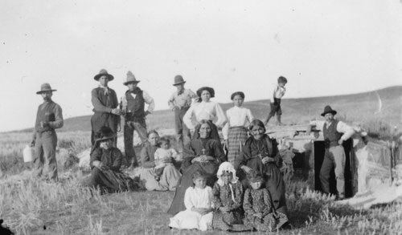
It is also home to the Metis Nation, a people of mixed First Nations and European ancestry.
www.metisbygabriella.wikispaces.com
Notes:
www.metisbygabriella.wikispaces.com

Slide 29
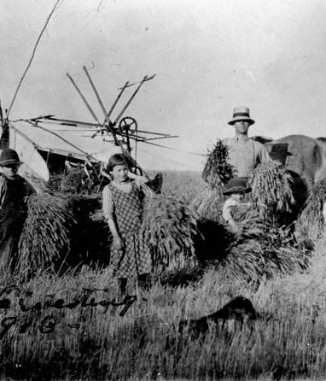
During the late 1800’s, German, Russian, and Ukrainian immigrants were actively recruited to come to the region because of their farming skills.
http://tc2.ca/sourcedocs/uploads/images/Gallery/History%20Docs/Immigration/Conditions%20for%20early%20Ukranians/harvesting.jpg
Notes:
www.ukrainianchurchesofcanada.ca

Slide 30
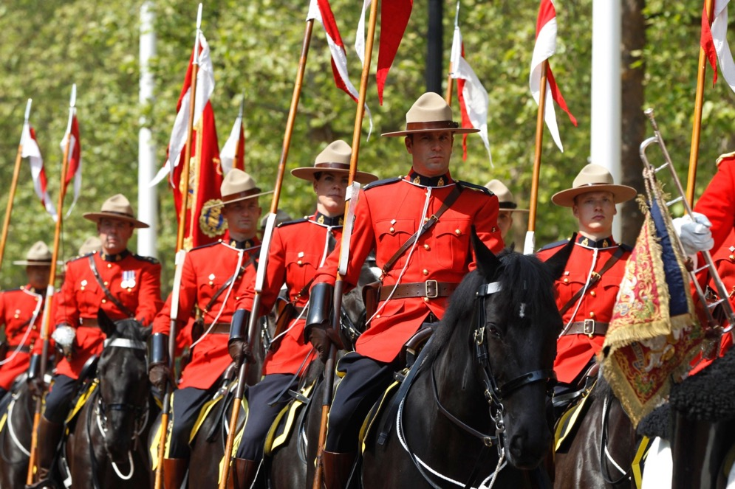
The Royal Canadian Mounted Police started here, and maintain a training facility in Regina, Saskatchewan.
www.metronews.ca
Notes:
www.metronews.ca

Slide 31
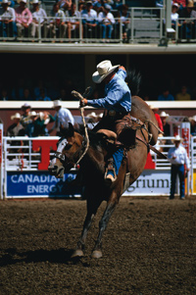
Each year, they celebrate their cowboy heritage with the Calgary Stampede (rodeo) in Calgary, Alberta.
www.calgary.usconsulate.gov
Notes:
www.calgary.usconsulate.gov

Slide 32
The Far North Region
This region is located in the northern Northwest Territories and Nunavut, and the Arctic Islands.

Slide 33
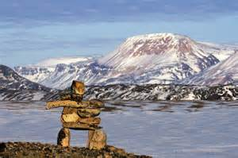
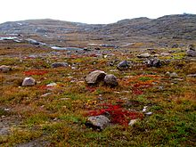
It is the most diverse of the regions-tundra, coastal plains, mountains, glaciers, and permafrost.
www.10000birds.com
www.wikipedia.org
Notes:
www.wikipedia.org

Slide 34
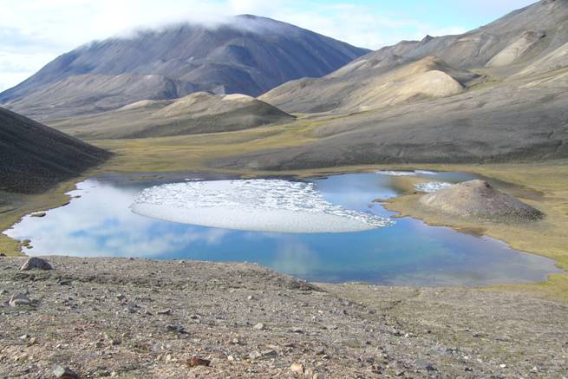
www.post.queensu.ca
Notes:
www.post.queensu.ca

Slide 35
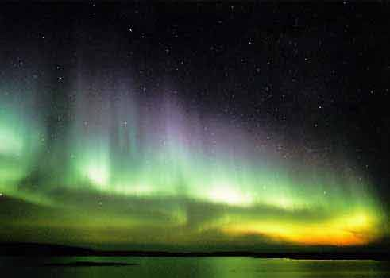
This is the region known as the Land of the Midnight Sun and for the Northern Lights.
www.inukshuk.com
Notes:
www.inukshuk.com

Slide 36
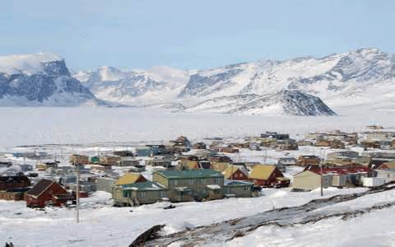
It is the least populated of all the regions.
www.arctic-guide.net
Notes:
www.arctic-guide.net

Slide 37
This is an economically poor region. There is an arts and crafts industry, several fish and meat processing plants, and a growing construction industry. However, most people rely on government assistance.

Slide 38
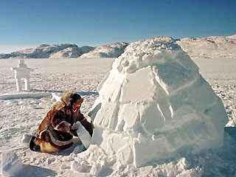
This region is home to the Inuit First Nations.
www.foxnews.com
Notes:
www.foxnews.com

Slide 39
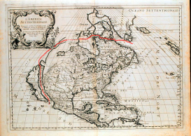
Europeans were first attracted to the area in search of the Northwest Passage. Later, they came due to the fur trade and whaling industry.
www.polarprince.com
Notes:
www.polarprince.com

Slide 40
With the creaton of Nunavut in 1999, the Inuit First Nations have had more influence and control over the economic development of the region. This will help them to benefit from the extraction of mineral resources in the area.

Slide 41
The Great Lakes-St. Lawrence Lowlands Region
This region consists of southern Ontario and Quebec. It is the smallest region, but also the most populous.

Slide 42
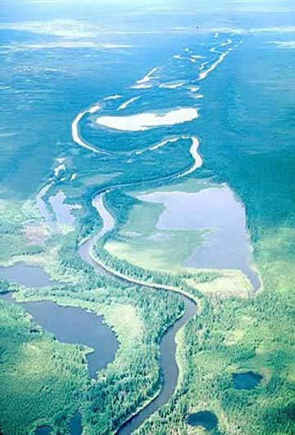
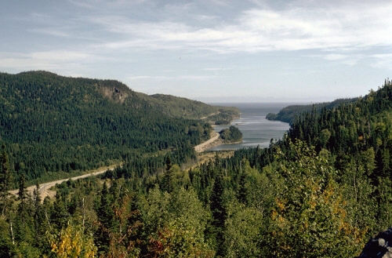
The region is flat with rolling hills, rivers, and lakes.
www.grade7geography.wikispaces.com
www.canadianregions.wikispaces.com
Notes:
www.grade7geography.wikispaces.com

Slide 43
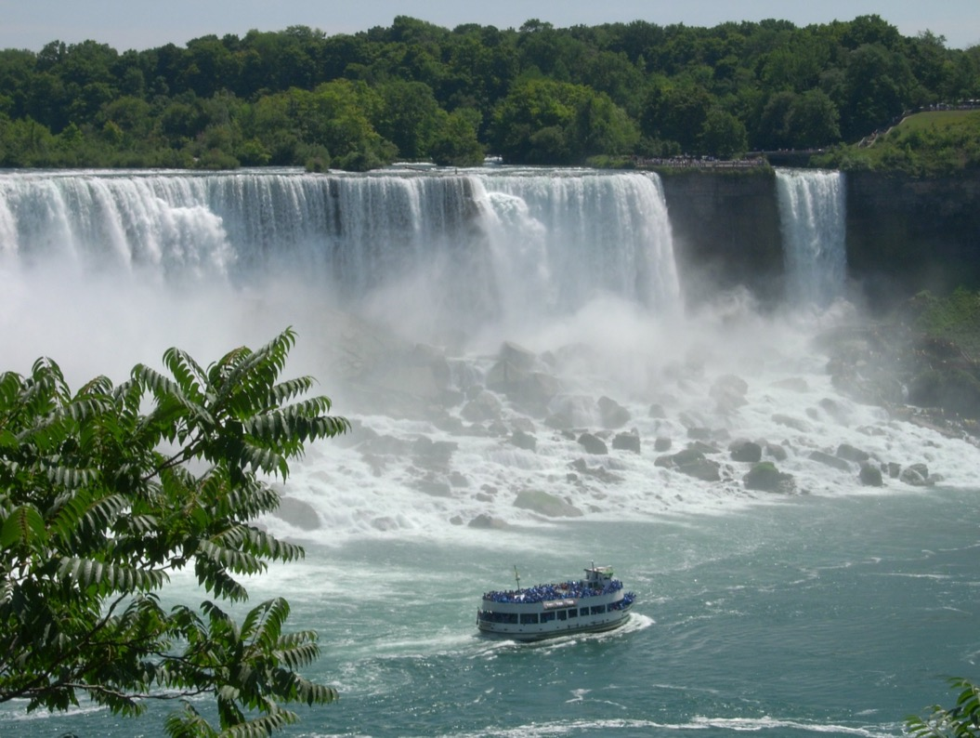
Niagara Falls are found here.
www.niagaraontario.com
Notes:
www.niagaraontario.com

Slide 44
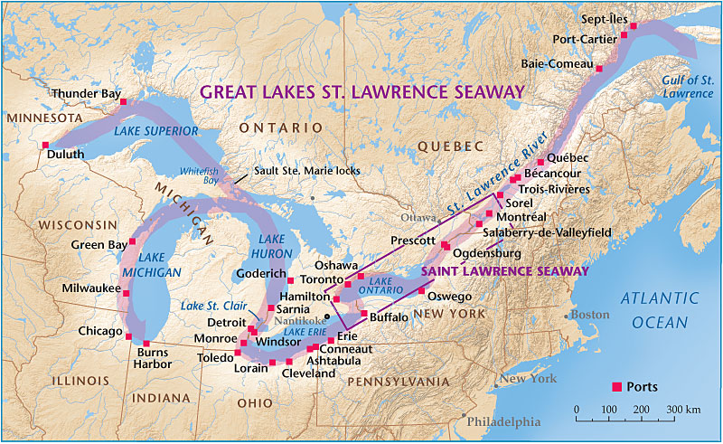
The main feature, however, is the St. Lawrence River and Great Lakes. They connect the interior with the Atlantic Ocean.
www.canadiangeographic.ca
Notes:
www.canadiangeographic.ca

Slide 45
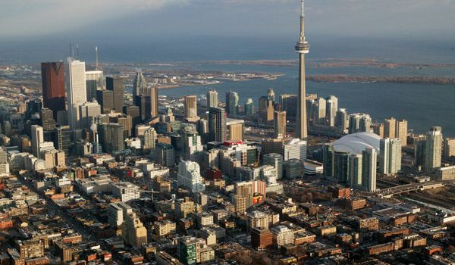
This region is the urban core of Canada. It is often called Canada’s Main Street.
www.images.businessweek.com
Notes:
www.images.businessweek.com

Slide 46
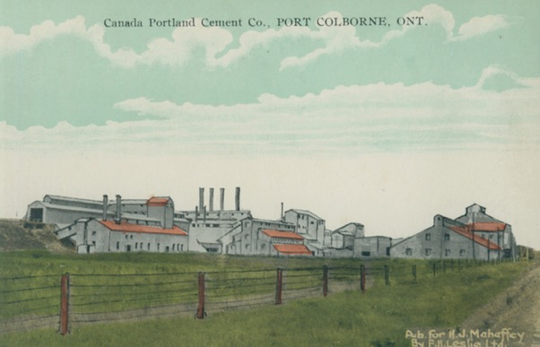

The region’s economy is based on farming, manufacturing, and financial services.
www.nflibrary.ca
www.forbes.com
Notes:
www.forbes.com

Slide 47
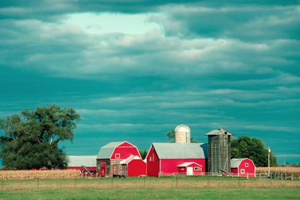
www.pinterest.com
Notes:
www.pinterest.com

Slide 48
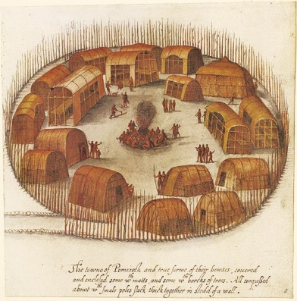
The region is home to the Algonquin, Huron, Ojibwa, and Iroquis First Nations.
www.newtopiamagazine.wordpress.com
Notes:
www.newtopiamagazine.wordpress.com

Slide 49
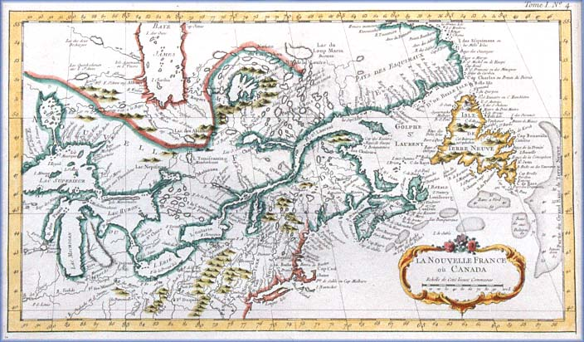
The French were the first Europeans to settle the region. Their culture remains strong in the province of Quebec.
www.civilication.ca
Notes:
www.civilication.ca

Slide 50
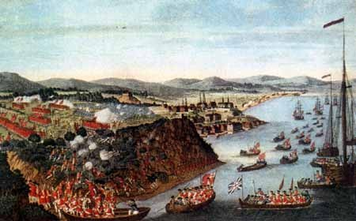
The British gained control in 1763 as a result of the French and Indian War.
www.5francisroney.weebly.com
Notes:
www.5francisroney.weebly.com

Slide 51
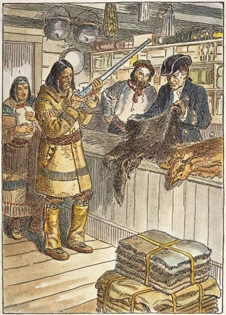
Both were drawn by the profitable fur trade.
www.veteranstoday.com
Notes:
www.veteranstoday.com

Slide 52
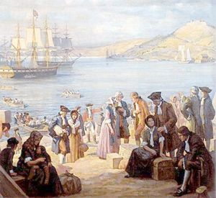
After the American Revolution, the region became a haven for American Loyalists.
www.conservapedia.com
Notes:
www.conservapedia.com

Slide 53
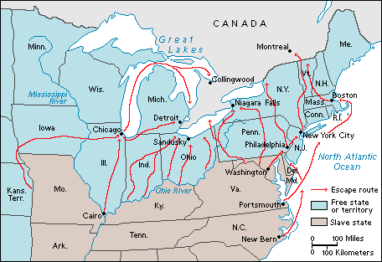
It was also the destination of runaway slaves prior to the Civil War.
www.waxingandwaningcousinsconnections.blogspot.com
Notes:
www.waxingandwaningcousinsconnections.blogspot.com

Slide 54
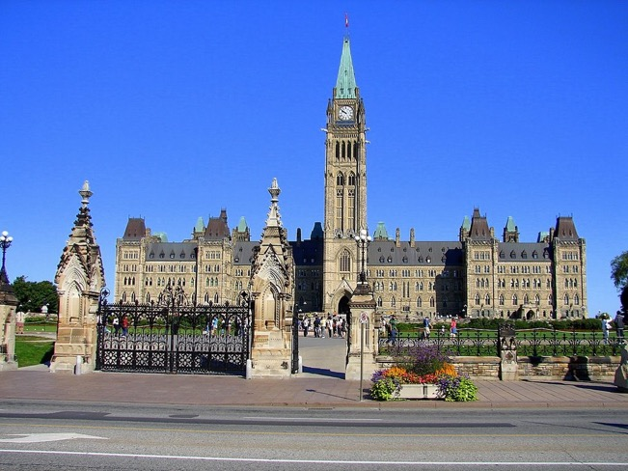
In 1857, Ottawa, Ontario was selected as the site of the national capital of Canada due to its location in the historical and economic heartland of European Canada.
www.panoramic.com
Notes:
www.panoramic.com

Slide 55
The Cordillera Region
This region consists of British Columbia and the Yukon Territory.

Slide 56
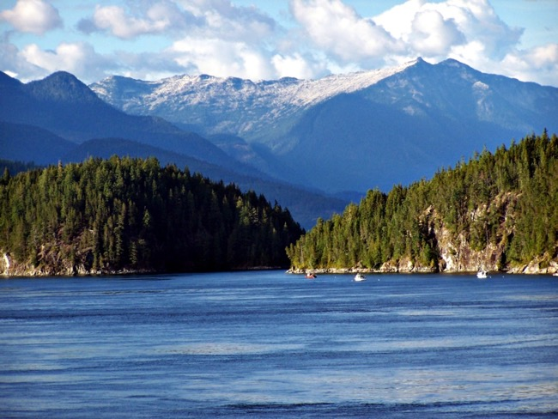

The region is known for its mountains, fjords, and forests.
www.cbwc.ca
www.cathedralgrove.eu
Notes:
www.cathedralgrove.eu

Slide 57


Coastal areas are warm and wet, while interior areas are cold and dry.
www.botanicalgarden.ubc
www.andreagrant.org
Notes:
www.andreagrant.org

Slide 58


The region’s economy is based on fishing, lumber, and farming.
www.pelhamplastics.com
www.superstock.com
Notes:
www.superstock.com

Slide 59


The Northwest Coastal First Nations live here.
www.pinterest.com
www.leslielopez.wordpress.com
Notes:
www.leslielopez.wordpress.com

Slide 60

The region was the site of several gold rushes.
www.pinterest.com
Notes:
www.pinterest.com

Slide 61
Because of it location on the Pacific Coast, the region is Canada’s window on Asia for immigration and trade.

