Slide 1
Study of the Armadillo: Combining Biology, Technology, Art, and Geography

Slide 2
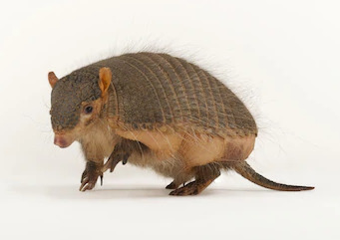
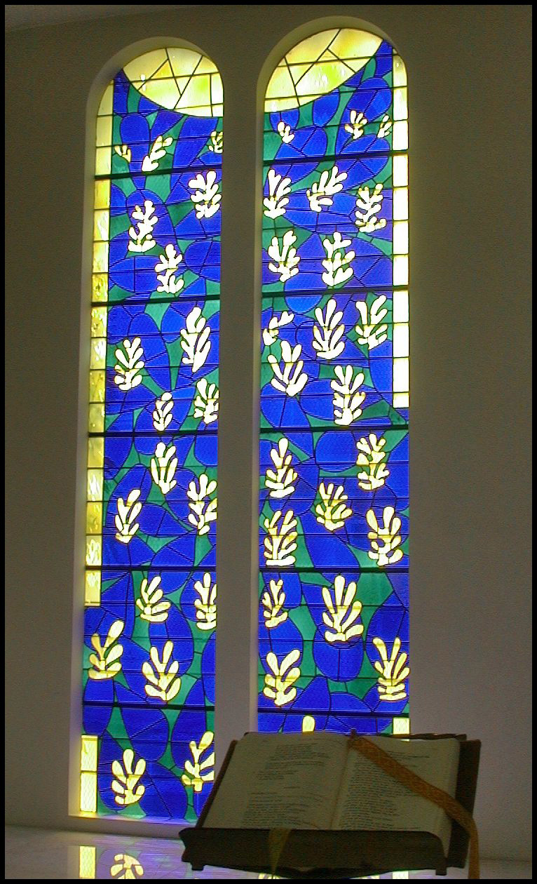
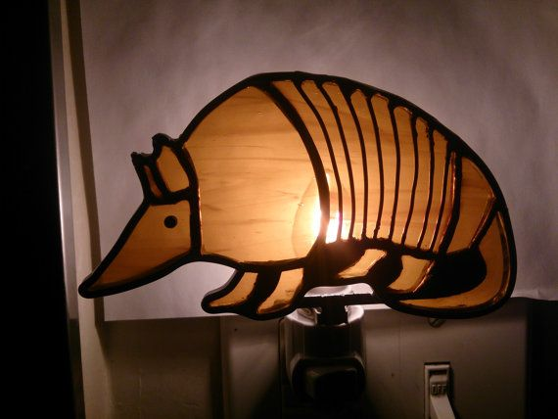
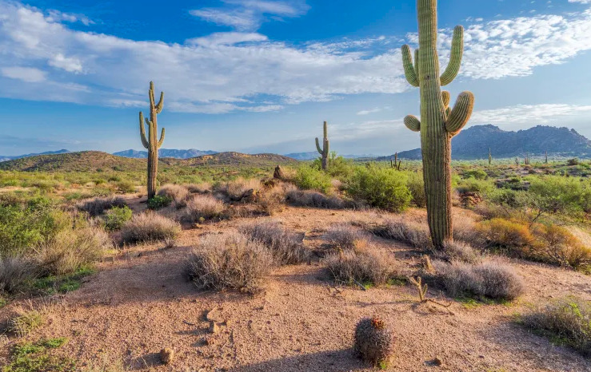
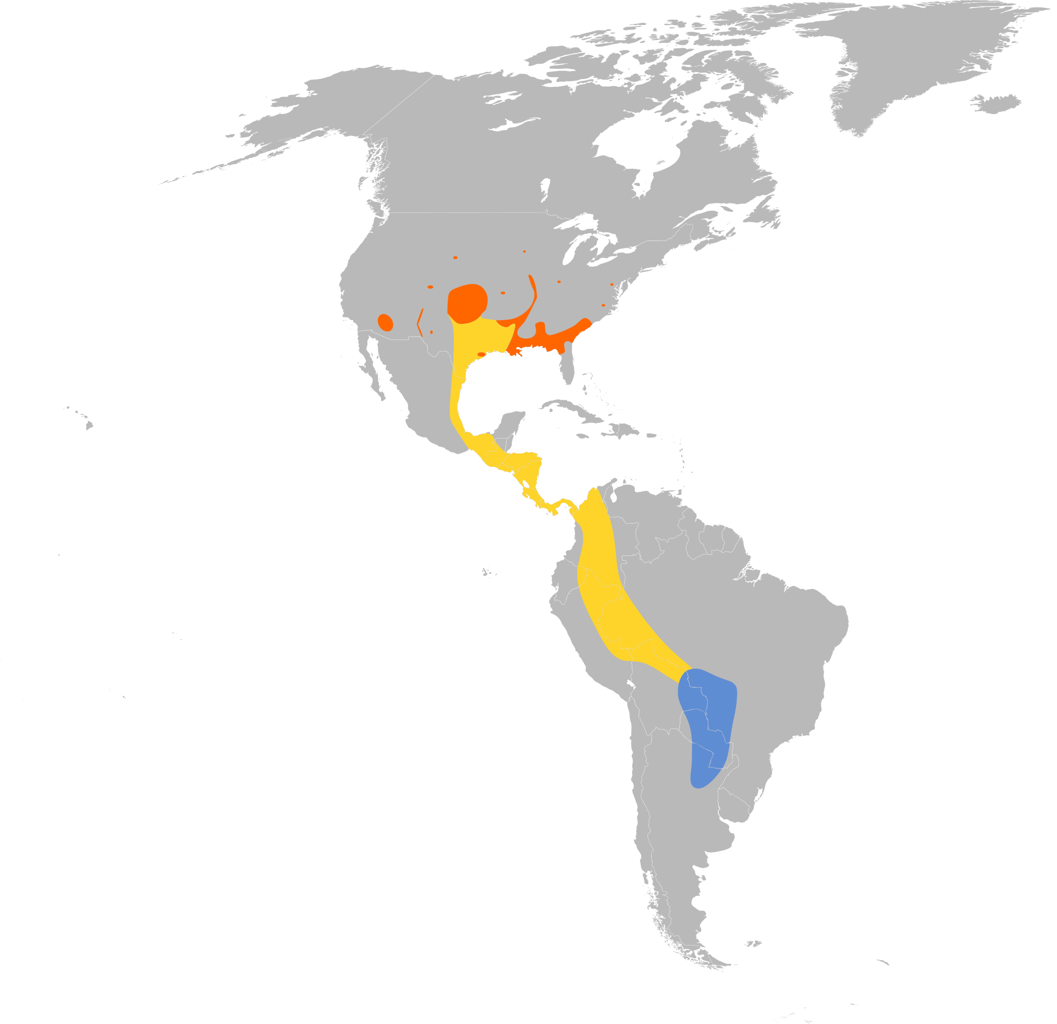
Combining Biology Technology, Art, Geography

Slide 5
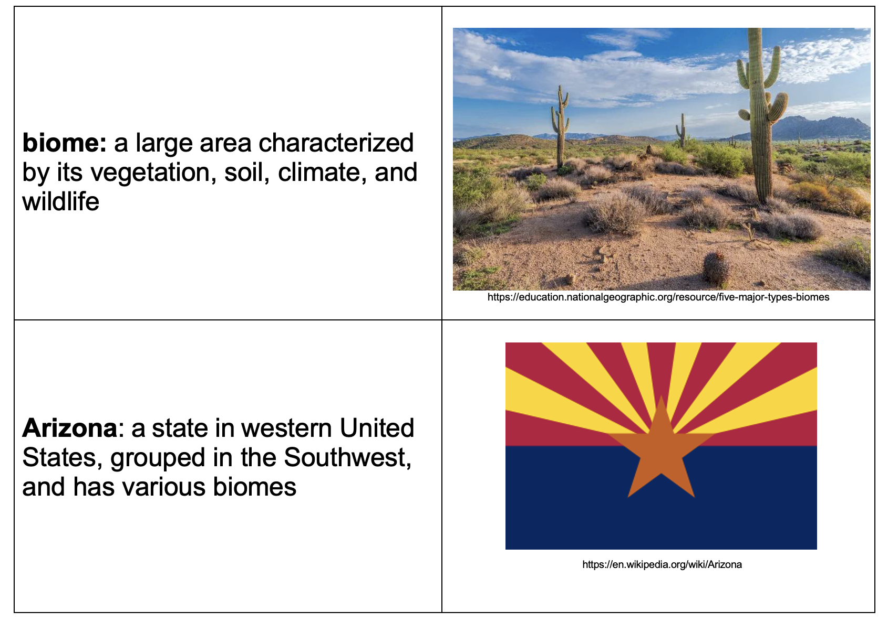

Slide 7
Armadillos: Natures Armoured Miracles (Wildlife Documentary) Wild America/Real Wild
https://youtu.be/ZbyVGLukSVQ

Slide 8
Armadillo Expansion reading https://armadillo-online.org/expansion.html

Slide 9
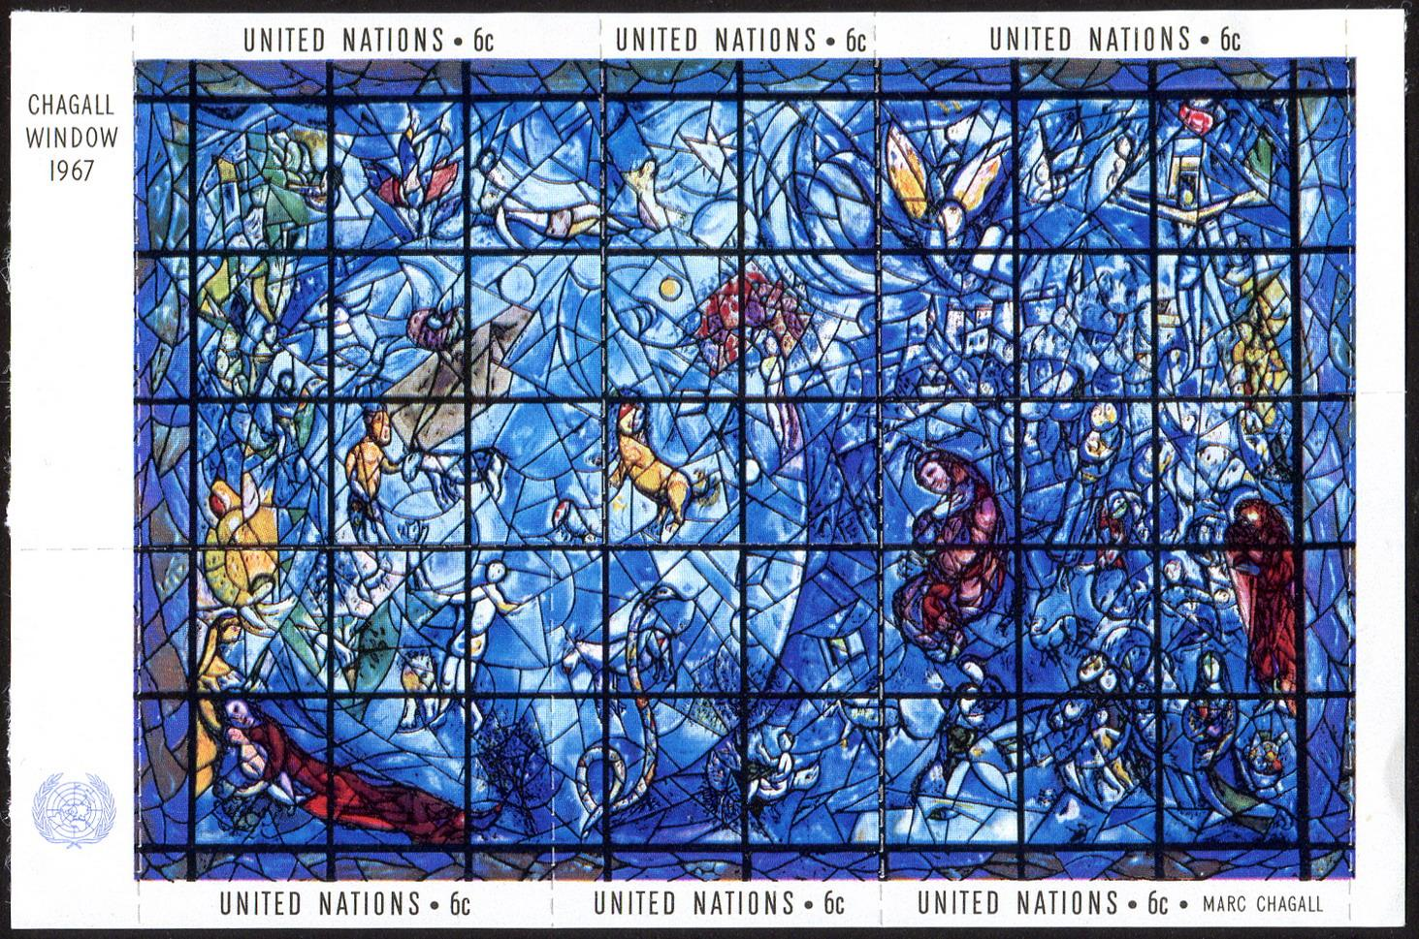
Stained Glass
National Cathedral Tour: War Memorial Chapel https://www.youtube.com/watch?v=61dcMC4CBac
Marc Chagall https://www.youtube.com/watch?v=SiqysC0nPF0
https://commons.wikimedia.org/wiki/File:UN-Chagall_window-1967.jpg

Slide 10
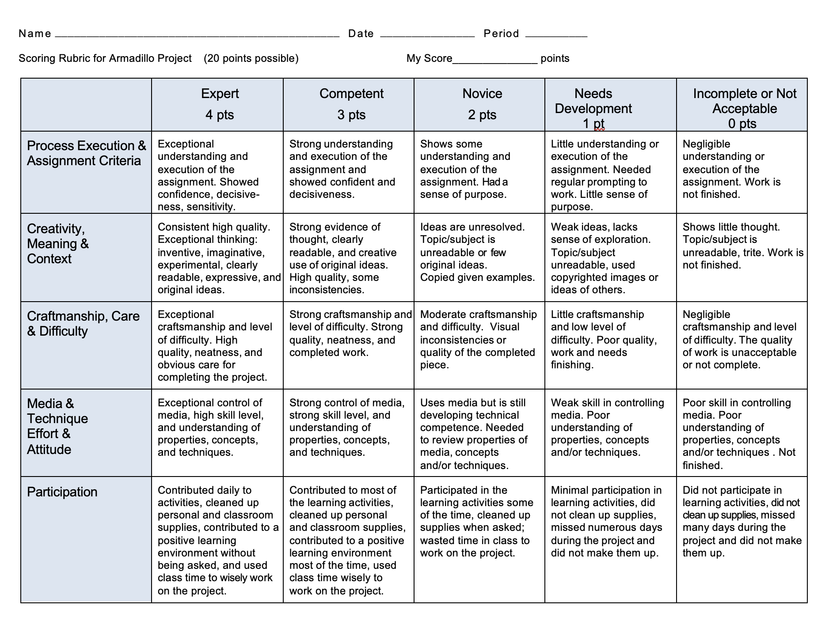

Slide 11
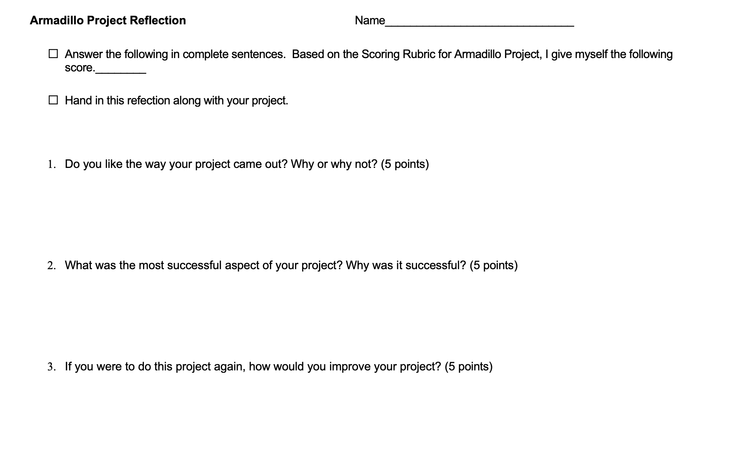

Slide 12
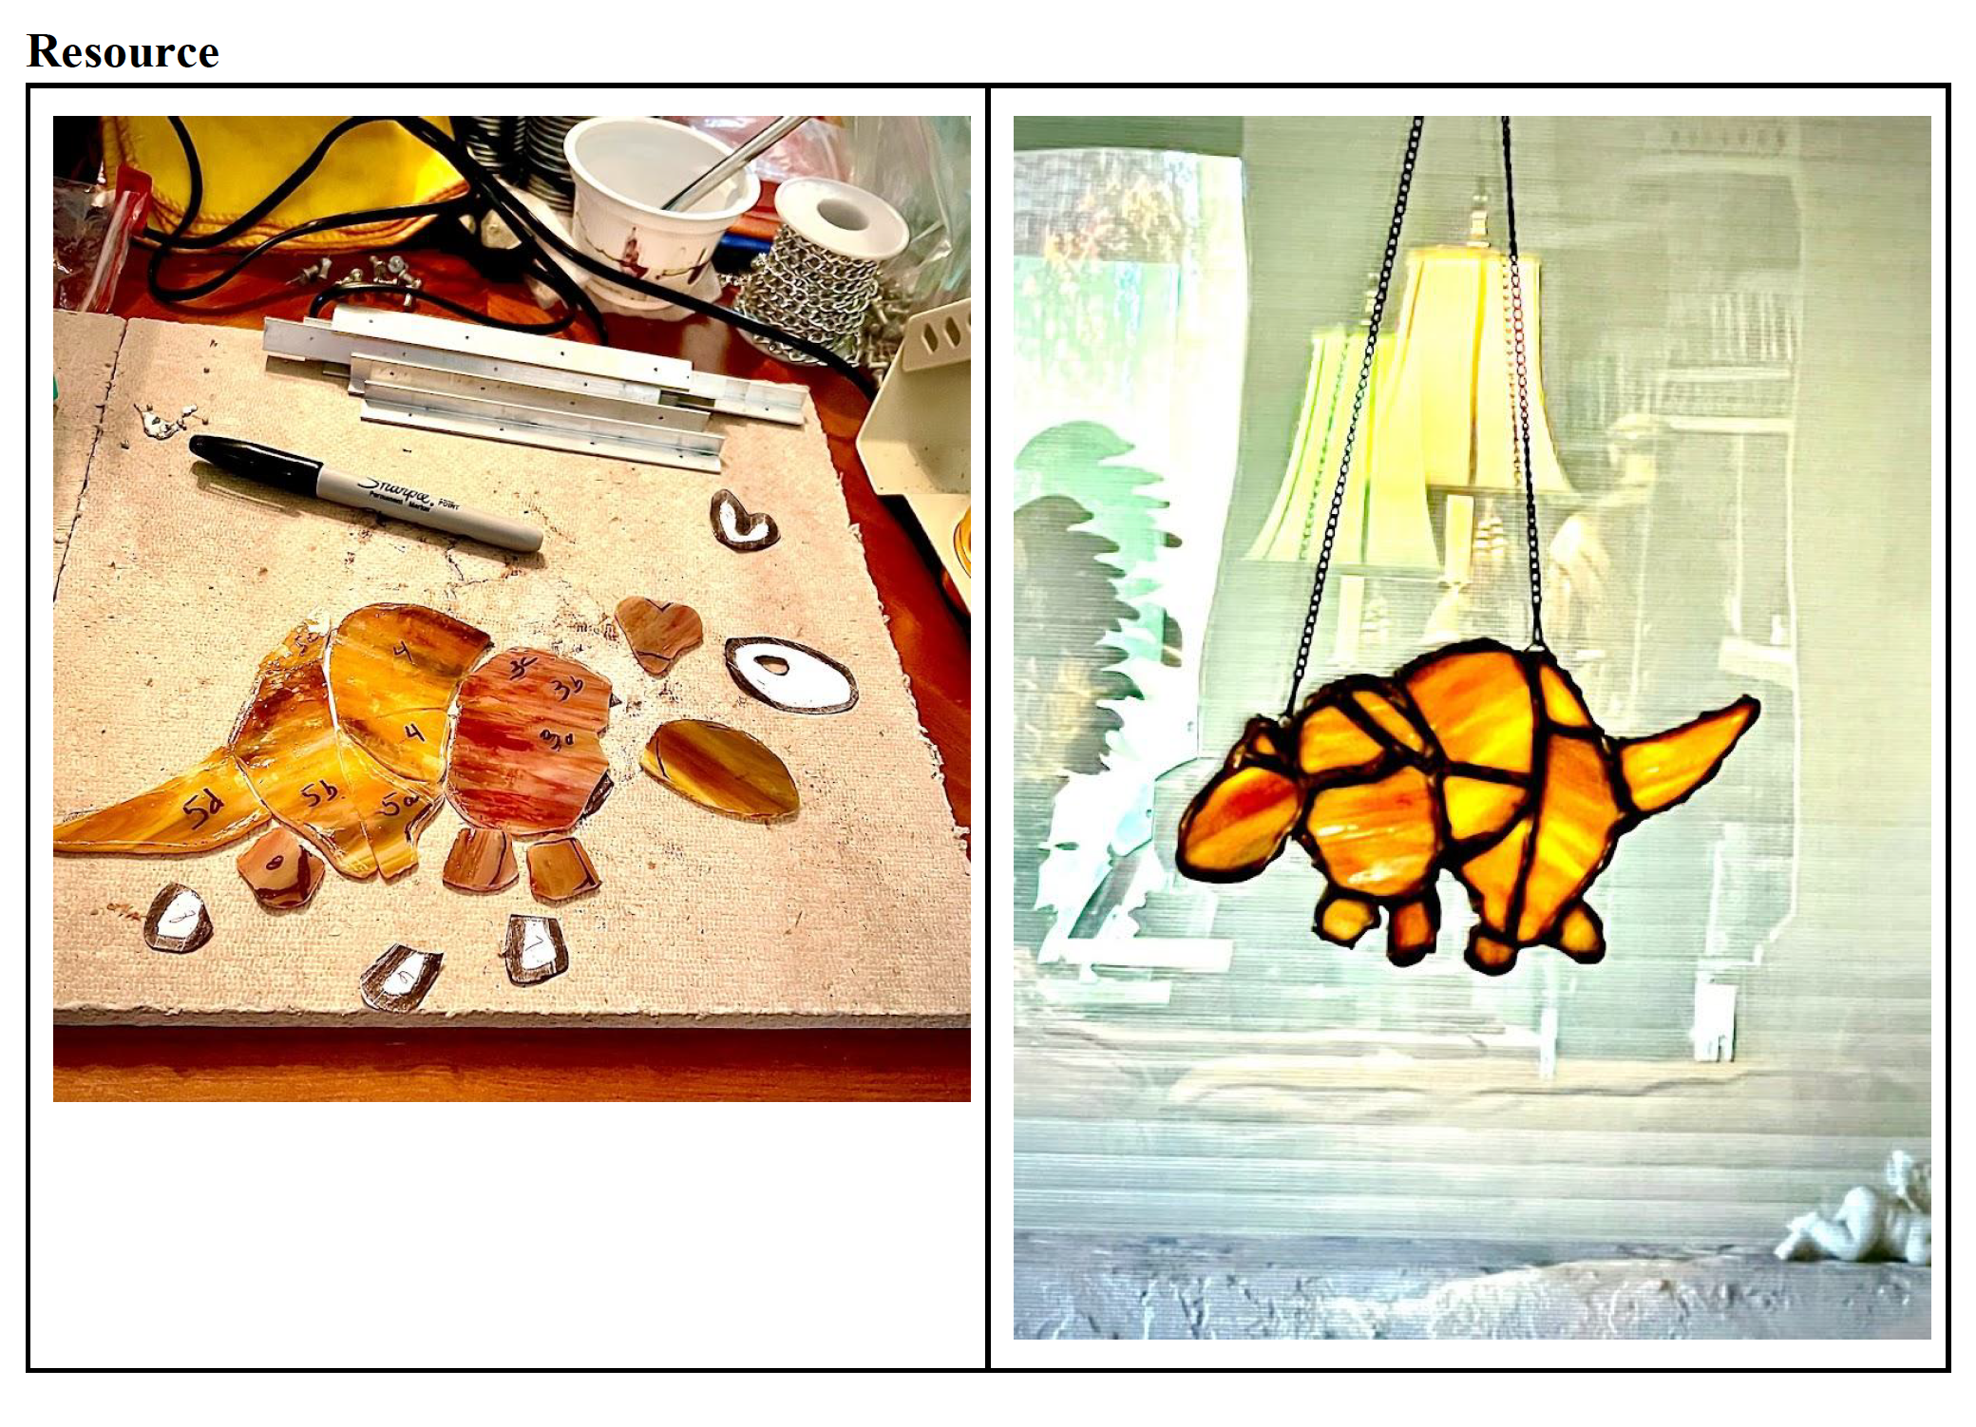
Sample of a Stained Glass Armadillo Sun Catcher

Slide 13
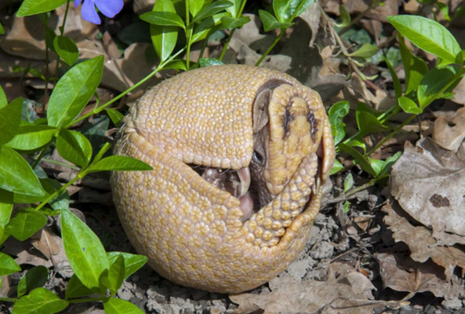
Biome
Climatologist and author: Dr. Randall Cerveny
https://education.nationalgeographic.org/resource/real-world-geography-dr-randall-cerveny

Slide 14
References
Armadillos: Natures Armoured Miracles (Wildlife Documentary) Wild America/Real Wild Received June 22, 2022, from
https://youtu.be/ZbyVGLukSVQ
Arizona Arts Standards Received June 17, 2022, from https://www.azed.gov/standards-practices
/k-12standards/arts-standards
Cambridge Received June 19, 2022, from https://dictionary.cambridge.org/us/dictionary/english/creature
Cambridge Received June 19, 2022, from https://dictionary.cambridge.org/us/dictionary/english
/inhabitant
Cambridge Received June 19, 2022, from https://dictionary.cambridge.org/us/dictionary/english/termite
Cambridge Received June 22, 2022, from https://dictionary.cambridge.org/us/dictionary/english
/stained-glass
ELA Standards Received June 17, 2022, from https://www.azed.gov/standards-practices
/k-12standards/ela-resources
How its made a stained glass monarch Received June 22, 2022, from https://www.youtube.com
/watch?v=F6Ked_ntsP8

Slide 15
(Image-1). National Geographic Received June 17, 2022, https://www.nationalgeographic.com/animals/
mammals/facts/armadillos
(Image-2). National Geographic Received June 17, 2022, from https://www.nationalgeographic.com
/animals/mammals/facts/armadillos
(Image-3). https://kids.nationalgeographic.com/animals/invertebrates/facts/termite
(Image-4). Received June 19, 2022, from https://upload.wikimedia.org/wikipedia/commons/thumb/
9/9d/Flag_of_Arizona.svg/320px-Flag_of_Arizona.svg.png
(Image-5). Received June 22, 2022, from https://upload.wikimedia.org/wikipedia/commons/thumb
/f/f5/Ictinia_mississippiensis_map.svg/248px-Ictinia_mississippiensis_map.svg.png
(Image-6). Received June 22, 2022, from https://upload.wikimedia.org/wikipedia/commons/thumb
/6/63/Matisse%2C_Vence.jpg/146px-Matisse%2C_Vence.jpg
National Geographic Standards Received June 17, 2022, from https://ncge.org/teacher-
resources/national-geography-standards/

