Slide 1
Marvelous Moroccan Mosaics: Patterns in Zillij
By:
Cheryl Wiens

Slide 2
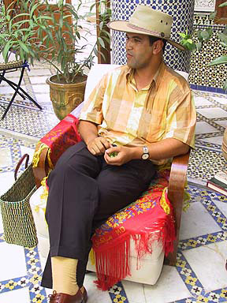
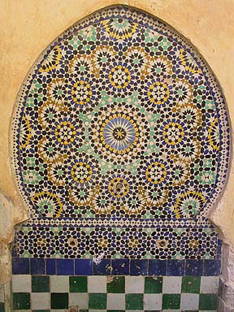
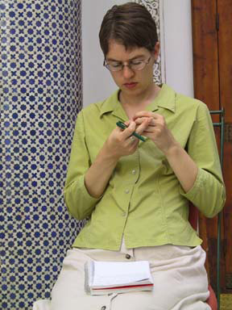
You can find zillij just about anywhere in Morocco. It decorates sidewalk planters, buildings, floors, houses of worship, restaurants, and homes.

Slide 3
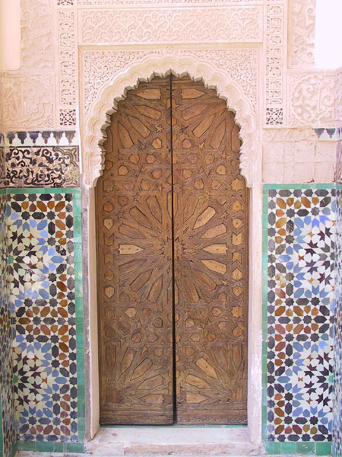
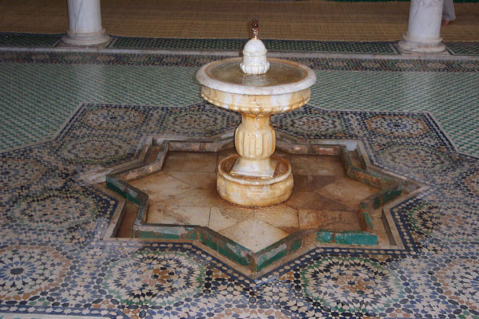
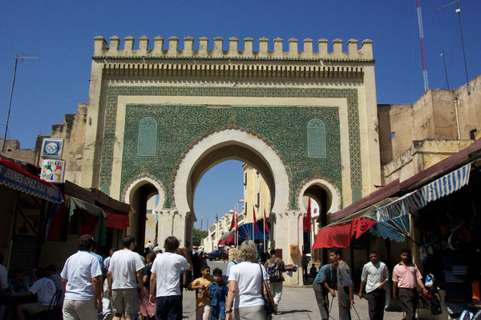
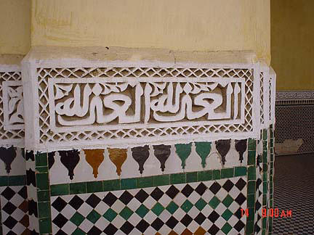

Slide 4
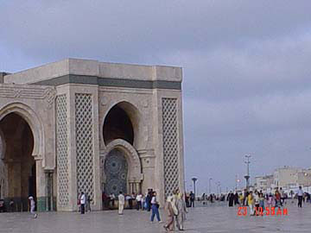
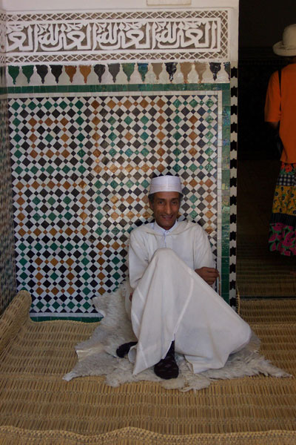
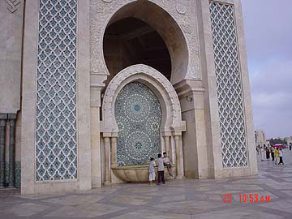
Because Morocco is an Islamic country and Islam discourages artists to paint people, animals, or other real-world objects; Islamic houses of worship (or mosques) are sometimes elaborately decorated with zillij.

Slide 5
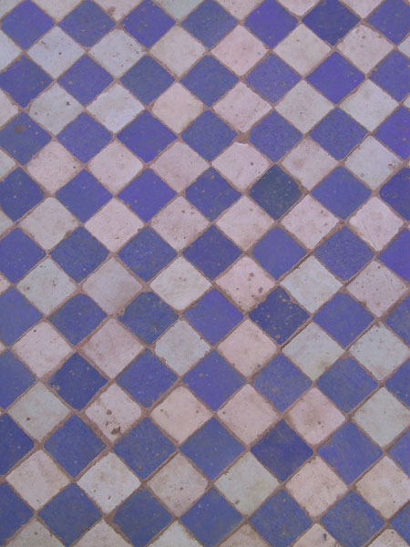
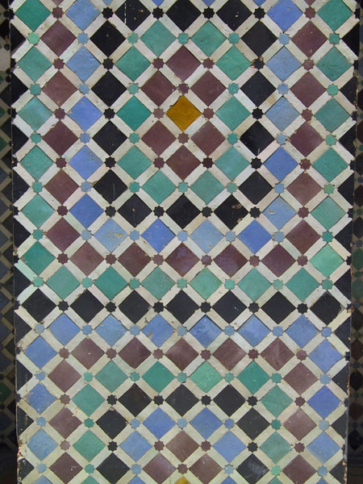
Some zillij designs are based on one or two basic figures.

Slide 6
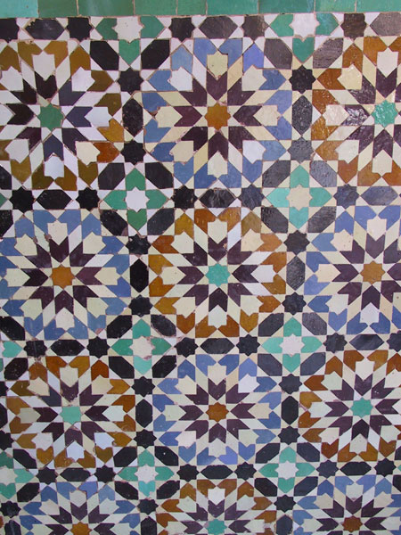
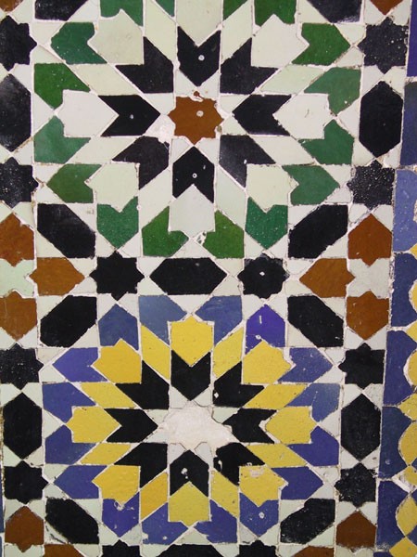
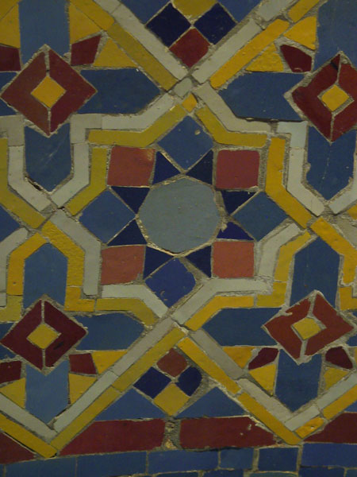
Many zillij designs are very elaborate repetitions of symmetric shapes.

Slide 7
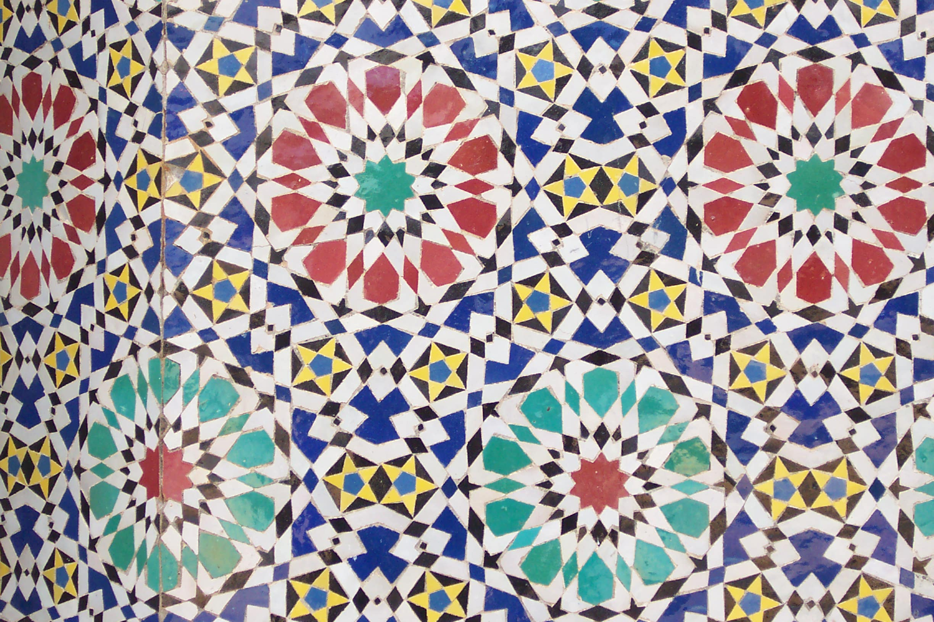
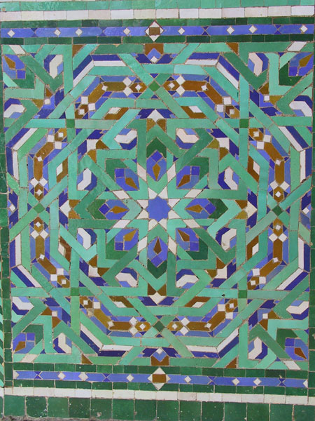
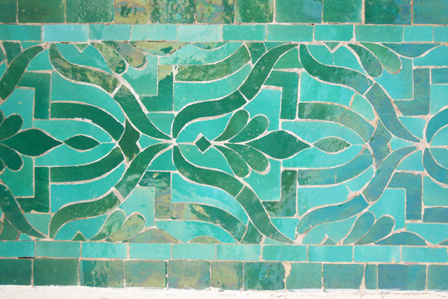
Look closely at the shapes used in these designs. Are the shapes symmetric? Are there any that are asymmetrical?

Slide 8
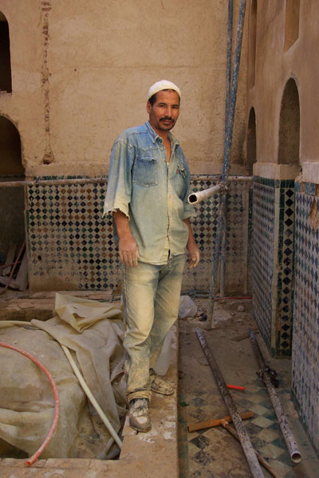
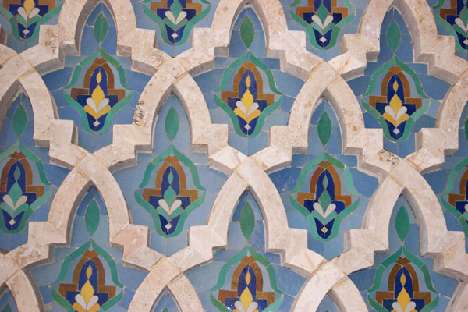
Artisans continually work at restoring the tiling on Morocco’s ancient mosques and religious schools. The craft of making these tile designs is in demand worldwide, and people go to Fez, one of Morocco’s largest cities, to learn the craft.

Slide 9
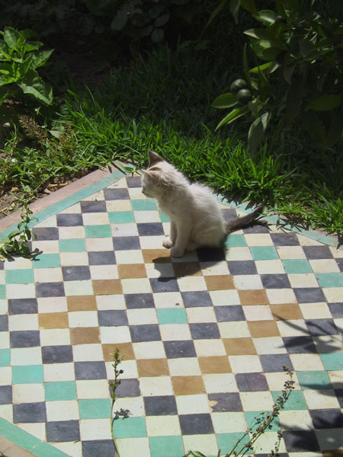
A cat purrs in the sunshine on a zillij design.

