Slide 1
Utilizing Resources at What Cost! Session Two
By Donna Taylor
Unit on Resources Session 2

Slide 2
How do resources relate to your dinner?
Agricultural Facts
77% of the world’s food comes from cropland. Covers 12% of the Earth’s land.
16% of the world’s food comes from grazing lands. Covers 26% of Earth’s land.
7 % of the world’s food comes from the ocean. Covers 71% of Earth’s surface.
Only 2% of the United States’ labor force is directly employed in agriculture.
An average U.S. farm is about 434 acres today compared to a 20th century U.S. farm being about 100 acres.
Earth gains 80 million people each year but loses 12 million acres of productive cropland each year.

Slide 3
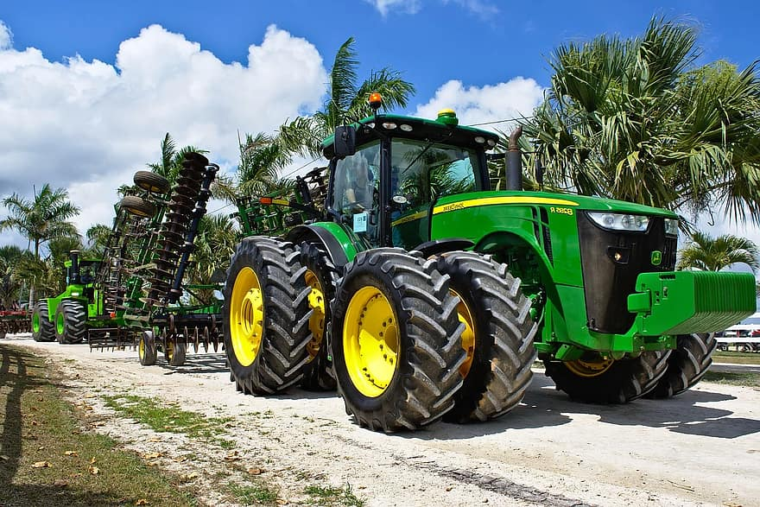
Why do we have fewer farms?
Bigger and better farming machines are more efficient and can work more land.
These machines use more fossil fuels which raises the price of food.

Slide 4
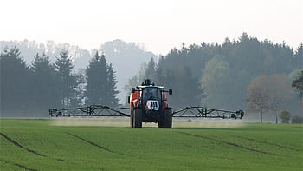
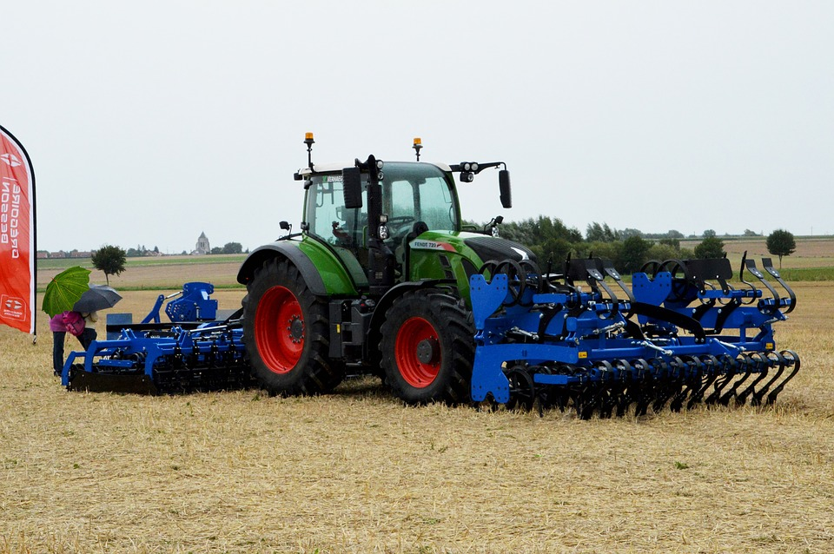
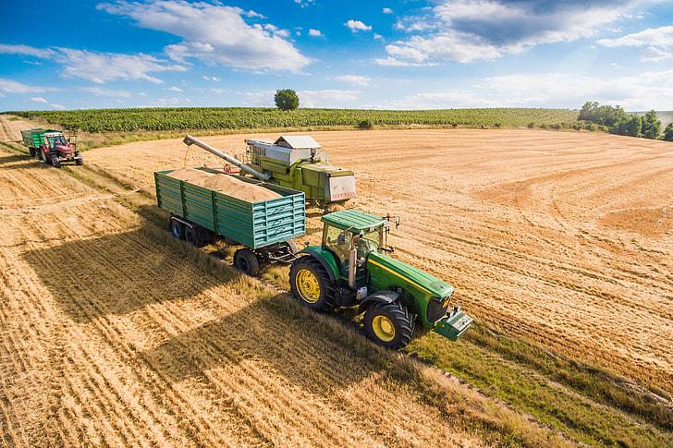
Big farming machinery

Slide 5
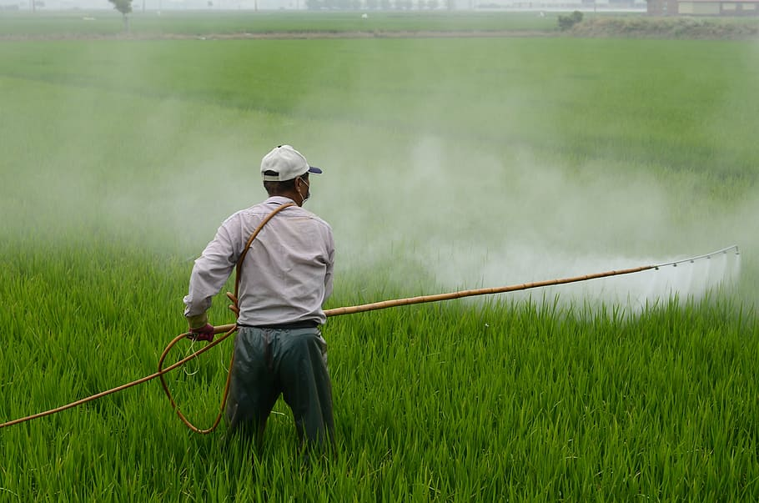
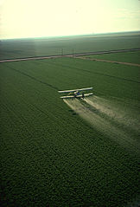
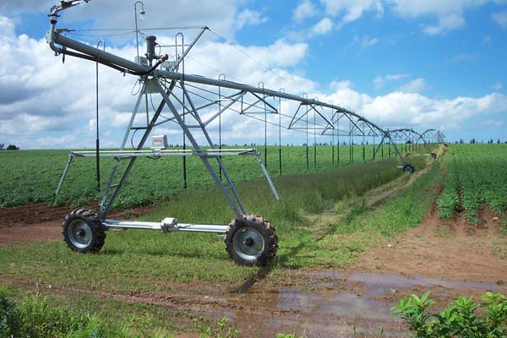
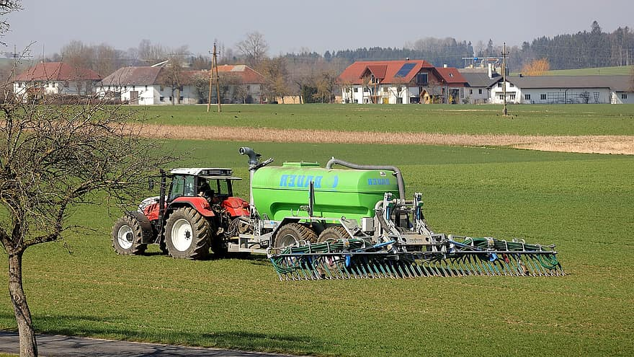
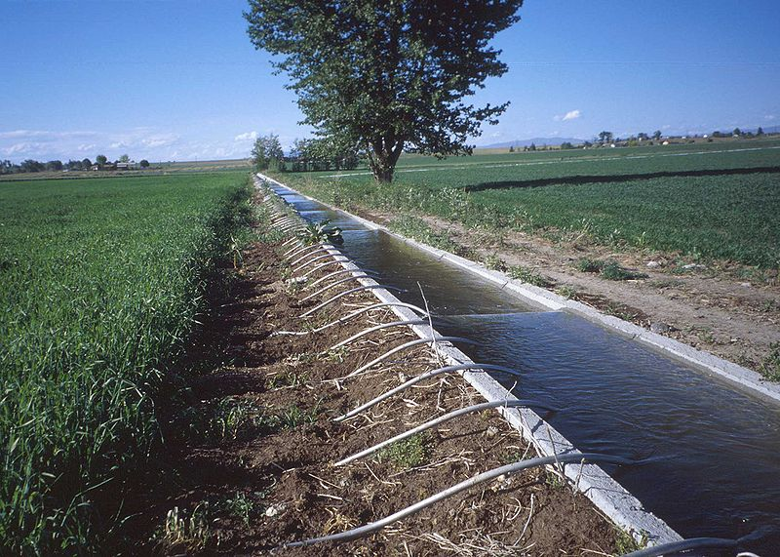
At what cost do we get food?
As the human population increases, the more food we need to produce. This results in increased use of :
Pesticides
Fertilizer.
Water/Irrigation.
1
1
3
2
3

Slide 6
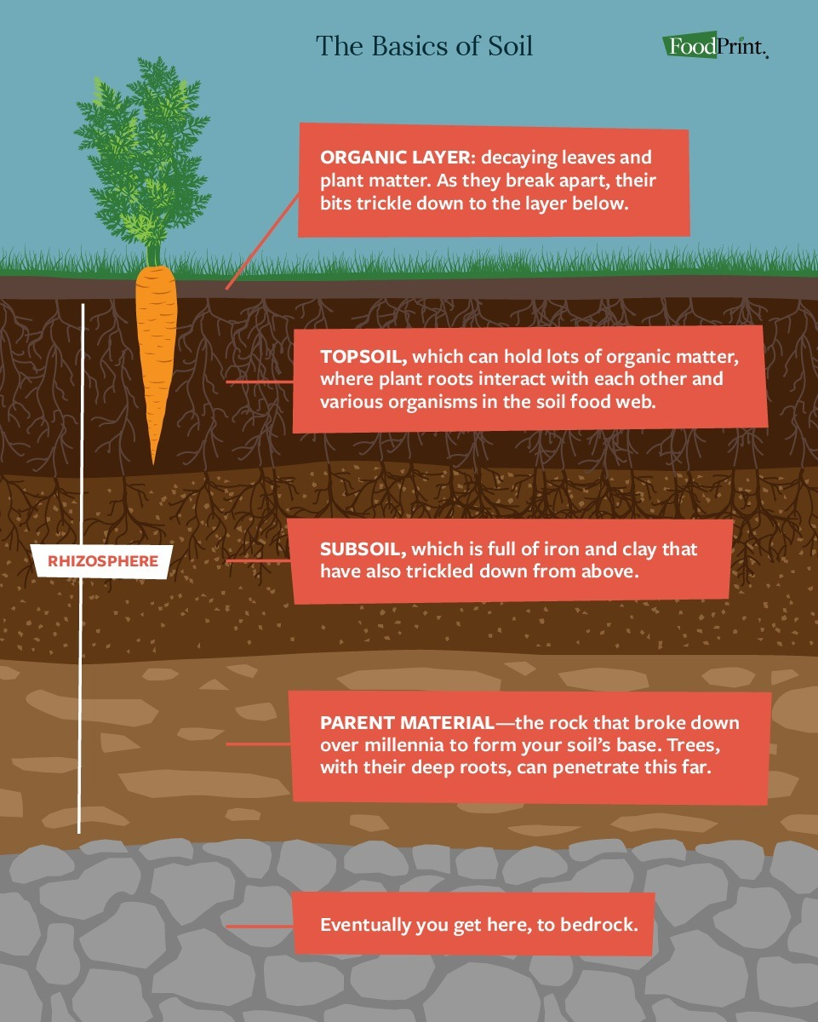
Why is soil important to agriculture?
Soil is a complex system. It is a renewable resource, however if soil is degraded or depleted, this renewal process occurs very slowly.
1 out of 3 acres produces food or fiber.
Issues of soil degradation
https://www.google.com/search?q=soil&client=firefox-b-1-d&source=lnms&tbm=isch&sa=X&ved=2ahUKEwi9oYeFipPxAhXSOn0KHa_MAt0Q_AUoAnoECAEQBA&biw=1303&bih=792#imgrc=v244munLjXfiSM

Slide 7
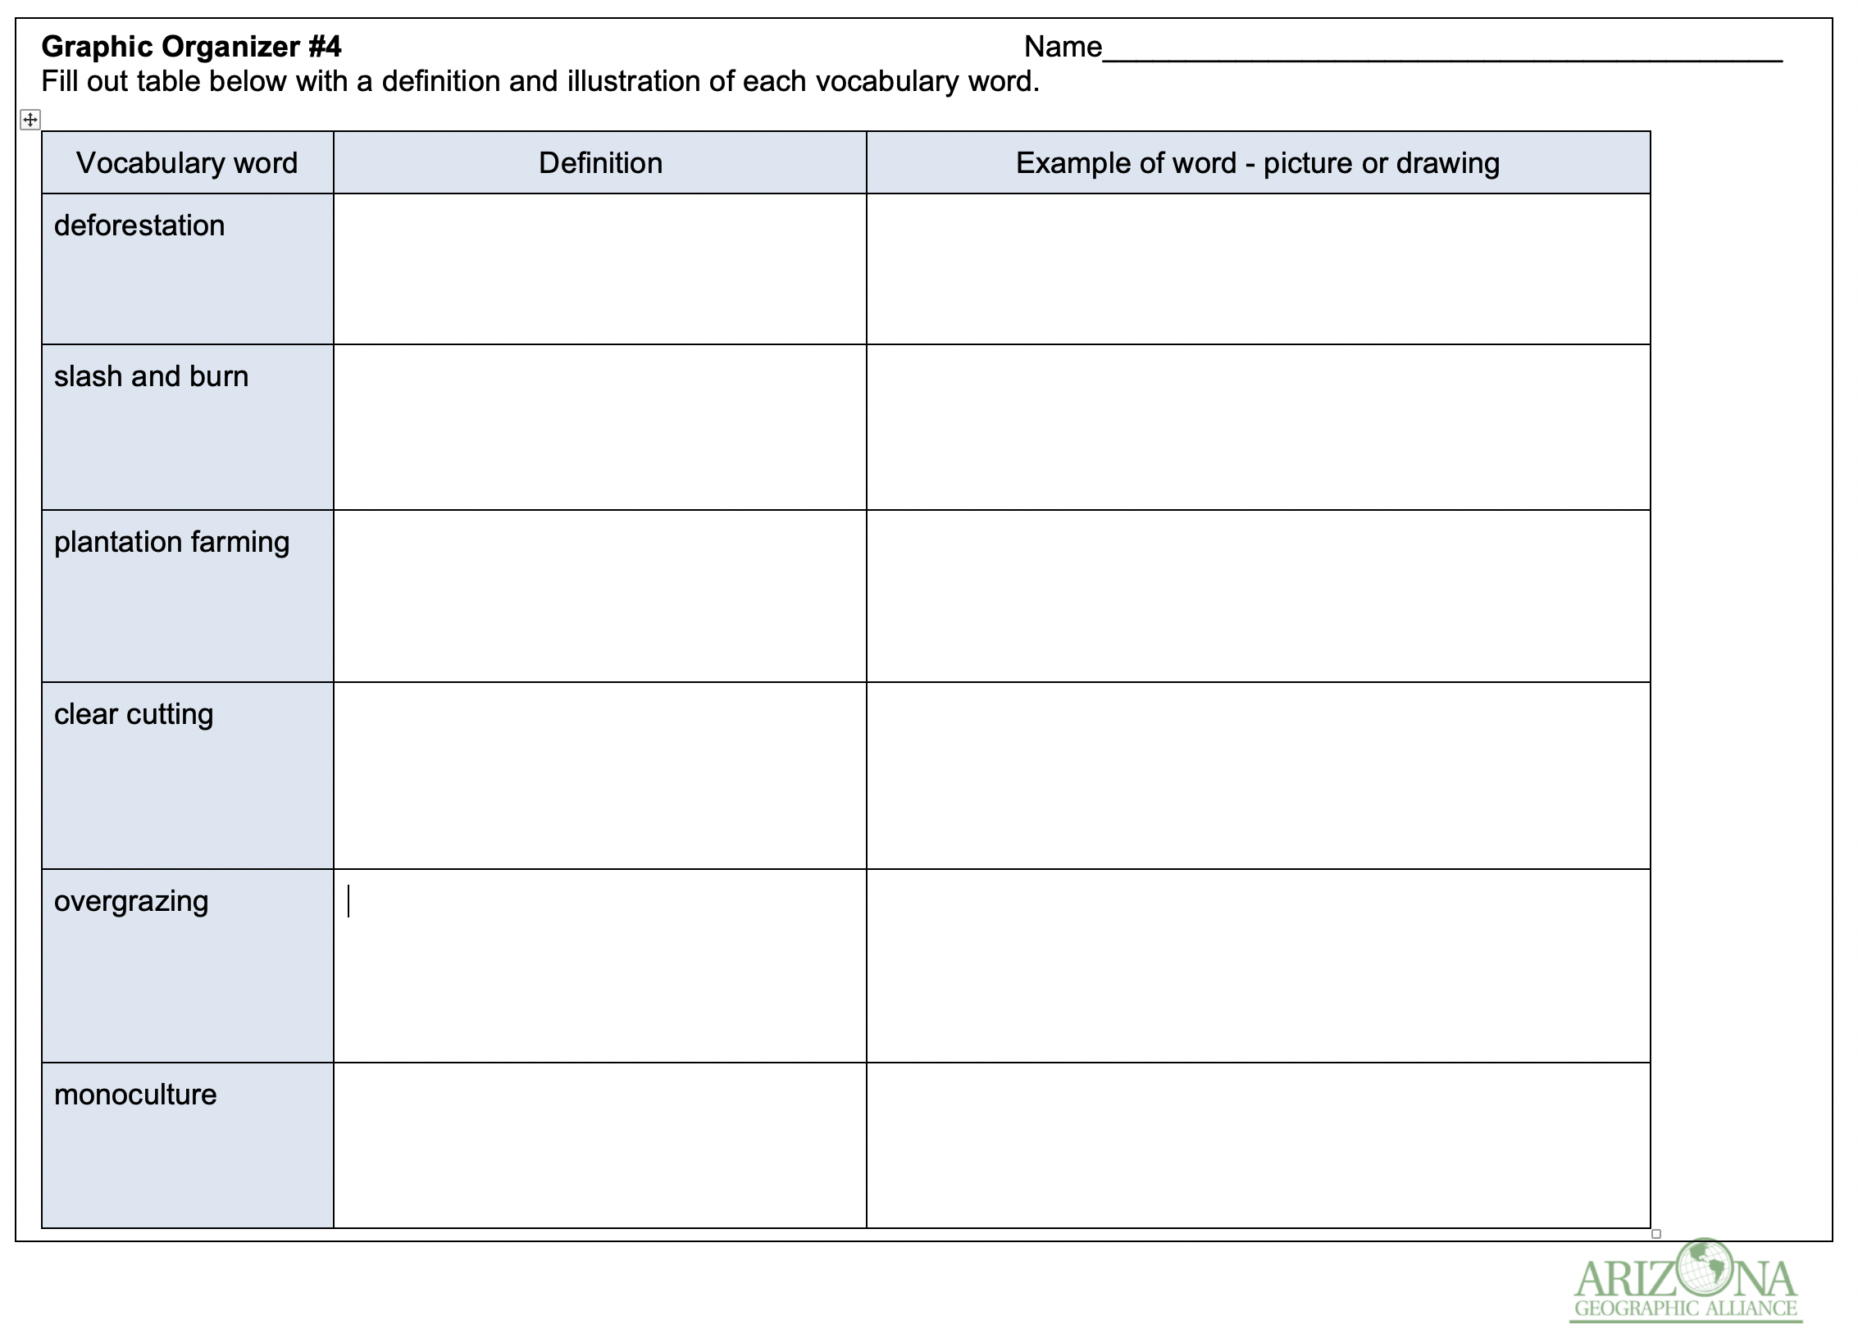
New Vocabulary
The following slides will help you define and illustrate the following words:
deforestation
slash and burn
clear cutting
overgrazing
plantation farming
monoculture

Slide 8
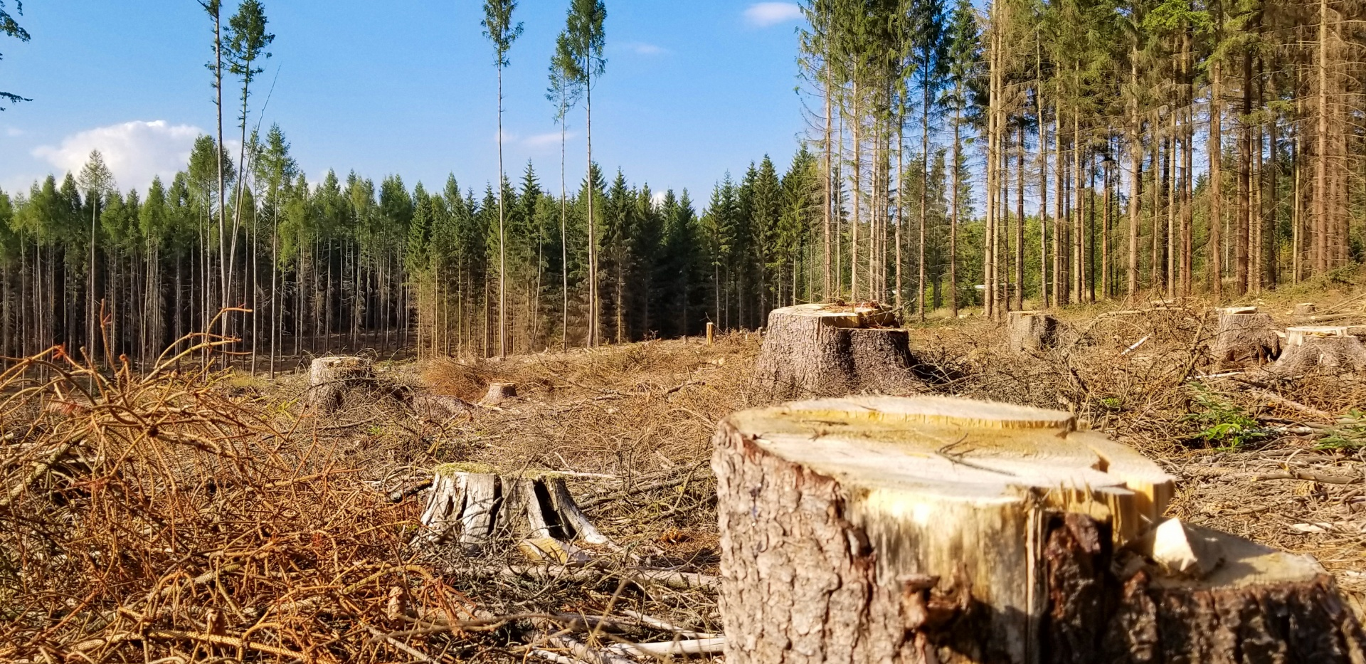
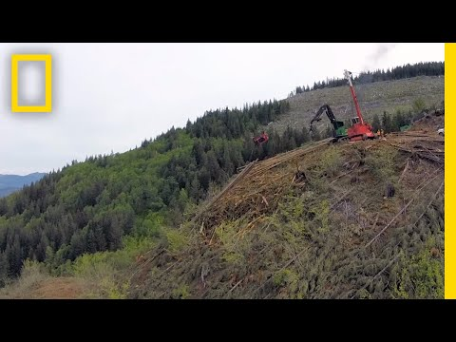
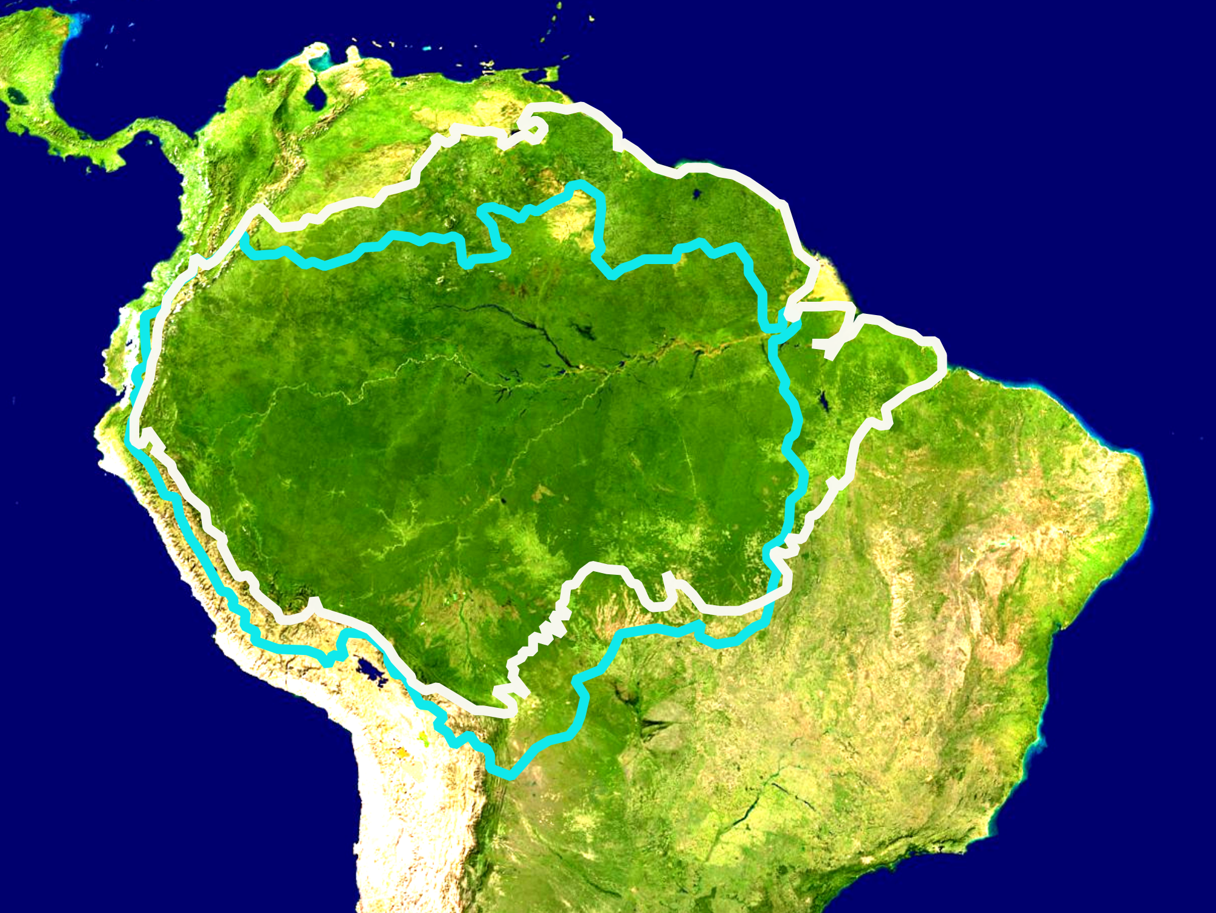
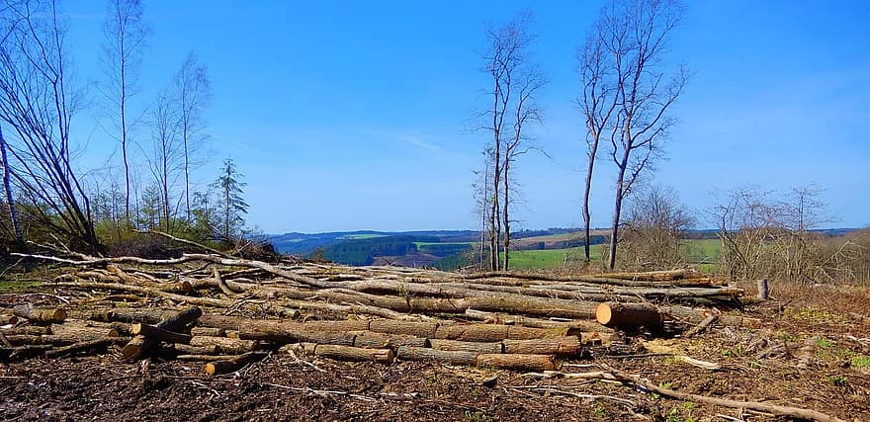
Deforestation
process of cutting down trees to use the land for non- forest purposes

Slide 9
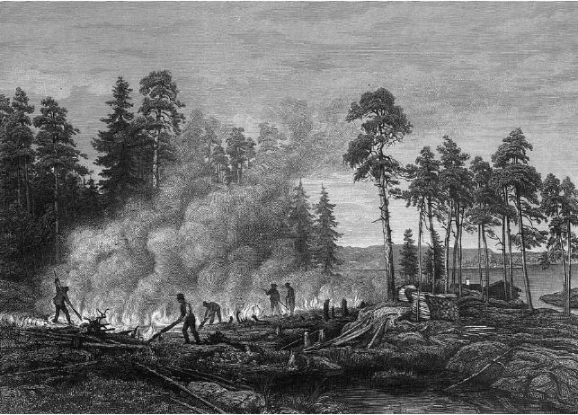
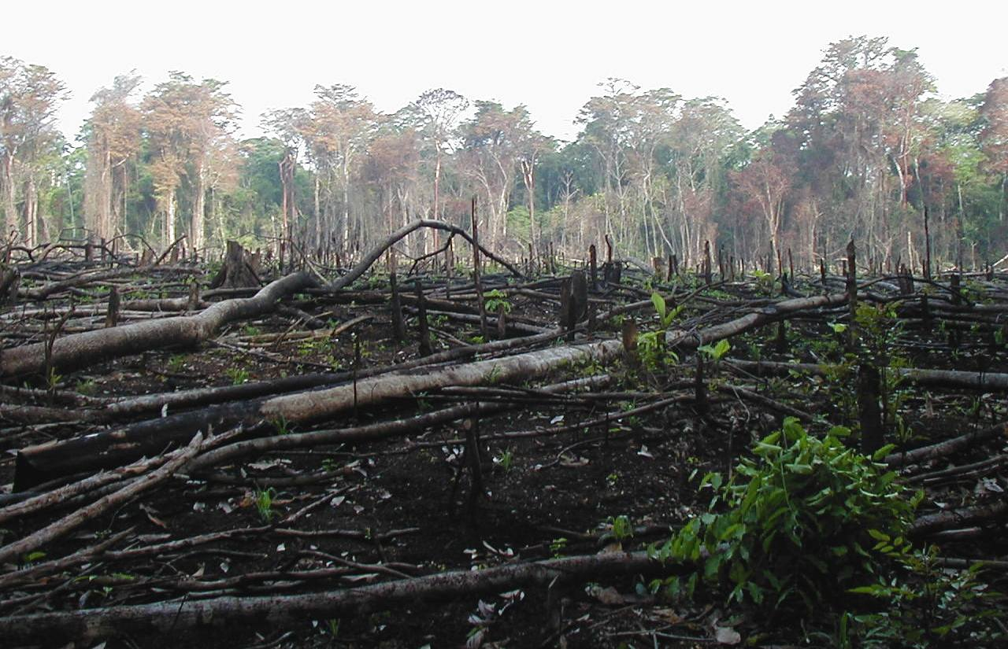
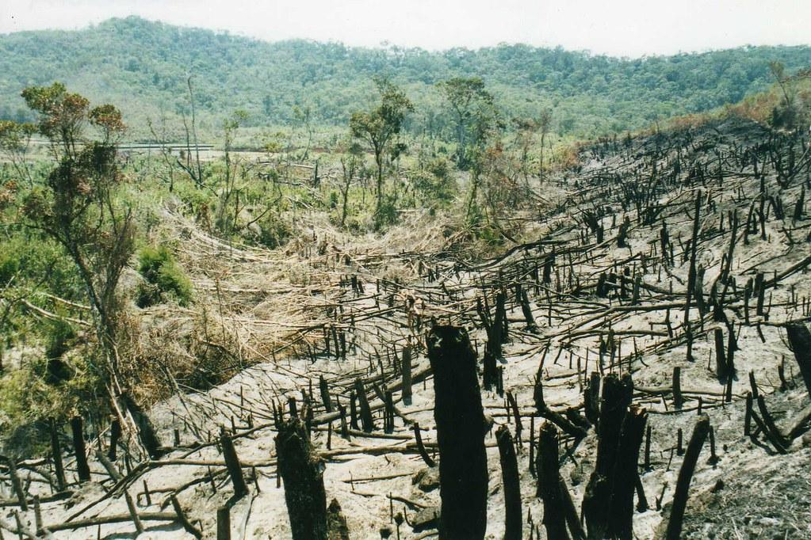
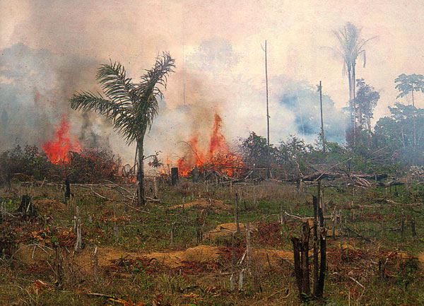
Slash and Burn
an area of vegetation that is cut down and burned before being planted with crops
This method has rapidly decreased the amount of tropical rainforest.

Slide 10
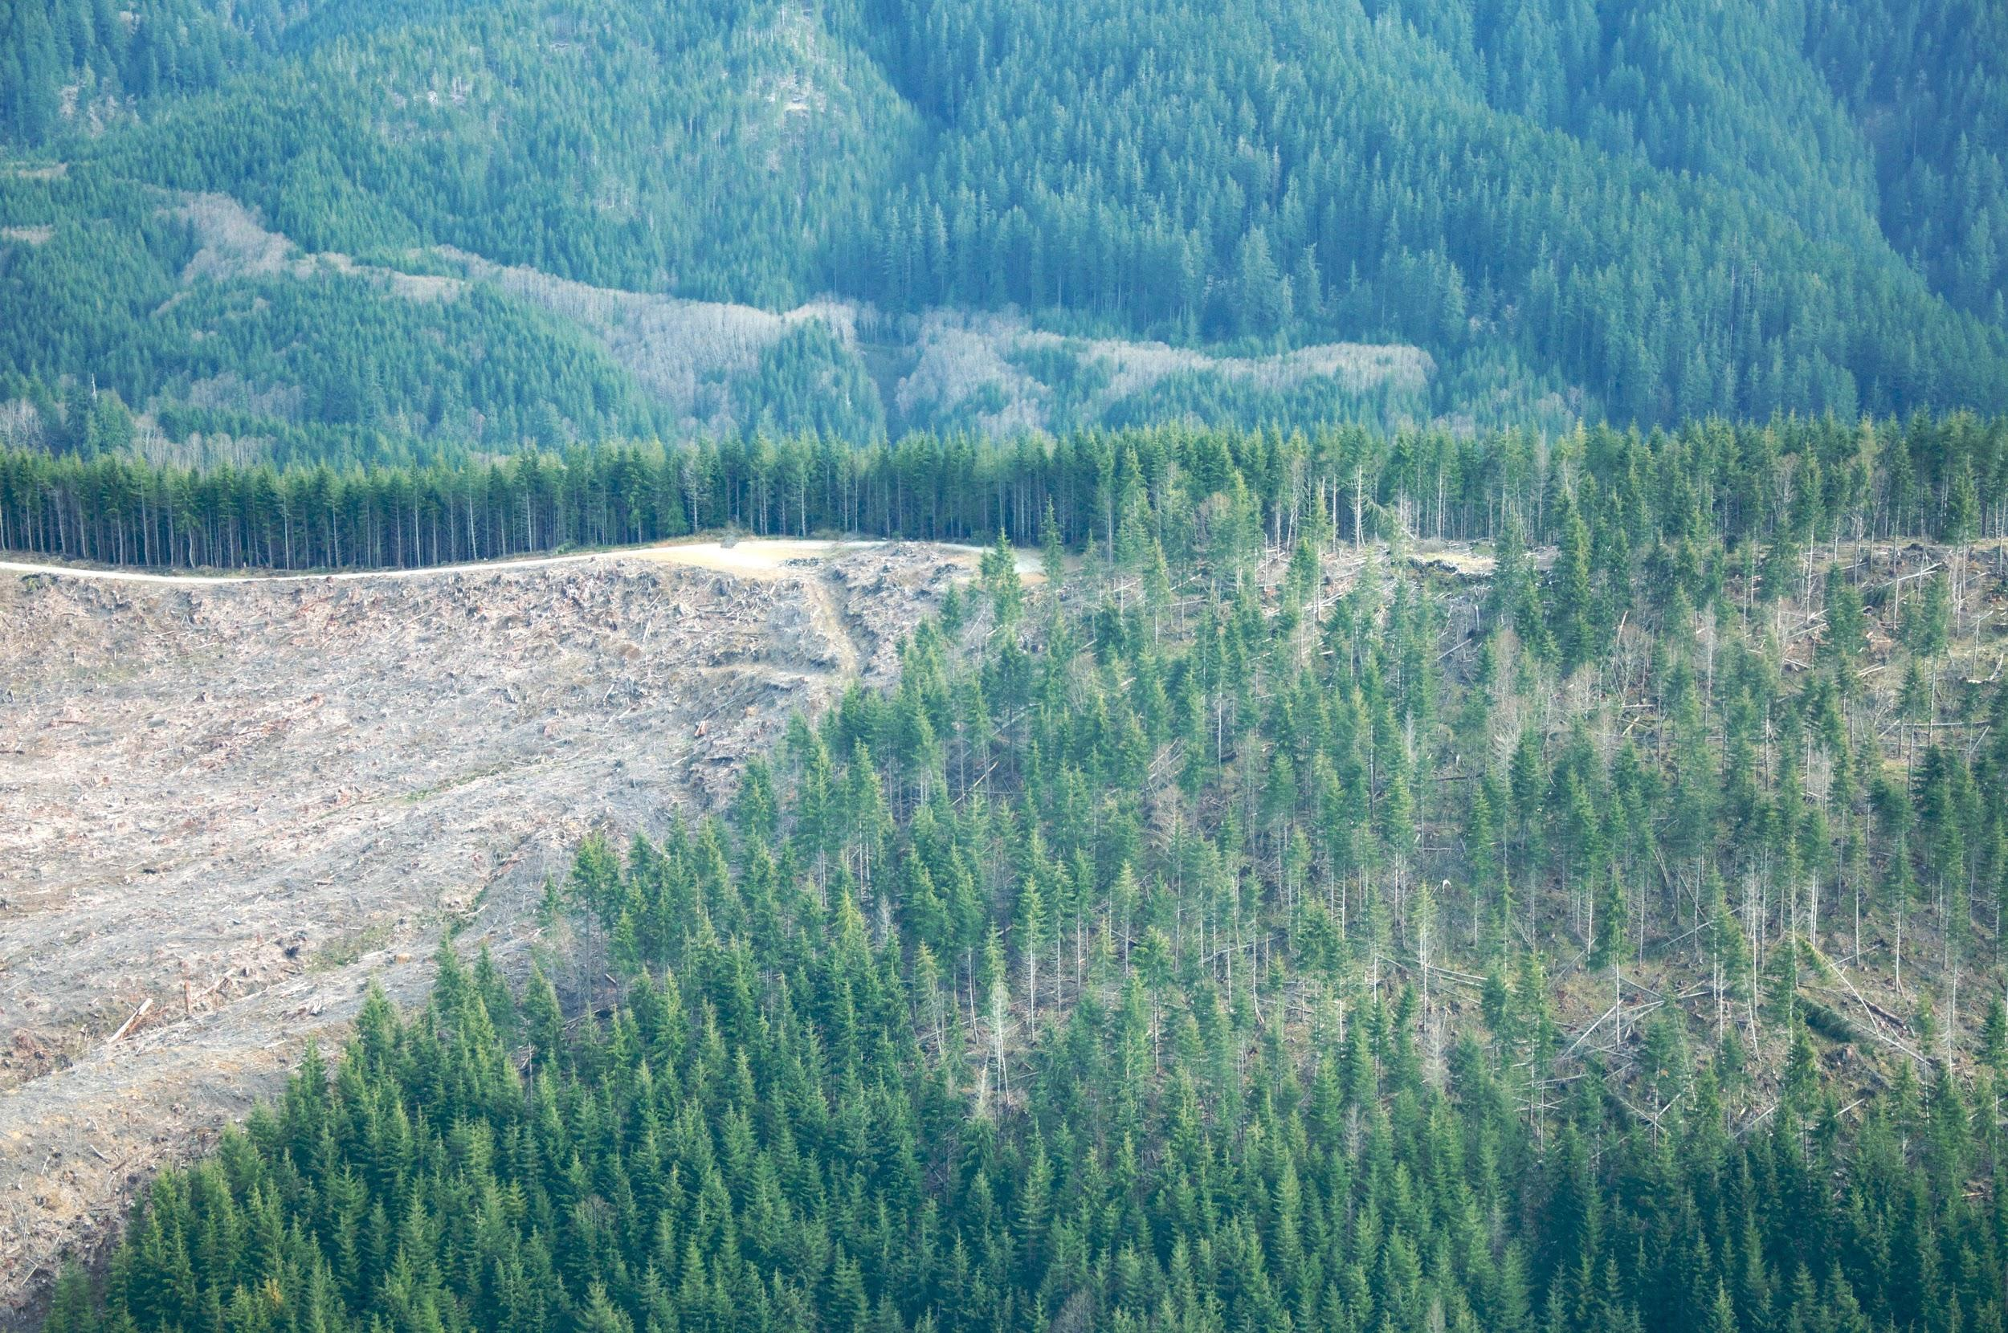
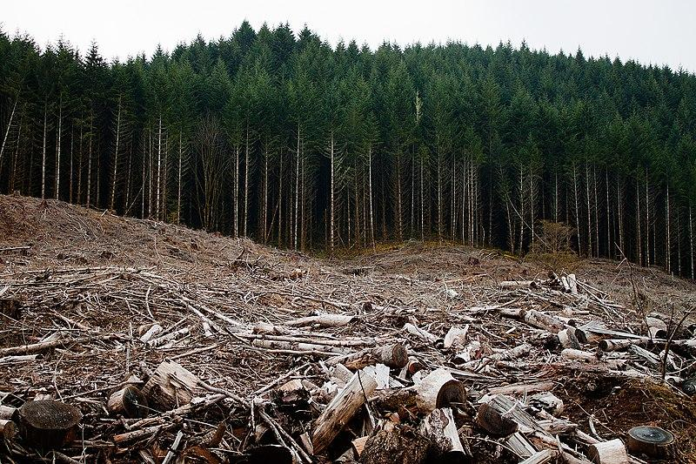
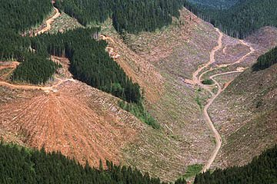
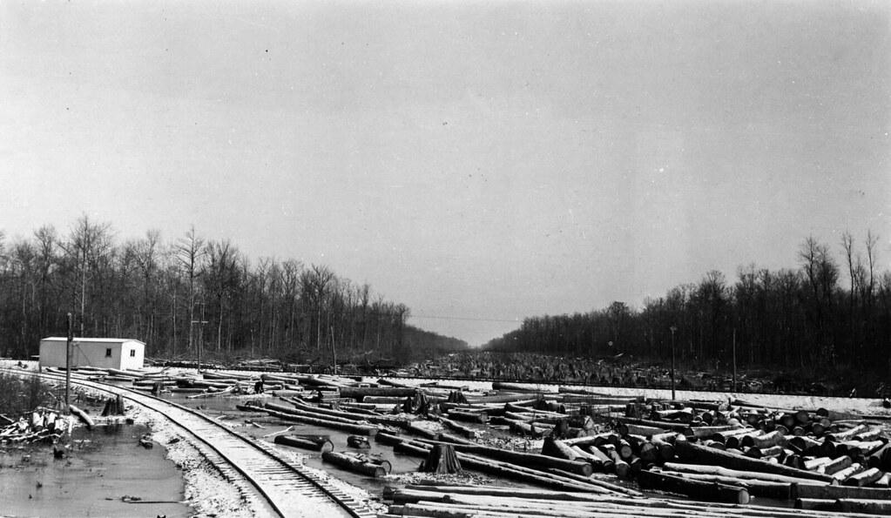
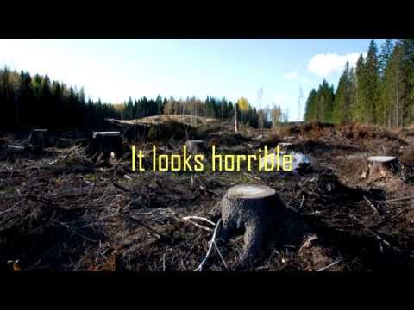
Clear Cutting
process of cutting down all the trees in an area
Clear cutting logging is a uniform practice.

Slide 11
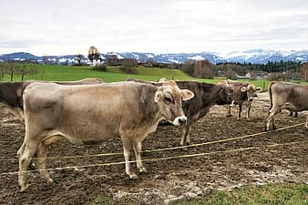
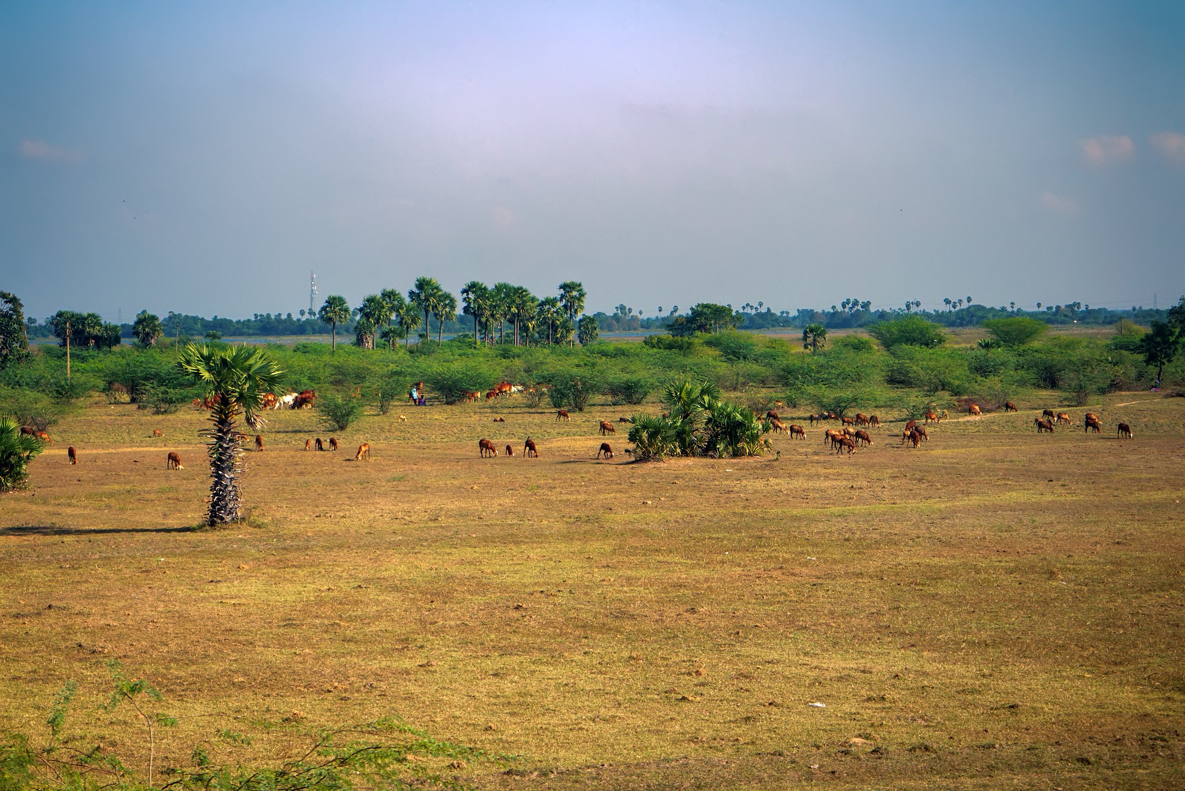
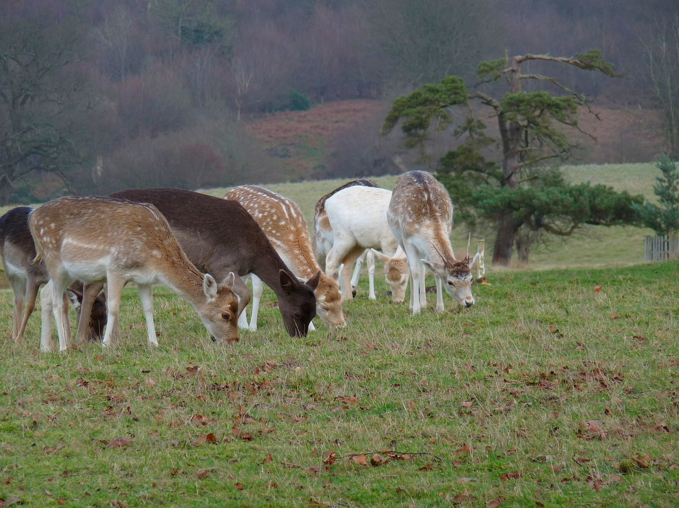
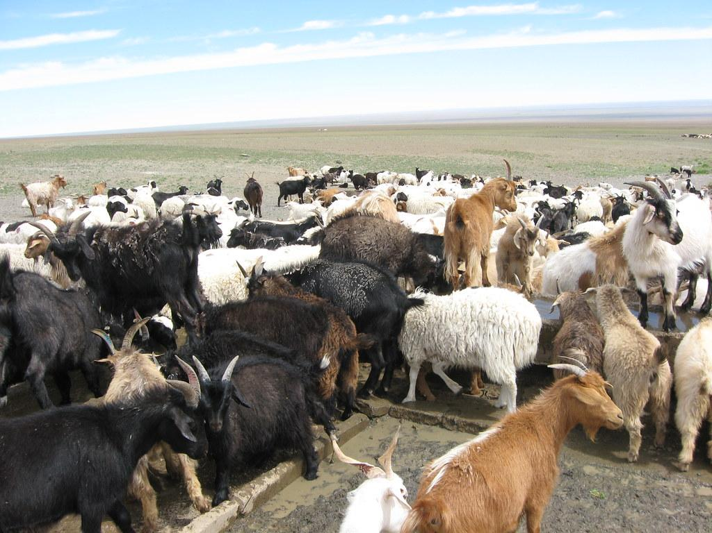
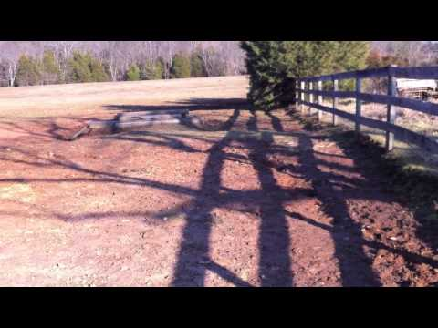
Overgrazing
damaging of plants or land through the overuse (feeding and trampling) of livestock and the land cannot recover to full health

Slide 12
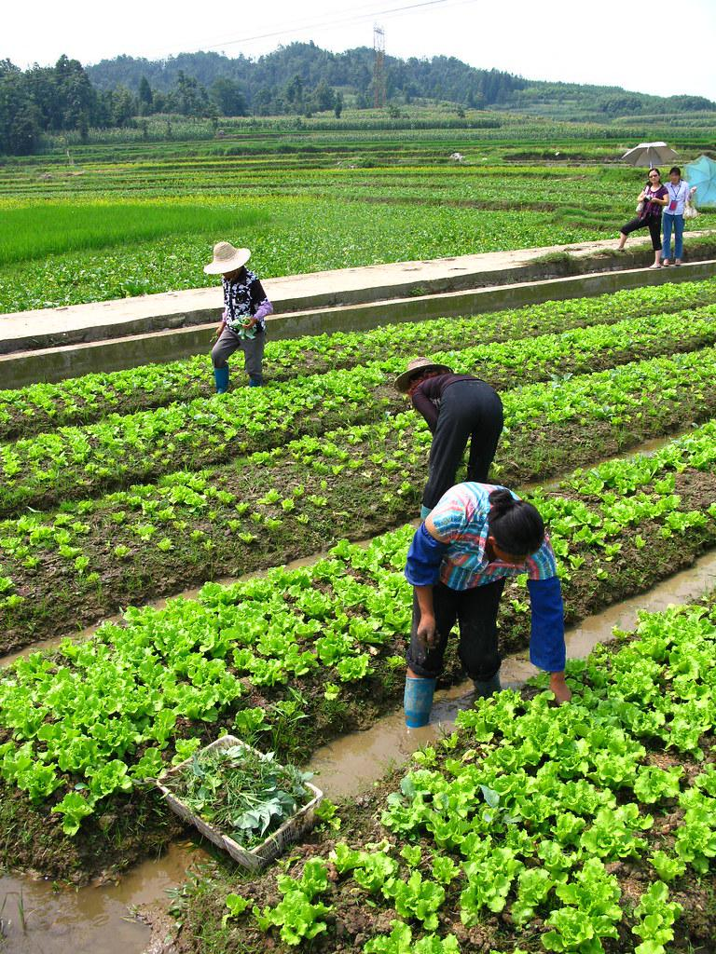
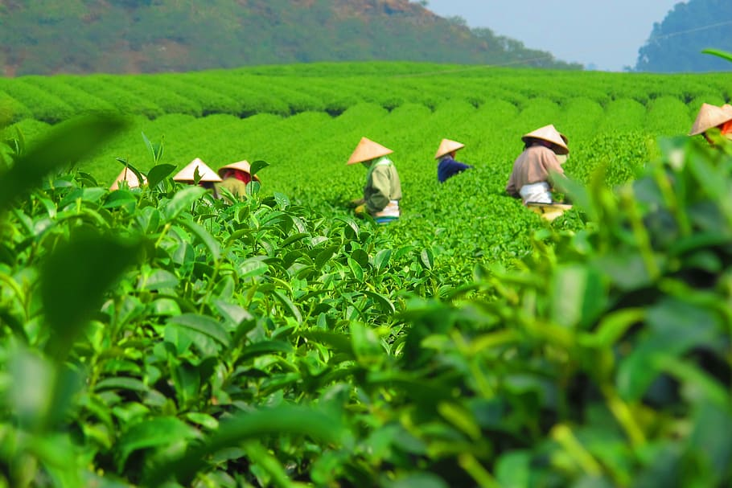
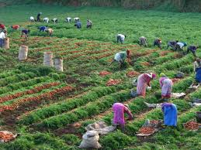
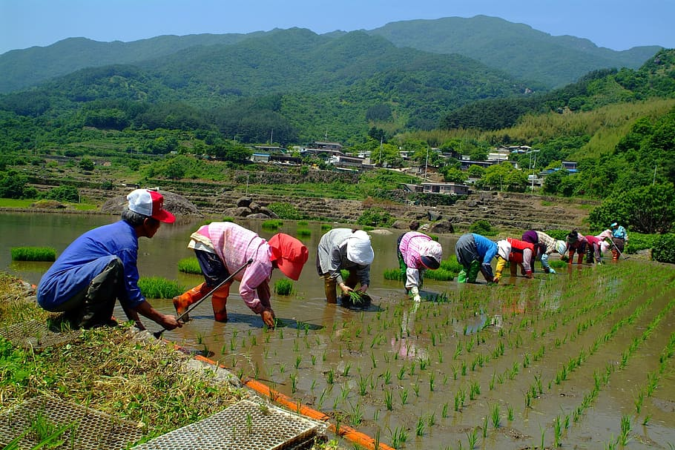
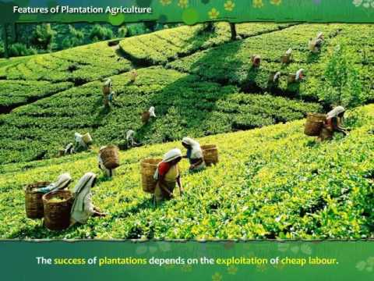
Plantation Farming
a type of industrialized agriculture in which a monoculture cash crop such as bananas, coffee, or vegetables is grown and is exported to developed nations

Slide 13
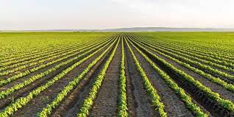
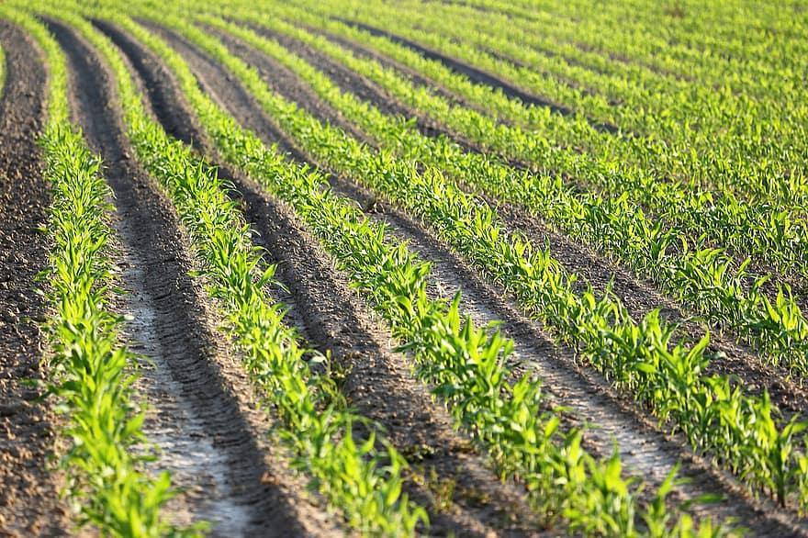
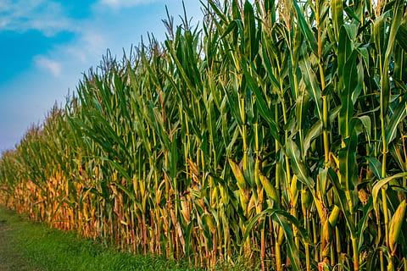
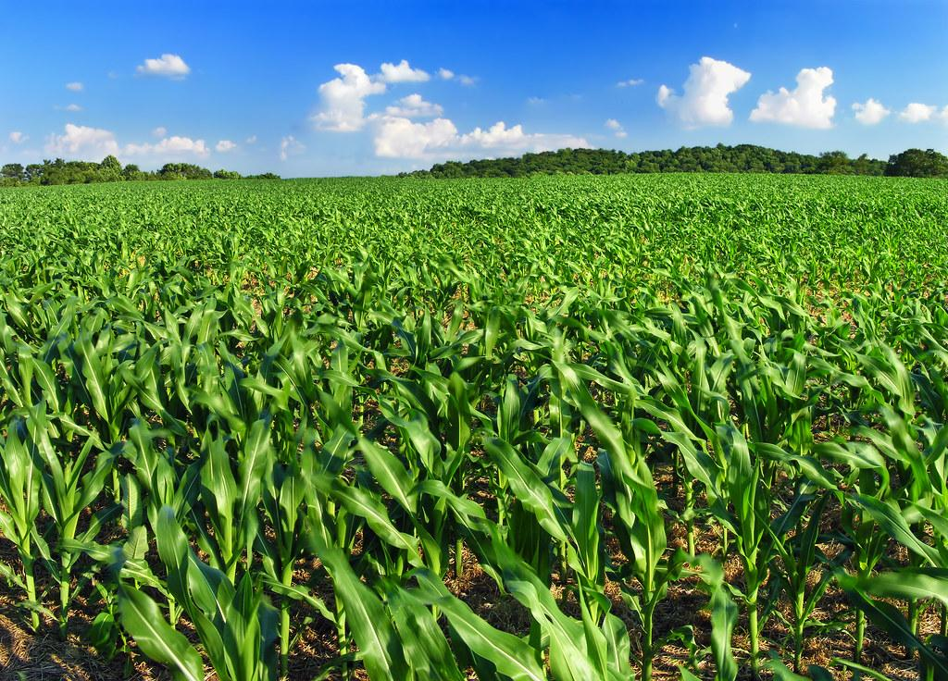
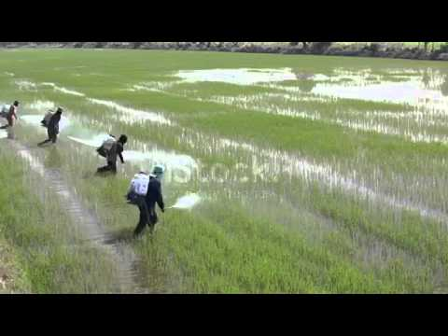
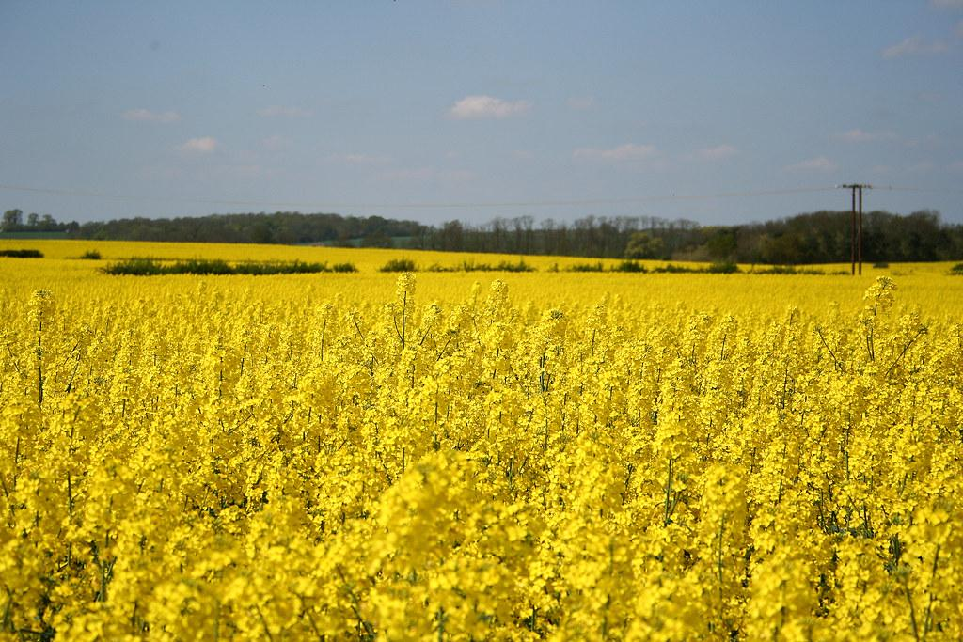
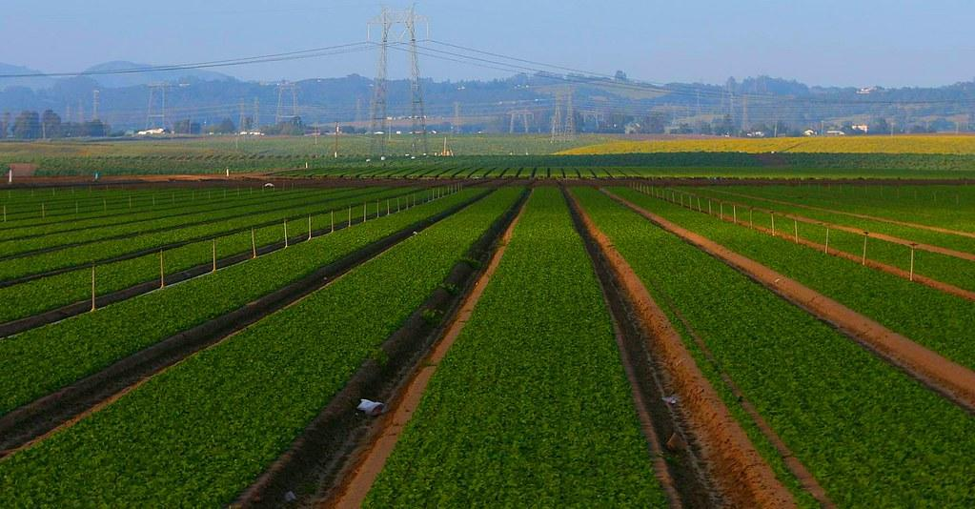
Monoculture
practice of growing a single crop, plant, or kind of livestock species

Slide 14
What causes soil degradation?
Some major developments in the history of agriculture
Overgrazing 34%
Deforestation 30%
Cropland agriculture 28%
Overexploitation 7 %
Industrialization 1%
10,000 years ago, Earth’s climate warmed and plants grew from seeds.
Family farming produced enough food to feed the family .
Industrial Revolution in 19th century brought farm mechanization.
1940s synthetic fertilizers and pesticides brought monoculture

Slide 15
Vocabulary Practice:
Let’s see what you know!
What causes 30% of the Earth’s soil degradation?

Slide 16
deforestation

Slide 17
What vocabulary word describes an area of vegetation that is cut down and burned before being planted with a crop?

Slide 18
slash and burn

Slide 19
What vocabulary word means growing one type of crop?

Slide 20
monoculture

Slide 21
What vocabulary word means the process of cutting down all the trees in an area?

Slide 22
clear cutting

Slide 23
What vocabulary word means damaging of plants or land through the overuse (feeding and trampling) of livestock and the land cannot recover to full health

Slide 24
overgrazing

Slide 25
What vocabulary word means a type of industrialized agriculture in which a monoculture cash crop such as bananas, coffee, or vegetables is grown and exported to developed nations?

Slide 26
plantation farming

Slide 27
Bonus Question
At what costs do we get food?

Slide 28
Increased pesticides (harmful to humans and livestock)
Increased fertilizers (can pollute the ground water)
Increased irrigation (takes away available water for human consumption and can increase pollutants in the water system

Slide 29
What did you learn in this lesson?
Are you ready for the assessment?

