Slide 1
Orphan Trains: Journeys of Salvation and Sorrow
Dennis Rees
Teacher-Consultant
Arizona Geographic Alliance

Slide 2
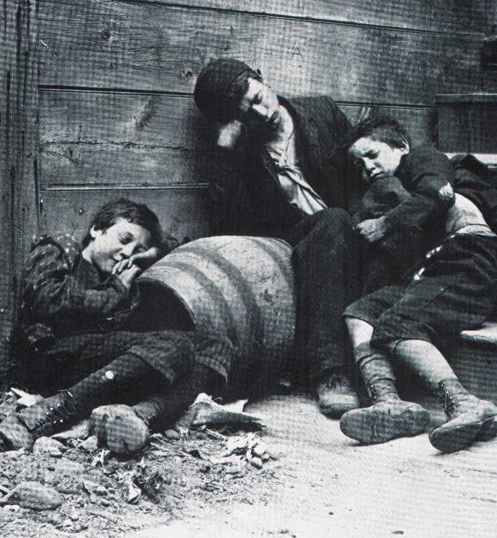
In 1853, thousands of children lived in orphanages and on the streets of New York City due to over population, death of parents, lack of extended family to take them in, and parental abandonment. No government agencies existed to help them.
www.americanhistory.unomaha.edu

Slide 3
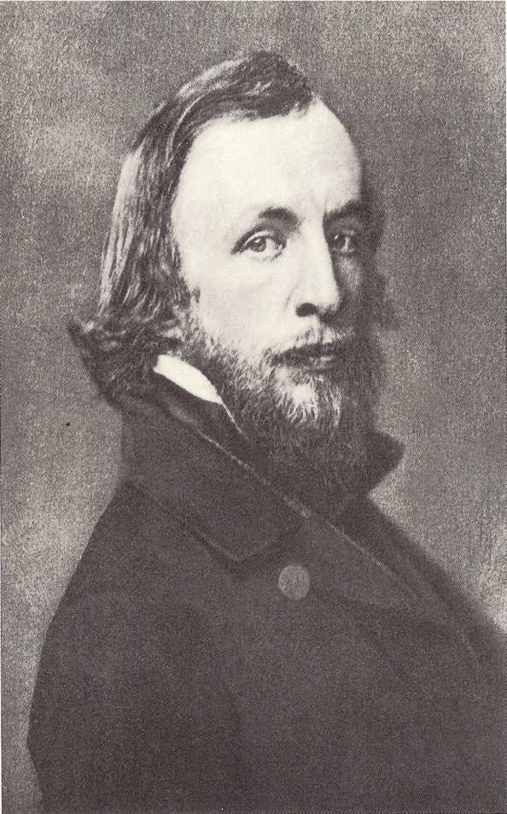
That same year, Reverend Charles Loring Brace founded the Children’s Aid Society of New York City.
www.orphantraindepot.org

Slide 4
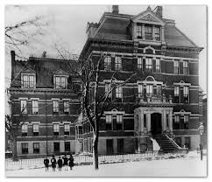
His goal was to send these children to rural areas and farms where he felt there would be clean air, healthy food, and a Godly atmosphere.
www.annparrwriter.com

Slide 5
From 1854 to 1929, nearly 250,000 children were placed out by the Children’s Aid Society, the New York Foundling Asylum, The Baldwin Place Mission and Home For Little Wanderers, and other charitable organizations.

Slide 6
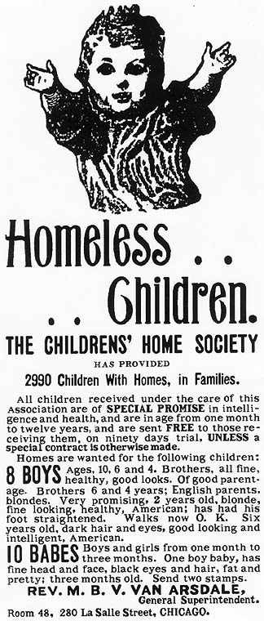
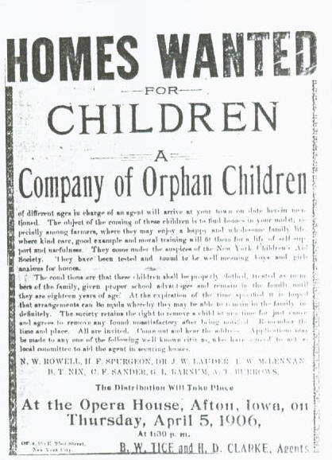
Stops were made in rural towns. Advance notice was given in the form of flyers and newspaper advertisements.
www.usgennet.org
www.nebraskahistory.org

Slide 7
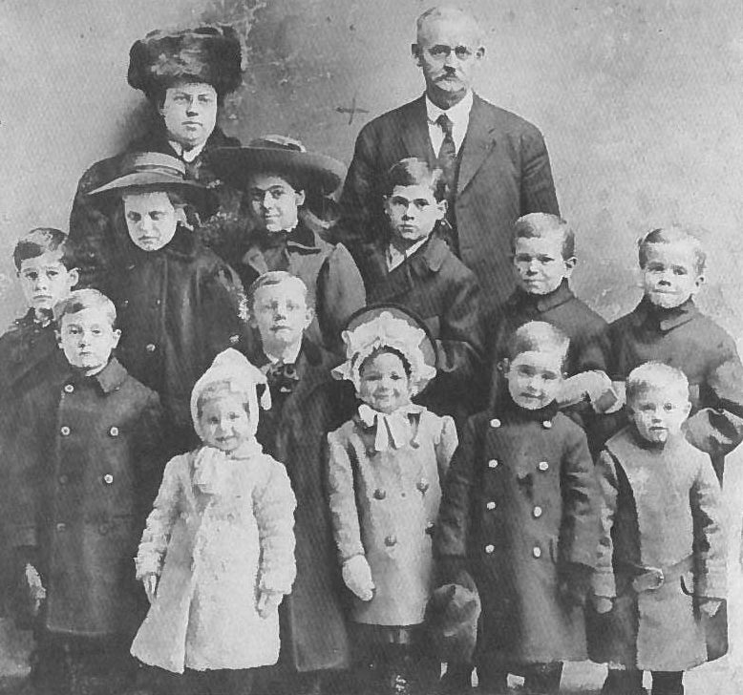
Children were accompanied by placing out agents.
www.historydetectives.nyhistory.org

Slide 8
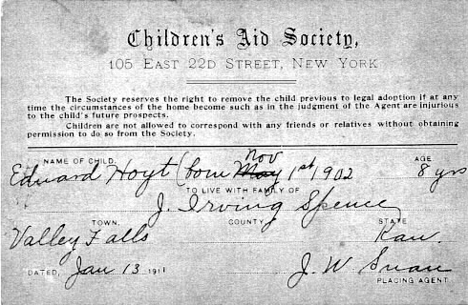
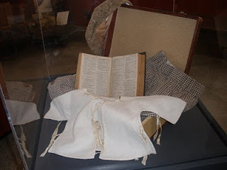
Each had an identification tag and suitcase with one new set of clothes and a Bible.
www.kancoll.org
www.orphantrainbook.blogstop.com

Slide 9
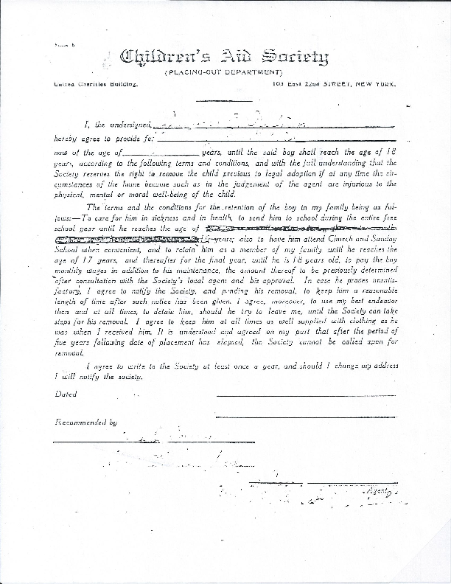
Families who took children in signed contracts agreeing to provide room, board, and clothes, send them to school and Church, healthcare, and send yearly progress reports.
OTHSA

Slide 10
OTHSA
OTHSA

Slide 11
In time, some of the children were adopted. Others were no more than a cheap source of labor as farmhands or house servants. Agents, who were supposed to do follow up visits, did not always come back, and families did not always send their progress reports. The Orphan Trains ended in 1929 when the federal government and states put in place agencies that would take care of orphaned and abandoned children.

Slide 12
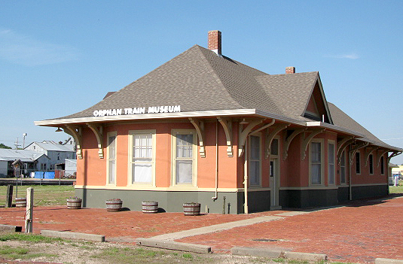
Today, the Orphan Train Heritage Society of America maintains a museum in Concordia, Kansas, to honor and remember those who rode the Orphan Trains. Other states have similar organizations and museums.

