Slide 1
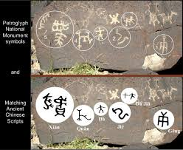
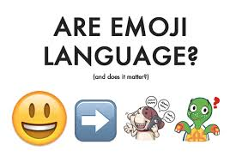
Petroglyphs, the Snapchat of ancients by Cherri redd

Slide 2
Petroglyphs near Prescott, AZ
What do you see?

Slide 3
Vocabulary
petroglyph: a picture made by chiseling directly on the rock using a stone chisel and a hammer stone

Slide 4
communication: the act or process of using words, sounds, signs, or behaviors to express or exchange information to one or more people

Slide 5
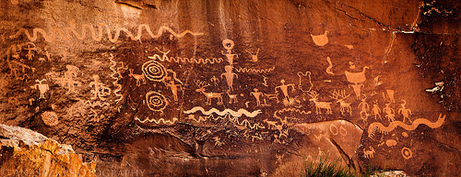
History of petroglyphs Petros - Greek for “stone” Glyphs - greek from glypher means “carve”
Petroglyphs or ancient rock carvings have been found dating as far back as 10,000 BC. They were used to tell stories, record significant events, warn of hazards, mark trails, or illustrate cultural or religious beliefs.
Geocontourglyphs are one type of petroglyph that represent a landform or surrounding terrain. For example: squiggly lines might represent a river. They may also communicate other information.

Slide 6
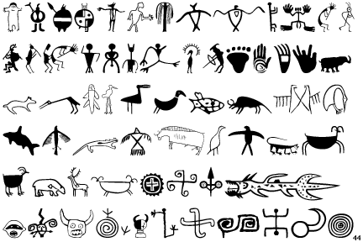
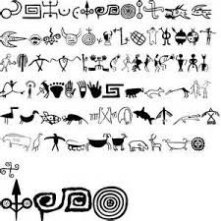
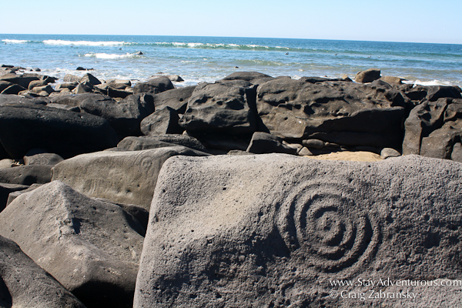
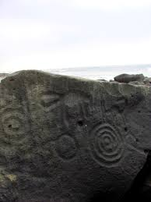
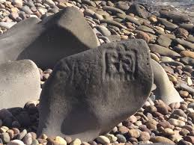
North American Petroglyphs and Native American Petroglyphs
Can you find some petroglyph symbols that are similar in these representations?
How many are similar?
Discuss them with your table group.

Slide 7
Petroglyphs around the world and their interpretations
Arizona Rock Art - National Geographic
https://video.nationalgeographic.com/video/us_arizonarockart
Video Hawaiian Culture Video: The Petroglyphs of Hawaii
https://www.youtube.com/watch?v=5boScAbfwQ4
Parowan Gap Petroglyphs https://www.youtube.com/watch?v=0otRLqr8wsg

Slide 8
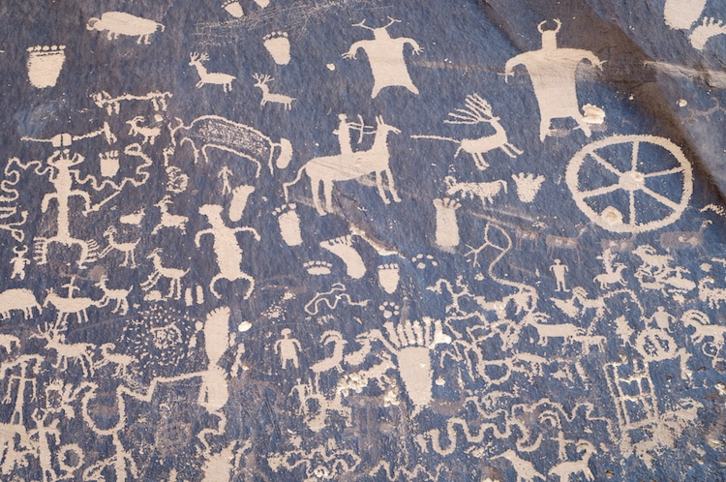
Create a message in a petroglyph
The partner group will think of an event, a tradition, or a warning that a group of people living many years ago (before paper and writing) would want to communicate.
Place your idea in the container and draw out a different message to convey.
Brainstorm with your partner how to make your petroglyph and how to explain the message to the class.
Using the art supplies provided, create your petroglyph and prepare to explain how the figures and symbols draw convey a message.

Slide 9
Petroglyph scoring guide
Criteria | Points Possible | My Points
Petroglyph is neatly drawn and shows effort. | 10
Petroglyph communicates an event, tradition, or warning. | 10
Group orally shared their petroglyph and explained its message in a clear and concise manner. | 10
Partners worked well together and exhibited good classroom behavior. | 5
Total | 35

Slide 10
Social media comparison
How does modern man communicate with Snapchat & emojis in a similar way that ancient man did with petroglyphs?
Why is this communication effective for our modern world?
How does diffusion of language as well as ideas take place here?
How do you think humans will communicate in the future?

Slide 11
Extension Table discussion Each person in your group explain your thoughts on one bullet point
What symbols in use today represent universal concepts (water waves, stick figure people, fish, sun)? Can you imagine that rock art depicting these concepts might use similar symbols?
There is more rock art in the American Southwest than in other parts of the United States. Why would this be? (Hint: It’s not related to the number of people who lived there or whether people made rock art in other places.)
Archaeologists often disagree on the interpretation of rock art symbols. What could they do to resolve debates? How could we know for certain what a rock art symbol means?
What role can present Native American cultures play in interpreting rock art?

