Slide 1
Maple Syrup’s Connection to Climate Change

Slide 2
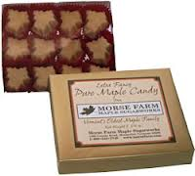
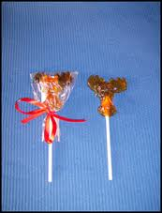
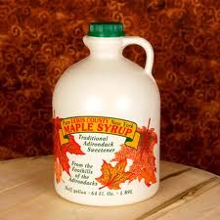
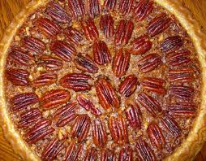
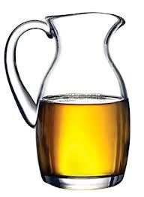
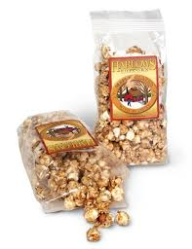
Products made from maple syrup

Slide 4
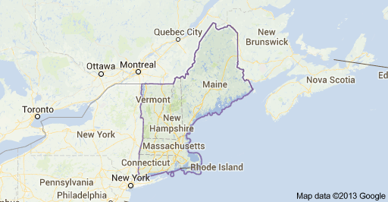
Explore-New England Area

Slide 5
Write down what the landscape is like in the New England states while watching this movie.
http://www.youtube.com/watch?v=XnRXXhvDCZM

Slide 6
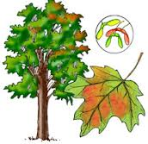
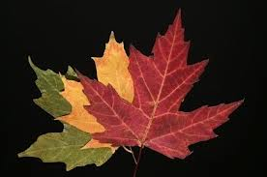
Background Information on New England and the Maple Syrup Industry
New England is located in the Northeastern corner of the United States consisting of Main, New Hampshire, Vermont, Massachusetts, Rhode Island and Connecticut. The dominate trees in the New England area are Sugar and Red Maple. They have a beautiful fall color, jagged coast line, mountains and rolling hills which makes it a great tourist area.

Slide 7
The New England area has four very distinct seasons:
Spring temperatures are usually wet with temperatures between 40-60 degrees.
Summers are somewhat humid and hot with thunderstorms usually between June-August.
Fall temperatures are usually 45-50 degrees. The air is cool and crisp with peak beautiful foliage changes.
Winter climate average is 25 degree and it usually snows an average of 35 inches per year.

Slide 8
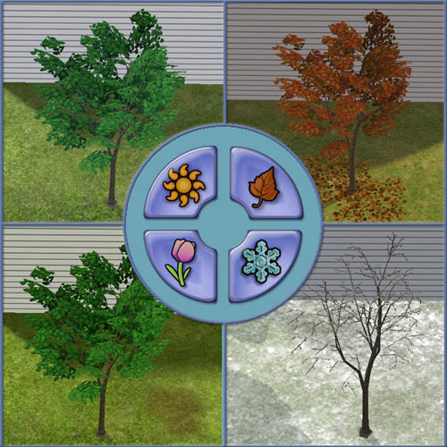

Slide 9
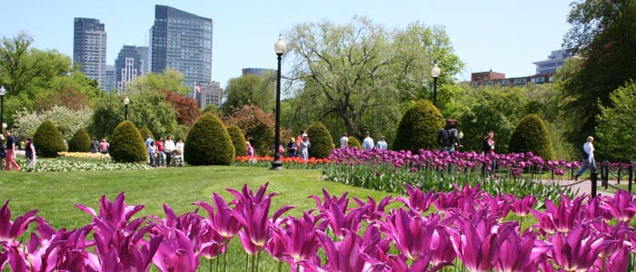
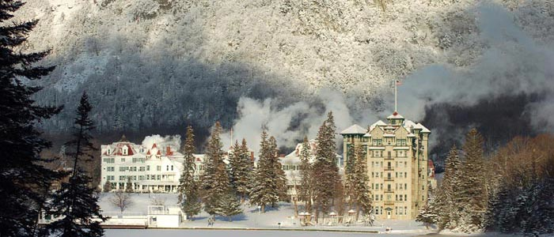
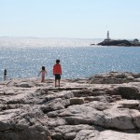
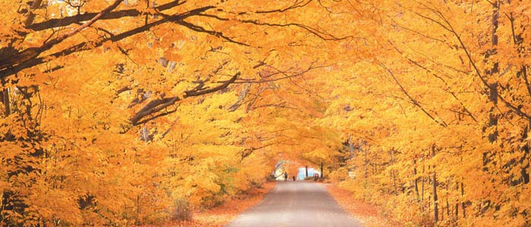
Spring
Winter
Fall
Summer

Slide 10
Maple sugar producers have kept records (data) for over 50 years. Here are some of the facts gathered:
The Maple Syrup season is starting three weeks earlier and ending two weeks sooner.
Scientists are predicting the New England area maple sugaring tradition will end by the century’s end.
The proper condition to get the maple syrup sap to flow properly depends on freezing nights followed by warm days in late winter.
At one time maple sugar farmers could use buckets to collect the syrup. Today, with a shorter season, they had to become innovative and now use tubes for collection.
The sugar maple tree flows sap from late February to early March depending on its geographic location and day/night temperature differences.
To get the sap, a tree must be “tapped” with a spigot or tube.
As little as two degrees warmer temperature could make the difference on how much sap will flow.

Slide 11
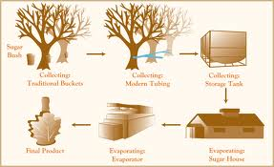
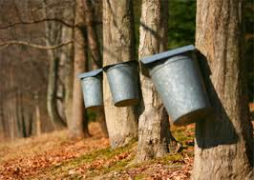
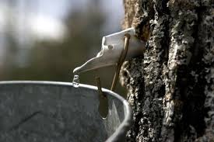

Slide 12
Maple Syrup Vocabulary
temperature: how hot or cold something is
precipitation: water falling from the clouds like rain or snow
graph: mathematical way to show connections between information
tapping: putting a tube in a maple tree so the sap will drip out
climograph: a graph that shows precipitation and temperature over a long time
sap: juice in a plant (like blood in a human)
weather: the daily temperature and precipitation
climate: average of the temperatures and precipitation of a place taken over many years

Slide 13
A climograph (climatograph) is used to show
the precipitation and temperature of a region.
Both sets of data are on the same graph.
Temperature
Rainfall

