Slide 1
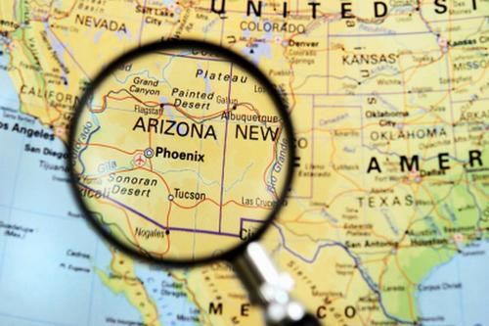
The Changing Face of the Arizona Border
bilingual.suleckha.com
Notes:
bilingual.suleckha.com

Slide 2
Dennis Rees
Teacher-Consultant
Arizona Geographic Alliance

Slide 3
How the border between Arizona and Mexico looked has changed over time. The following pictures show that evolution.

Slide 4
As you view the images, what changes to the border do you see? What do you think caused these changes? How do you think the border will change in the future?

Slide 5
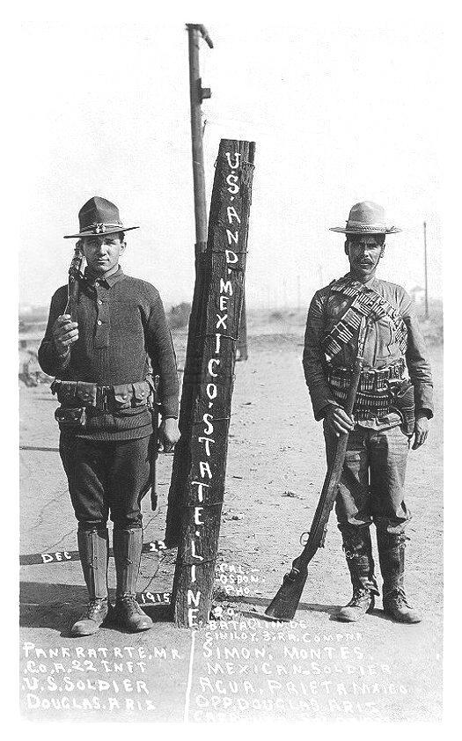
In 1915, the border at Douglas, Arizona, looked like this.
1-22infantry.org
Notes:
1-22infantry.org

Slide 6
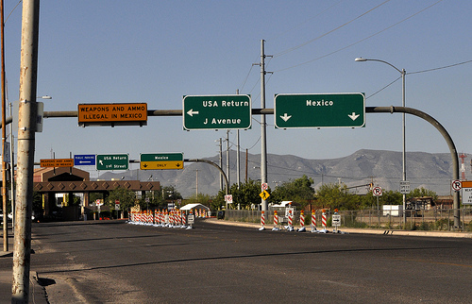
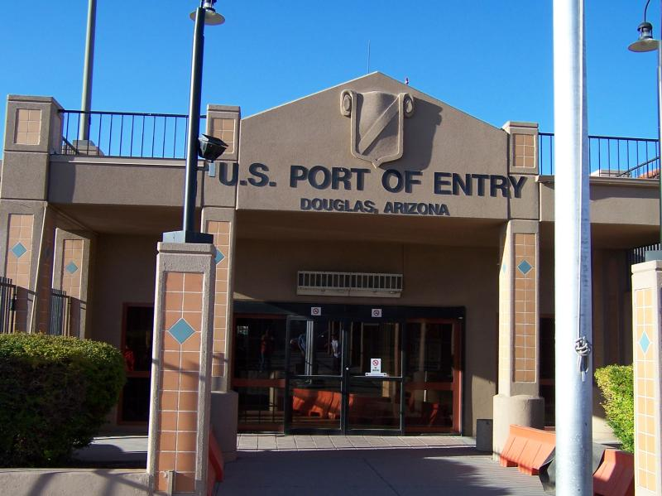
Today, this is what it looks like.
flicker.com
flicker.com
Notes:
flicker.com

Slide 7
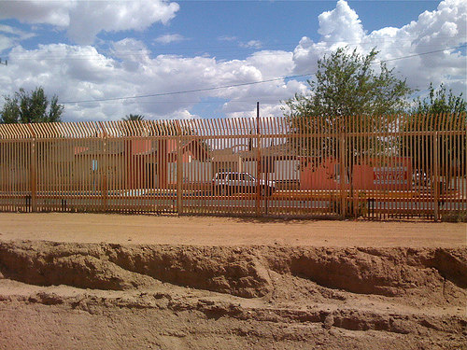
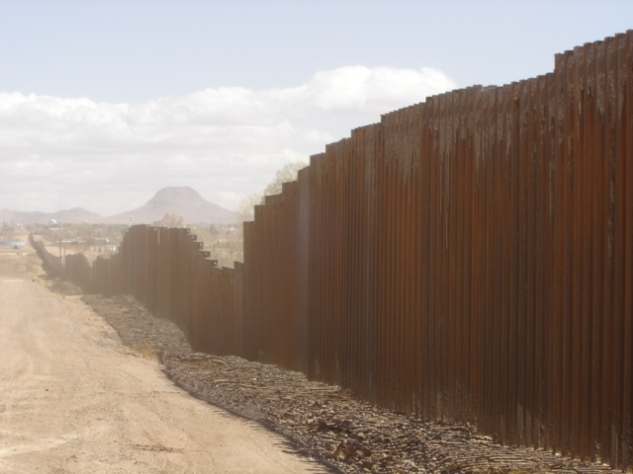
2012
wn.com
kvoa.com
Notes:
kvoa.com

Slide 8
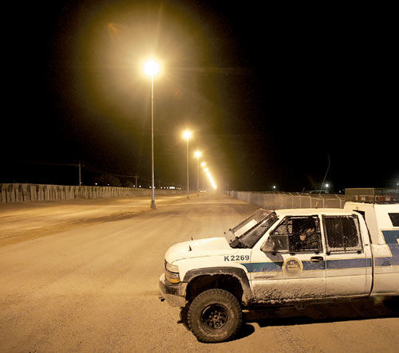
tucsoncitizen.com
Notes:
tucsoncitizen.com

Slide 9
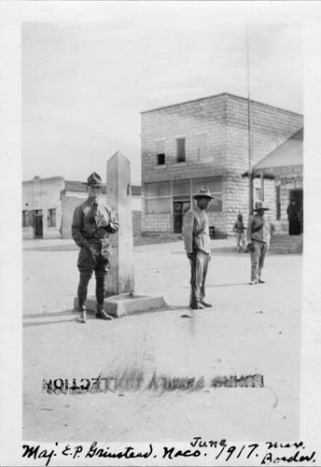
This is Naco, Arizona, in 1917.
knet.asu.edu
Notes:
knet.asu.edu

Slide 10
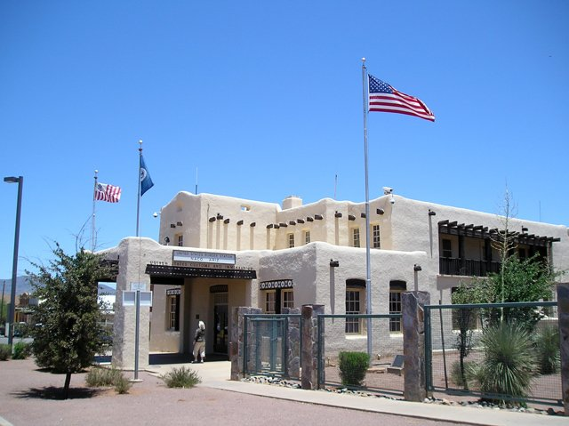
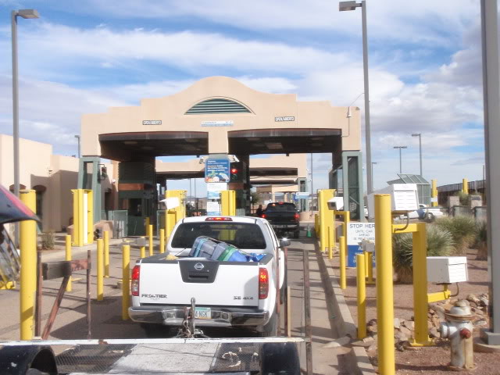
Here it is today.
flicker.com
flicker.com
Notes:
flicker.com

Slide 11
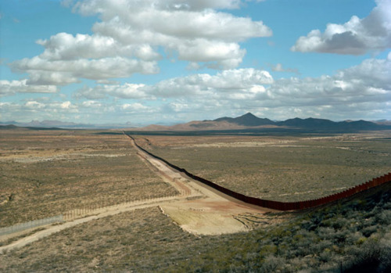
tucsonsentinel.com
Notes:
tucsonsentinel.com

Slide 12
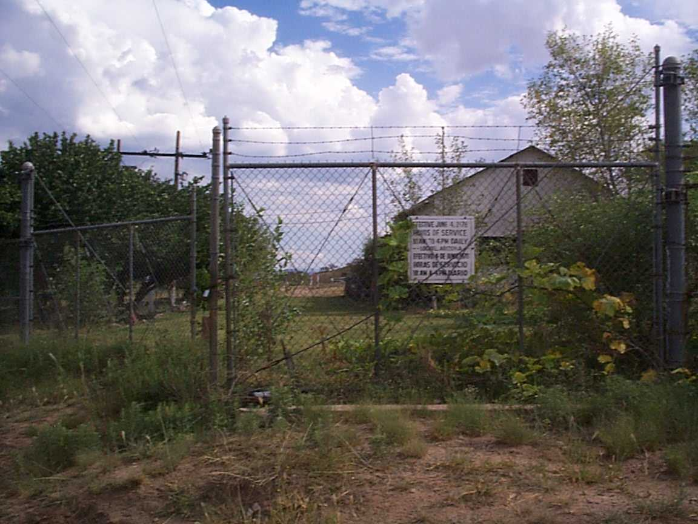
In the 1980’s, the crossing at Lochiel, Arizona, was closed.
wikipedia.com
Notes:
wikipedia.org

Slide 13
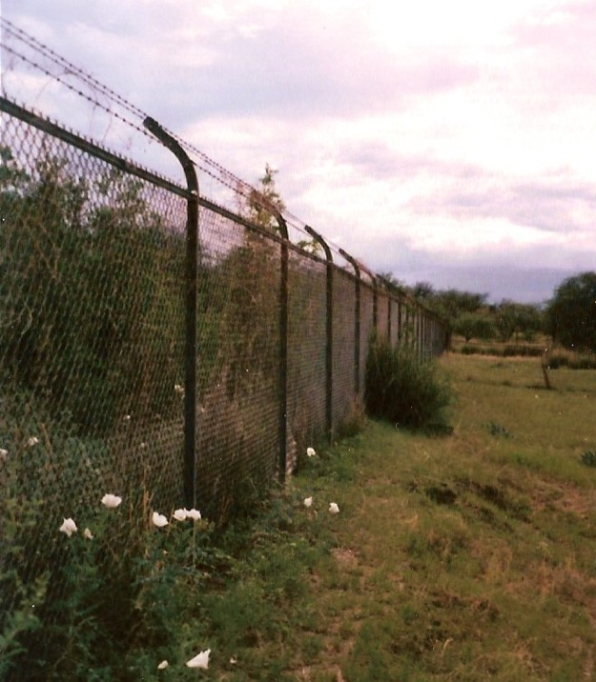
It looked like this in the summer of 2000.
Dennis Rees
Notes:
Dennis Rees

Slide 14
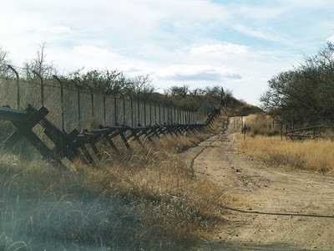
This is how it looked in 2012.
flicker.com
Notes:
flicker.com

Slide 15
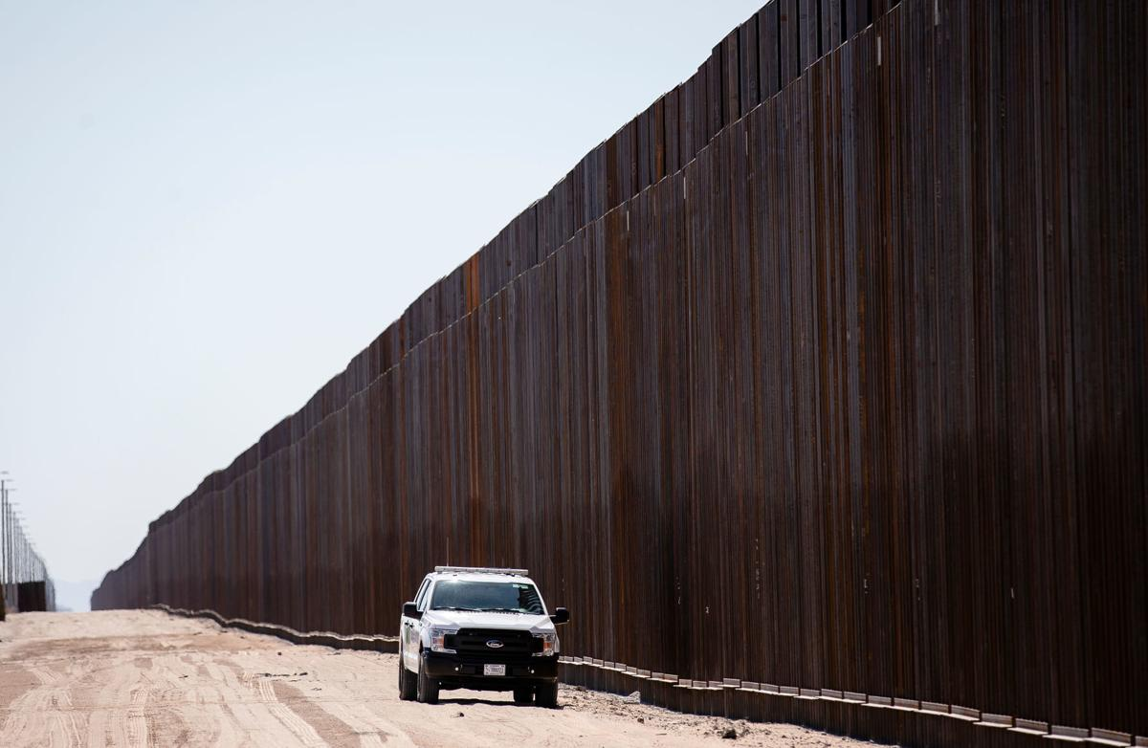
Today’s Wall

Slide 16
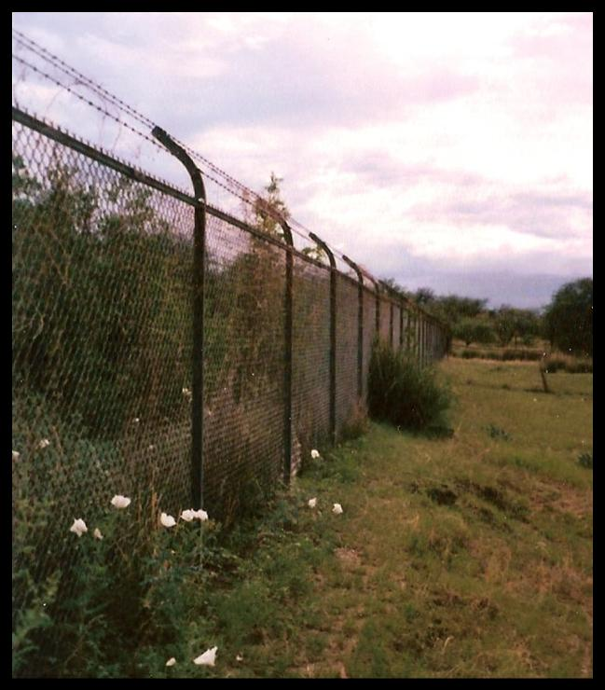

Compare these two photos.
2019
2000

Slide 17
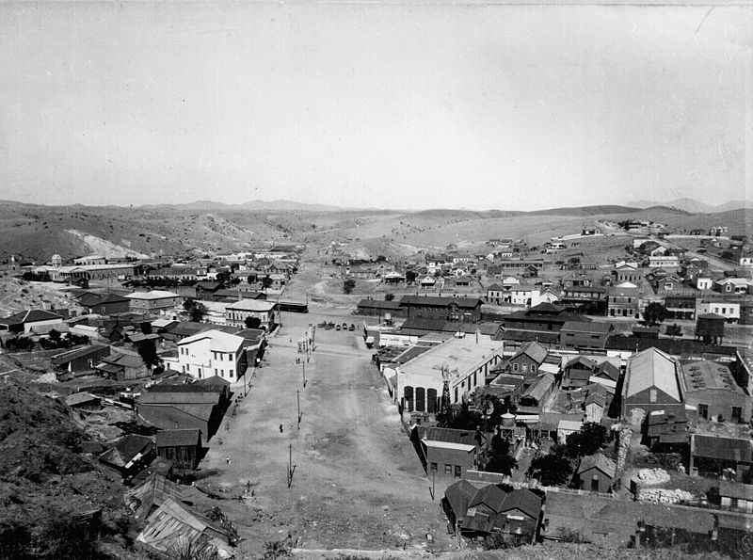
Nogales, Arizona, one of the older border crossings, looked like this in 1899.
cdlib.org
Notes:
cdlib.org

Slide 18
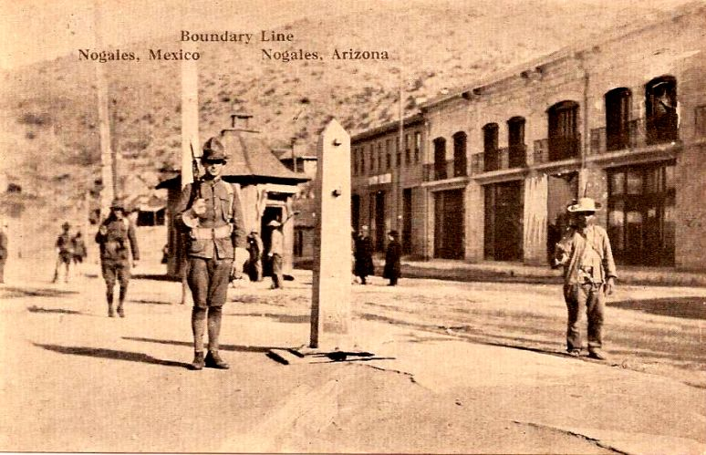
Here is what it looked like in the 1910s.
arizona100.blogspot.com
Notes:
arizona100.blogspot.com

Slide 19
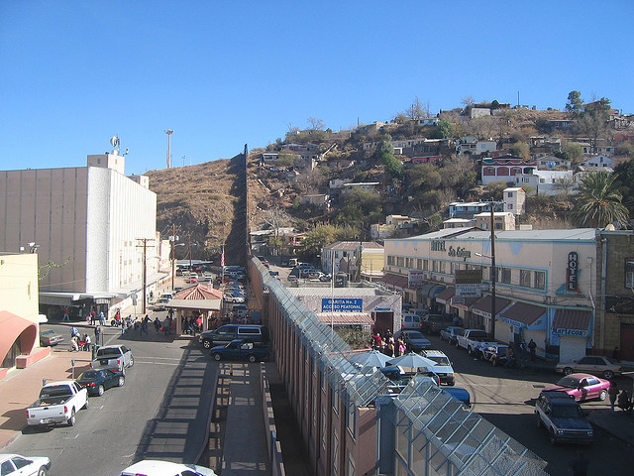
Today, it looks like this.
flicker.com
Notes:
flicker.com

Slide 20
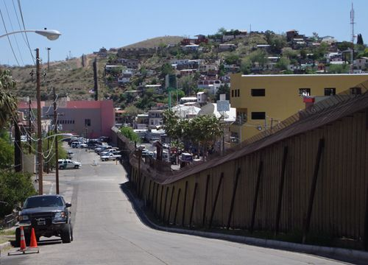
nogalesinternational.com
Notes:
nogalesinternational.com

Slide 21
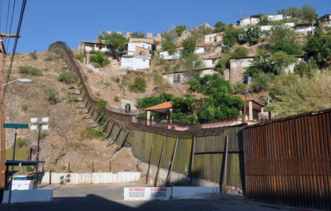
latindispatch.com
Notes:
latindispatch.com

Slide 22
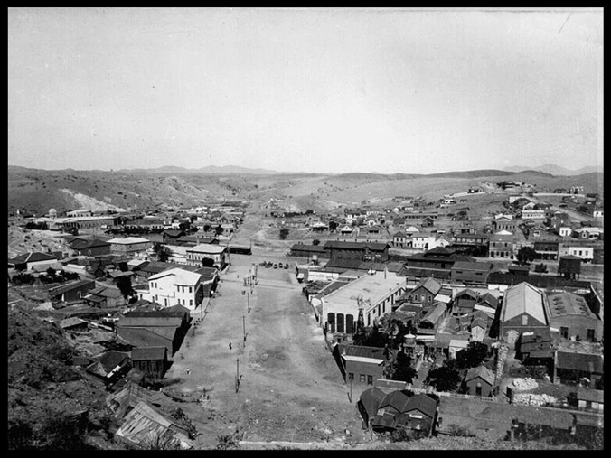
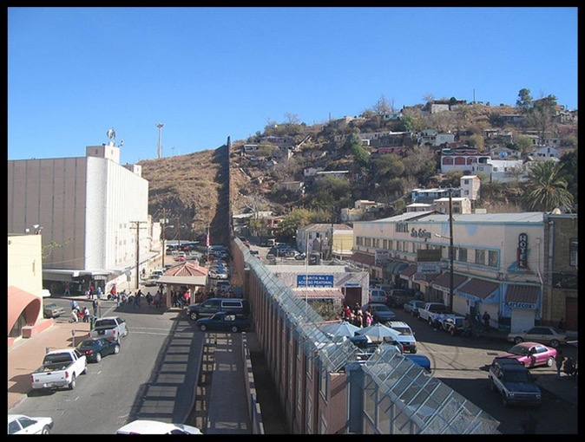
Compare these two photos.
1899
2012

Slide 23
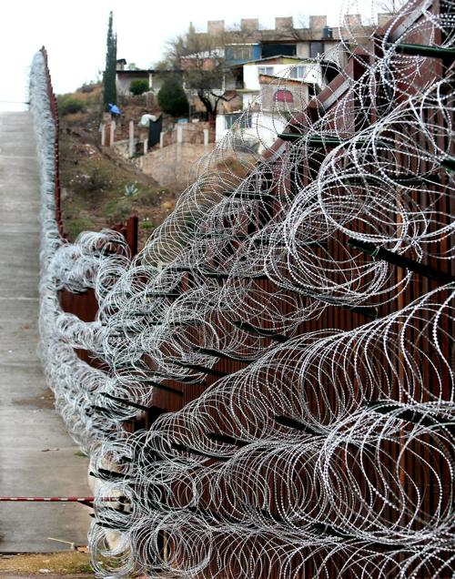
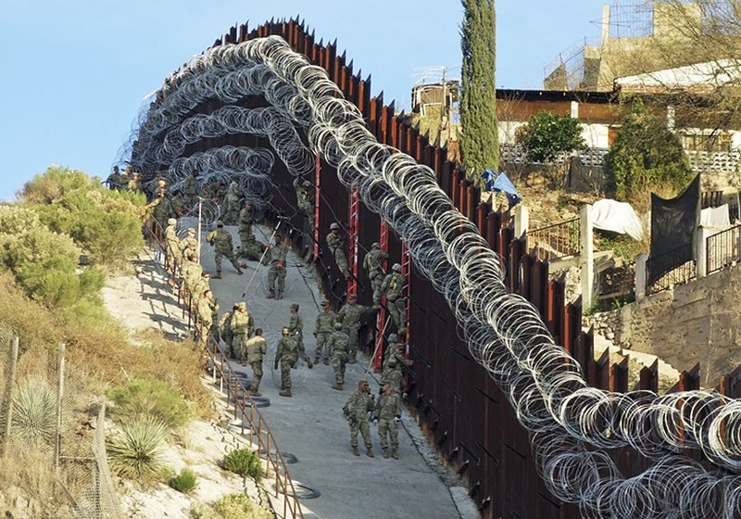
2019
Apnews.com

Slide 24
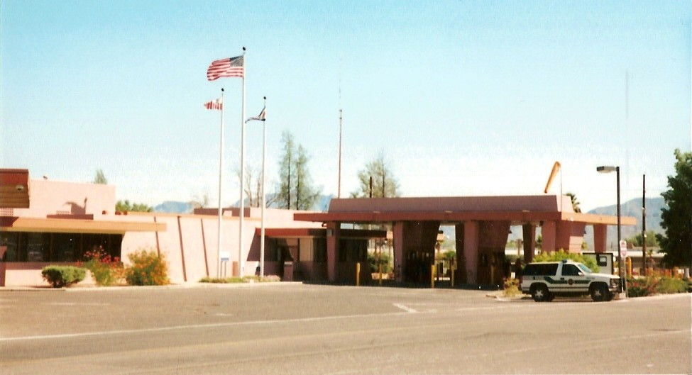
Lukeville, Arizona, a popular border crossing for people headed to Puerto Penasco, Sonora, looked like this in 2000.
Dennis Rees
Notes:
Dennis Rees

Slide 25
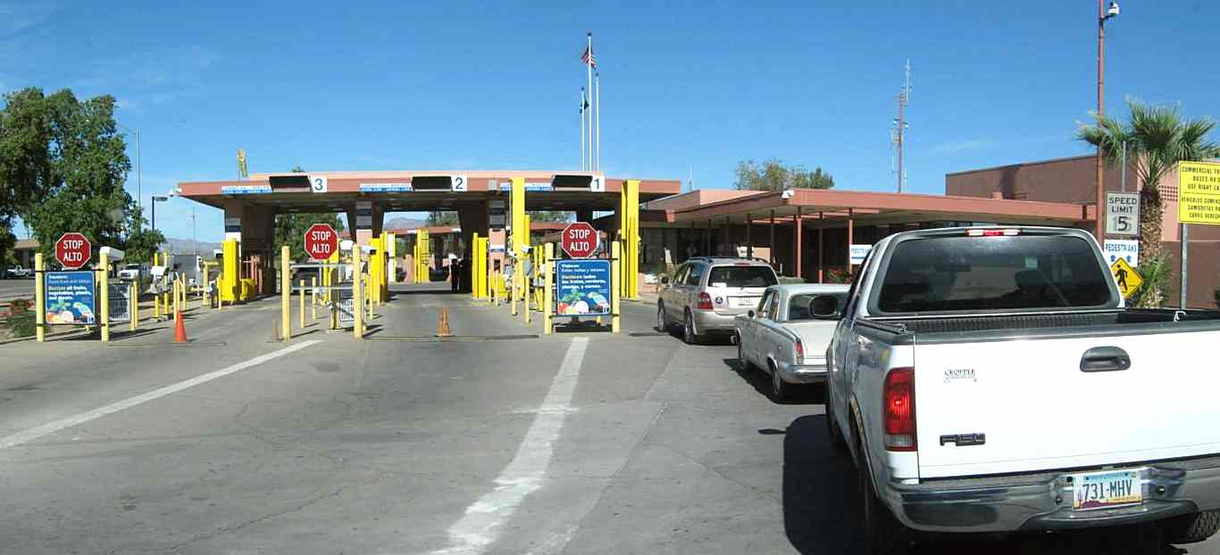
Today, it looks like this.
vagabonder-supreme.net
Notes:
vagabonder-supreme.net

Slide 26
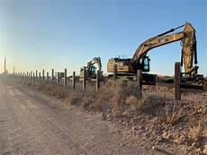
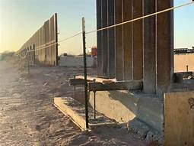
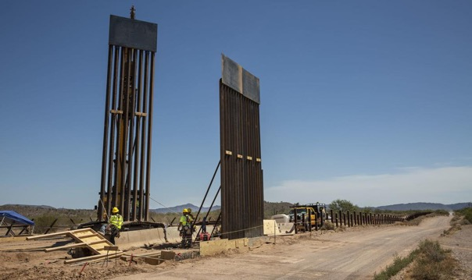
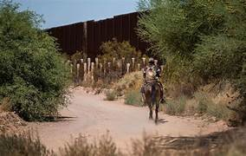
2019 Lukeville, AZ
Tucson.com
Notes:
environmentmagazine.org

Slide 27
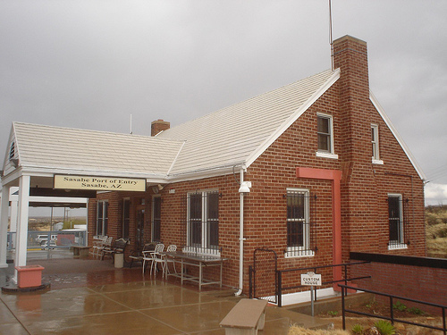
Sasabe, Arizona, is another border crossing. It once looked like this.
flicker.com
Notes:
flicker.com

Slide 28
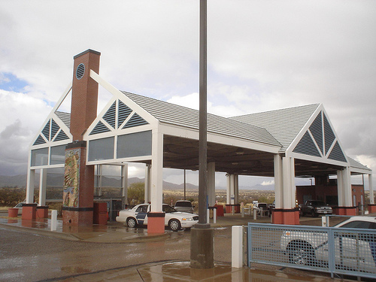
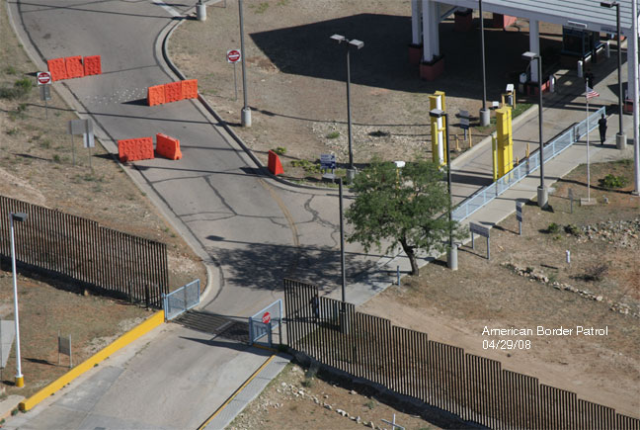
Today, it looks like this.
flicker.com
americanpatrol.com
Notes:
americanpatrol.com

Slide 29
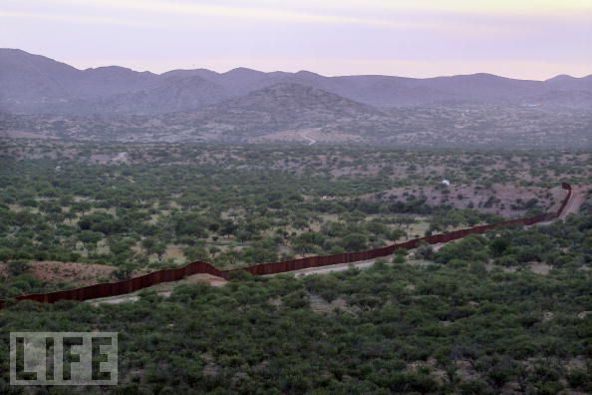
LIFE photo archive
Notes:
LIFE photo archive

Slide 30
San Luis is the westernmost Arizona-Mexico border crossing. Established in 1930, it quickly became a agricultural, manufacturing, and retail business center for the area.

Slide 31
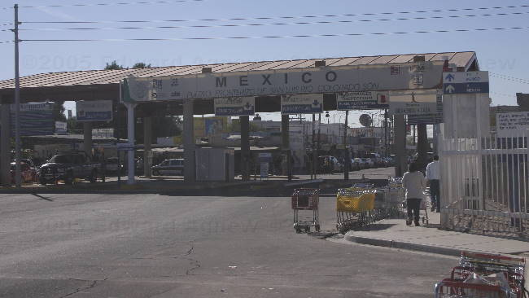
Today, it looks like this.
mappingmainstreet.org

Slide 32
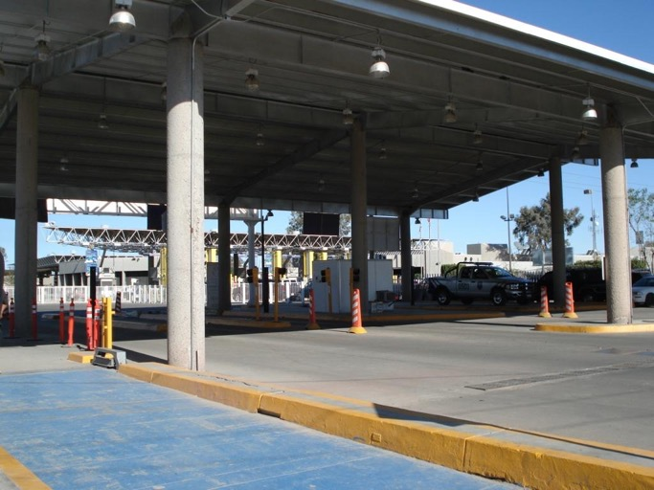
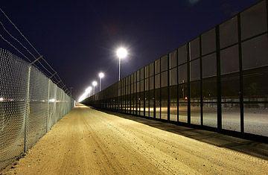
panoramio.com
time.com

Slide 33
Now that you have seen the border over the years, what changes did you see? What do you think caused these changes? How do you think it will change in the future?

Slide 34
Photograph and Image Credits
Slide 1: bilingual.suleckha.com
Side 5: 1-22 infantry.org
Slide 6: flicker.com
Slide 7: wn.com
kvoa.com
Slide 8: tucsoncitizen.com
Slide 9: knet.asu.edu
Slide 10: flicker.com
Slide 11: tucsonsentinal.com
Slide 12: wikipedia.org
Slide 13: Dennis Rees, AzGA Borderlands Institute 2000
Slide 14: flickr.com
Slide 16: cdlib.org
Slide 17: arizona100.blogspot.com
Slide 18: flicker.com
Slide 19: nogalesinternational.com
Slide 20: latindispatch.com
Slide 22: Dennis Rees, AzGA Borderlands Institute 2000

Slide 35
Slide 23.: apnews.com
Slide 24: vagabonder-supreme.net
Slide 25: environmentmagazine.org
Slide 26: tucson.com
Slide 27: flicker.com
americanpatrol.com
Slide 28: LIFE photo archive
Slide 29: mappingmainstreet.org
Slide 31: panoramio.com
Slide 32: time.com

