Slide 1
The Impact of Urbanization
Lesson by Gage Garcia

Slide 2
Essential Question
What impact can migration and population growth have on the landscape of cities?

Slide 3
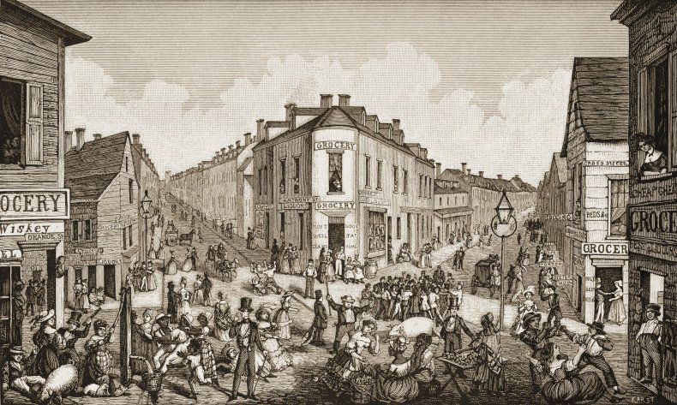

Slide 4
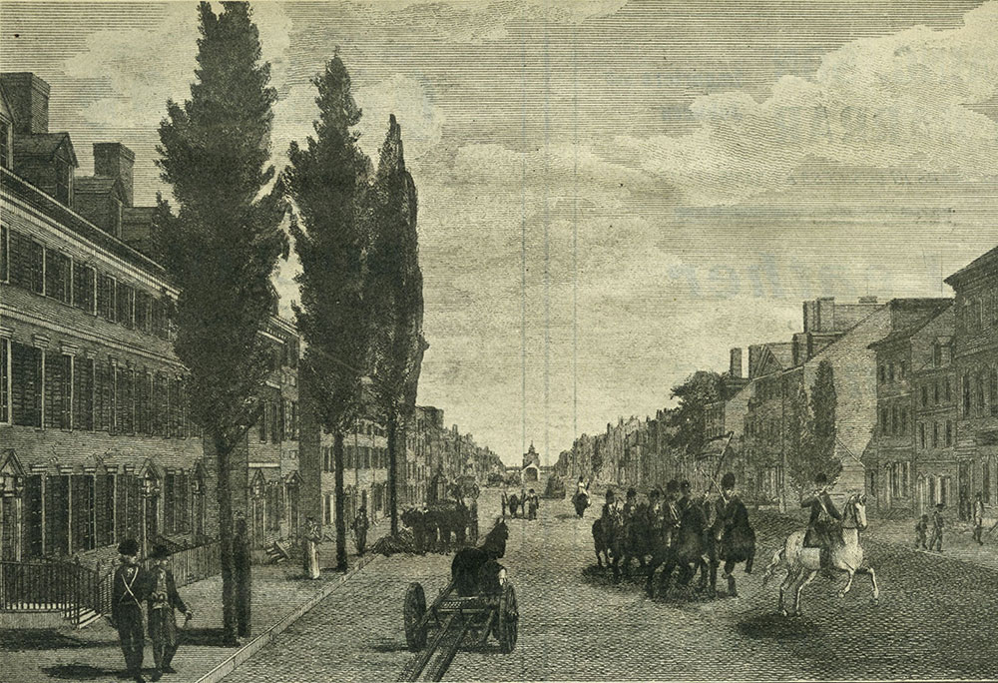

Slide 5
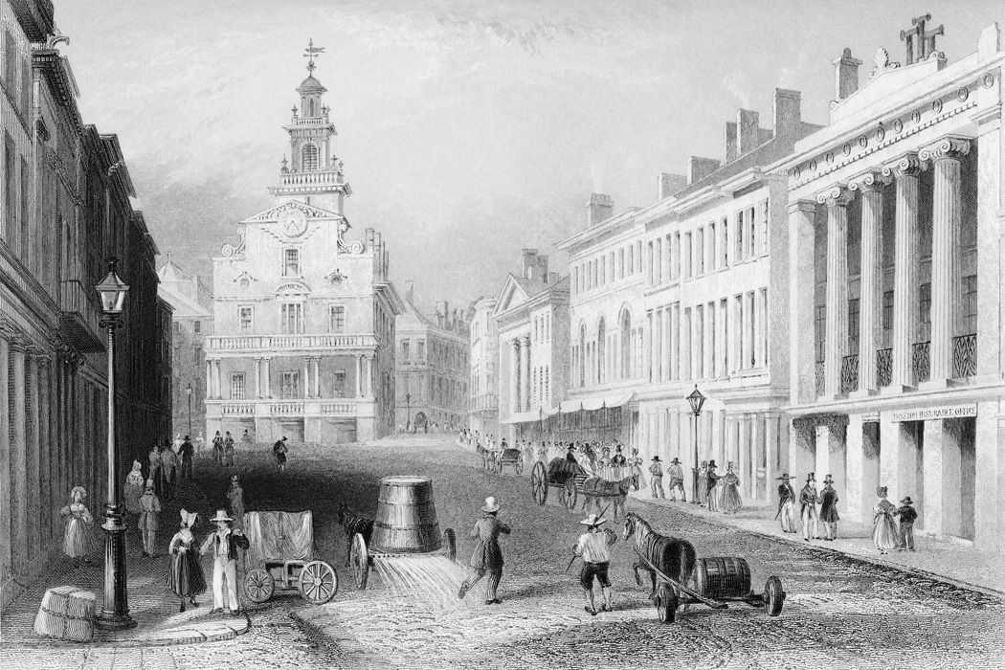

Slide 6
What 3 cities were represented by these images? Talk to the people around you.

Slide 7
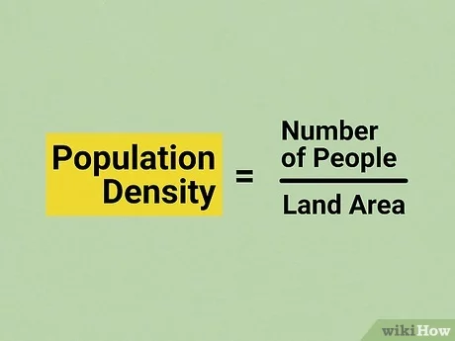
Visualizing Urbanization in New York City 1790-2000
One way to visualize population is through the term “population density.” Population density is taking the total population of a designated area and and dividing it by the number of square miles in the area.

Slide 8
Urbanization Activity
The area on the floor is representing 1 square mile of New York City. It was once covered by trees. Add 30 trees to the area.

Slide 9
Urbanization Activity
In 1790 (the date of the first U.S. census), New York City had a population density of 162 people per square mile. Each cut-out smiley face equals 1000 people. Cut the smiley face so it is about 1/5 of its size. Remove a tree and put the smiley face on the floor. This was the population density per square mile of NYC in that time period.
Notes:
162 would round to 0 but to make sure students understand there were some people there, cut a smiley face into about 1/5 of its size.

Slide 10
Urbanization Activity
In 1830, New York City had a population density of 1,295 people per square mile. Each smiley face equals 1000 people. How many smiley faces would this represent? (Round off the number.) Remove the smiley face from 1790 and put the whole smiley face on the floor. This is the population density in 1830 per square mile of NYC in that time period.
Notes:
1 and 1/3 would round off to 1 smiley face

Slide 11
Urbanization Activity
In 1870 (just after the Civil War), New York City had a population density of 4,894 people per square mile. Each smiley face equals 1000 people. How many smiley faces would this represent? Add the smiley faces so the total is 5 and remove trees as needed.
Notes:
4 and 4/5 would round up to 5 people

Slide 12
Urbanization Activity
In 1910 (just before World War I), New York City had a population density of 15,785 people per square mile. Each smiley face equals 1000 people. How many smiley faces would this represent? Add the new number of smiley faces to the floor. Remove trees as needed.
Notes:
15 and 4/5 would round up to 16 people

Slide 13
Urbanization Activity
In 1950 (after World War II), New York City had a population density of 26,132 people per square mile. Each smiley face equals 1000 people. How many smiley faces would this represent? Add to the smiley faces on the floor. Remove trees as needed.
Notes:
26 and 1/10 would round down to 26 people

Slide 14
Urbanization Activity
In 2000, New York City had a population density of 26,517 people per square mile. Each person equals 1000 people. How many smiley faces would this represent? Add to the smiley faces on the floor. Remove trees as needed.
Notes:
26 and 1/2 would round up to 27 people

Slide 15
Urbanization Activity
Of course, these people need houses, restaurants, schools, businesses, roads, hospitals, and government services. Add these to the area on top of smiley faces and any remaining trees.
Notes:
26 and 1/2 cut-outs

Slide 16
What you see now?

Slide 17
What do we see?
Urbanization of our cities is causing a change in our landscape and the changes have an impact on our environment.

Slide 18
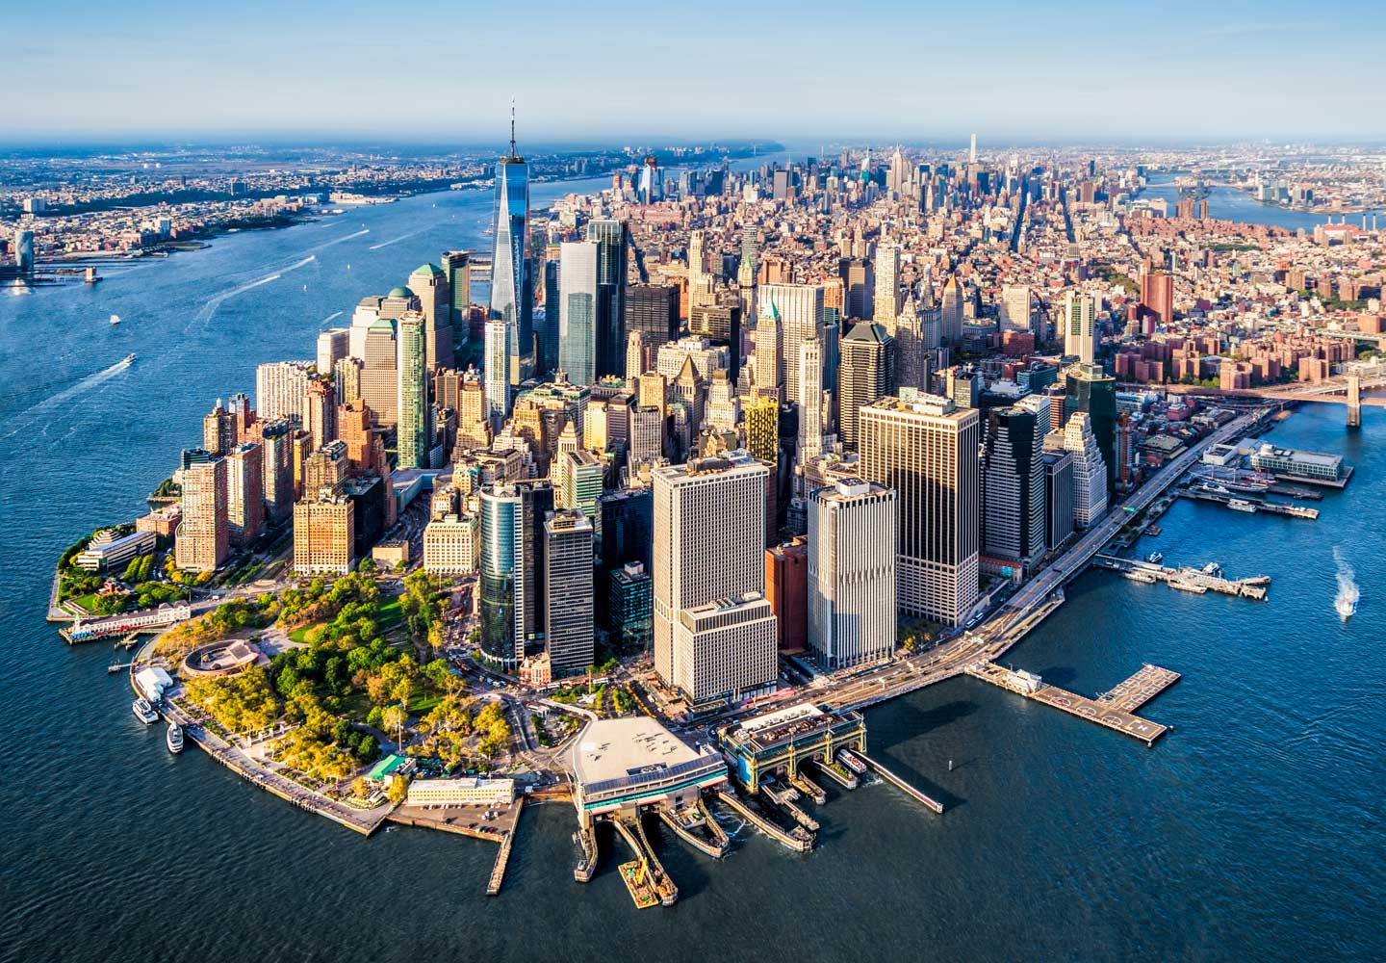
Then and Now NYC

Slide 19
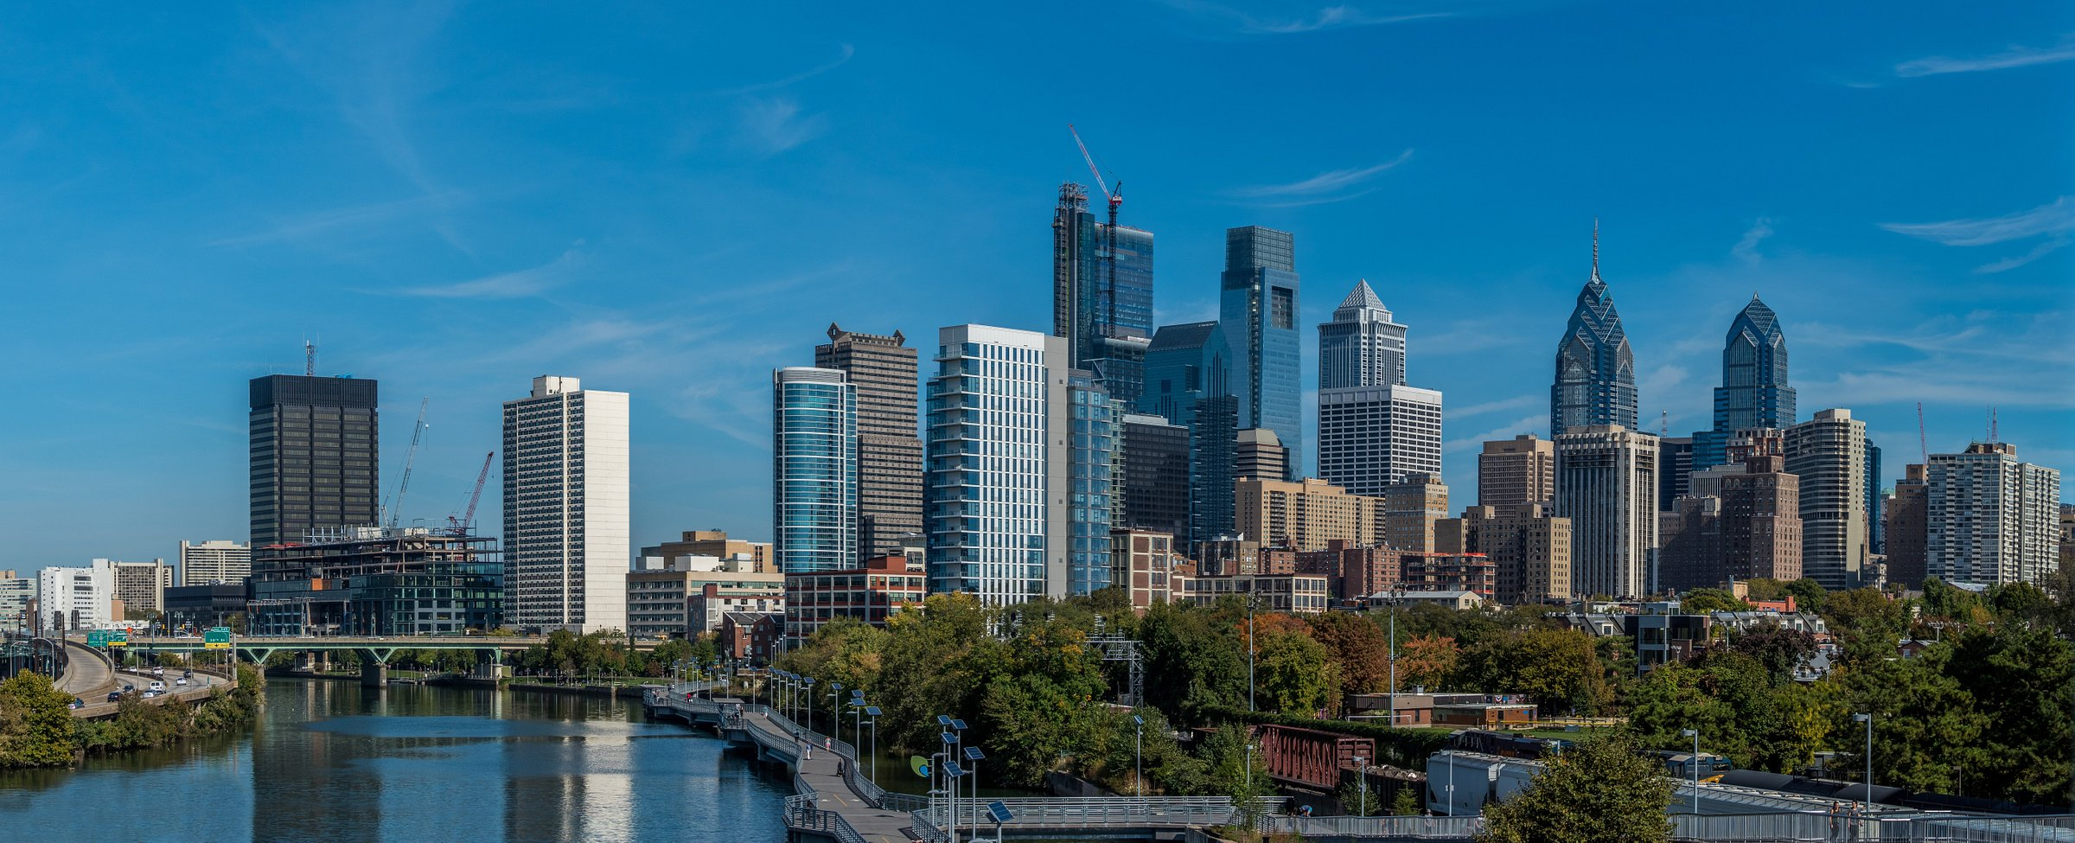
Then and Now
Philadelphia

Slide 20
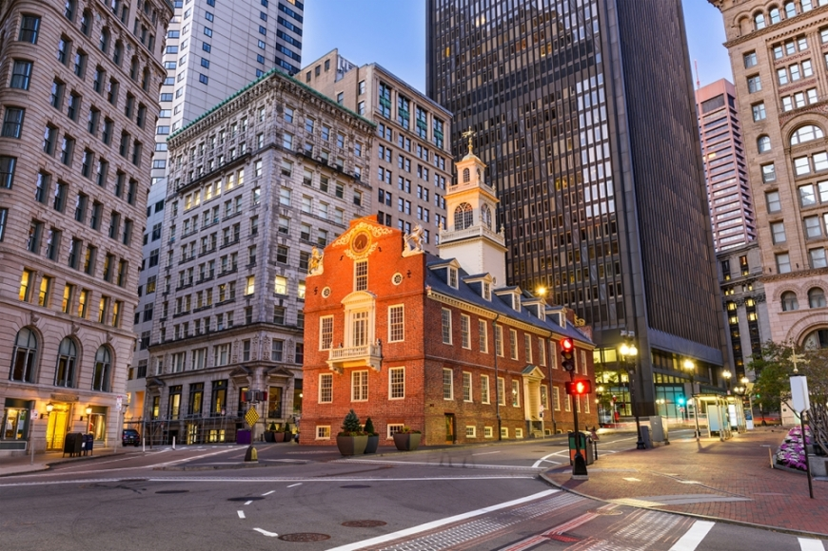
Then and Now
Boston

Slide 21
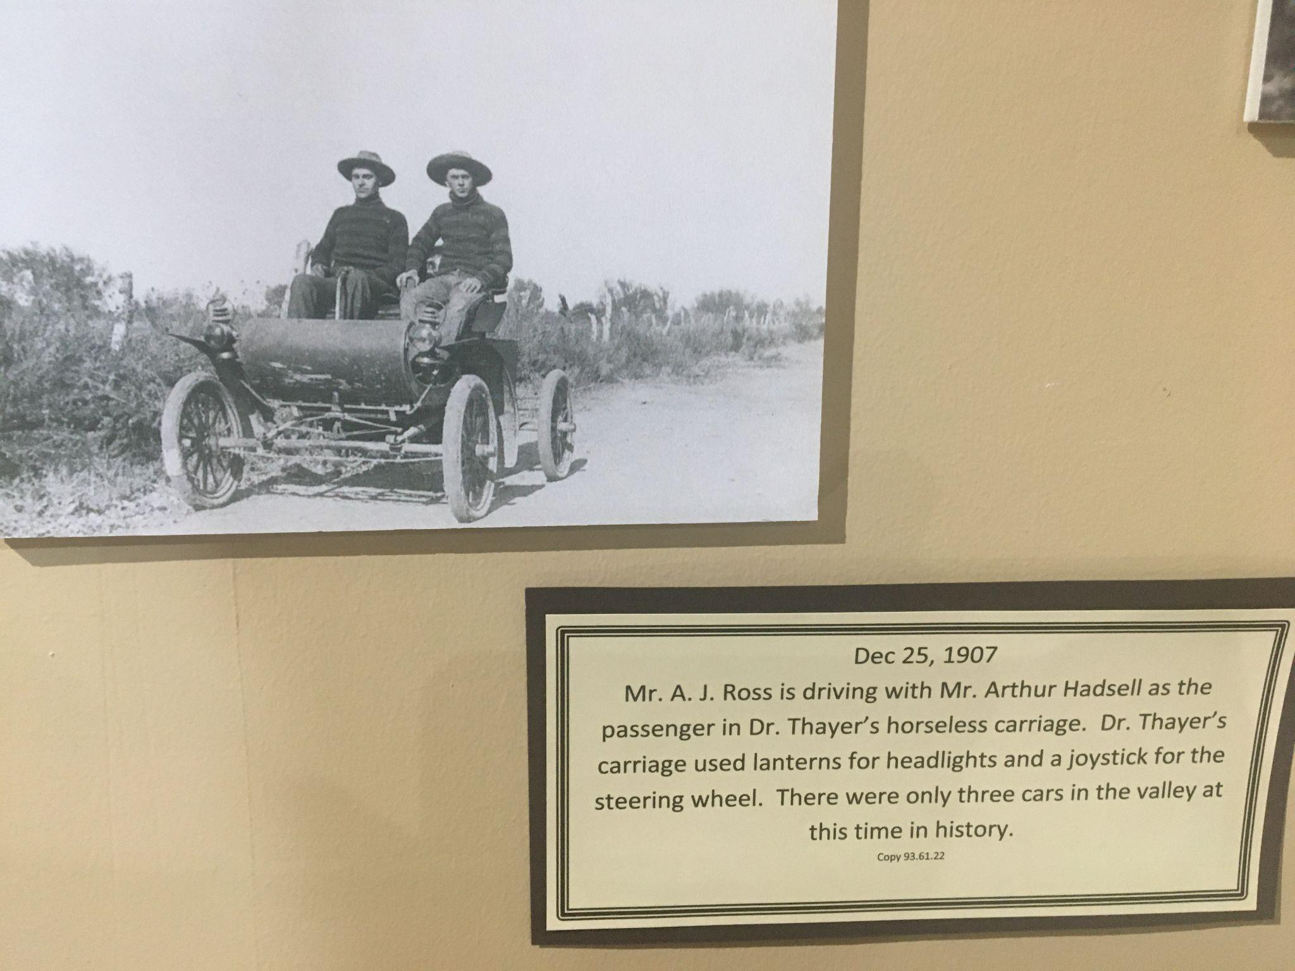
Buckeye, AZ
1907
Notes:
Buckeye, AZ

Slide 22
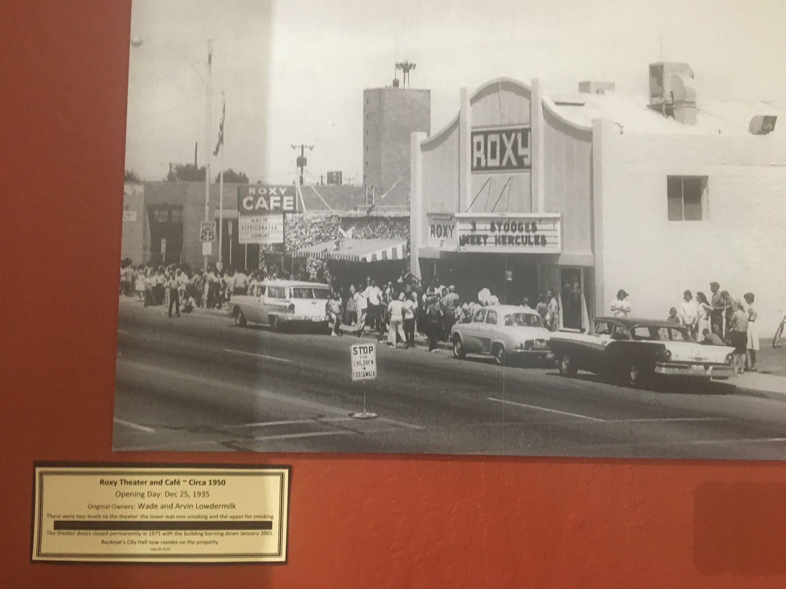
Buckeye, AZ
1950
Notes:
Buckeye, AZ

Slide 23
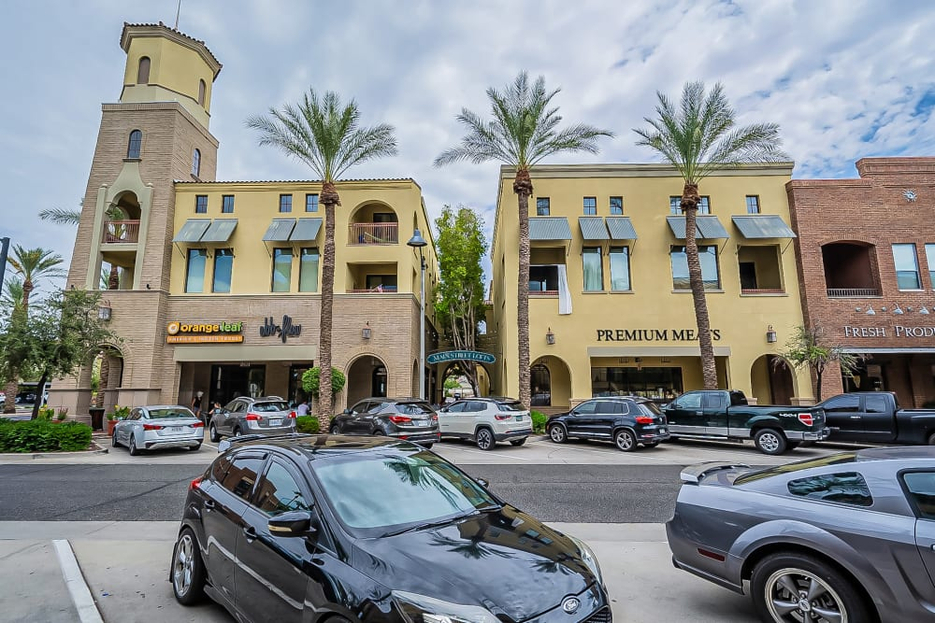
Buckeye, AZ
Today
Notes:
Buckeye, AZ

Slide 24
Your Turn Option One (Storyboard Urbanization)
You will be split into groups of 3 students. You will storyboard the growth of a city. Using your art supplies, you are to draw 6 scenes as a storyboard showing the city’s growth. You are to put captions below or above each scene explaining the changes in the landscape and environment.

Slide 25
Things to Consider
This should be a real city.
You need to know the date the city was established and then make your scenes every 20-40 years after that. End with a date close to now.
Bonus points for doing a city in Arizona!
You are welcome to search for real photos and information, but the storyboard should be your own artwork….no cutting and pasting from the Internet.
Captions need to be grammatically correct.

Slide 26
Your Turn Option Two (Buckeye, AZ)
You will be split into groups of 3-5 students.
Your group will be given one of the 3 images of Buckeye.
Using your art supplies, you will recreate what you see from the image.
After your replica is completed, you will write at least an 8-sentence summary. Your summary should include:
A description of your replica created on the construction paper.
Inferences as to what the kind of impact the environment of Buckeye had on its growth.
Explain why the urbanization happened
Good grammar and spelling.

Slide 27
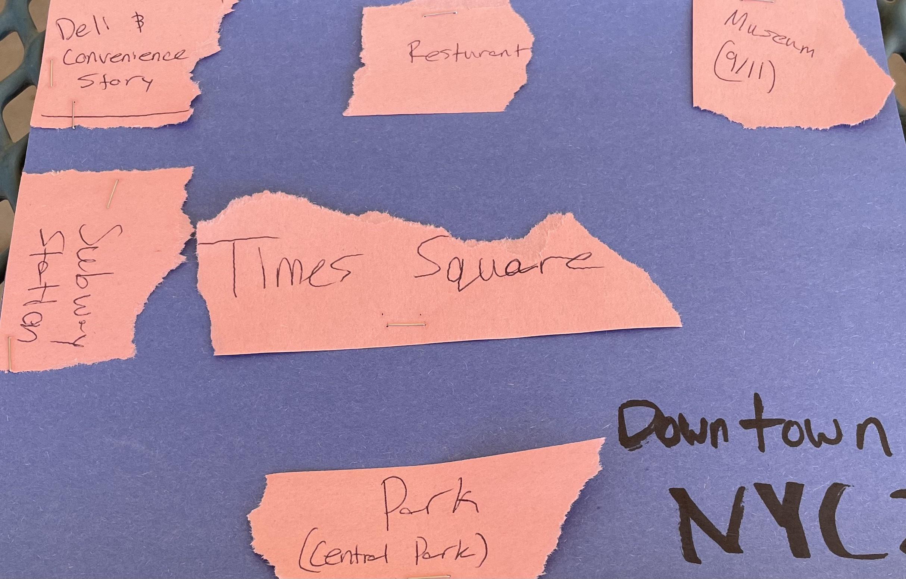
Your Turn Option Two (Buckeye, AZ)
Replica Example
Draw and cut out images to show major features in your photo.
Glue them in the correct location.
Label the images.
Be sure to include the name of the city and the date.
Hint: This one is not a well done example. Yours should show more effort.

Slide 28
Image Credits
https://www.thoughtco.com/new-york-city-19th-century-1774031
https://libwww.freelibrary.org/digital/item/43941
https://daily.jstor.org/the-birth-of-the-modern-american-debt-collector/
https://www.wikihow.com/Calculate-Population-Density
https://www.architecturalrecord.com/articles/15282-new-york-city-by-thomas-dyja
https://www.tripadvisor.com/Tourism-g60795-Philadelphia_Pennsylvania-Vacations.html
https://www.berkshirechoral.org/programs/locations/boston-massachusetts
https://www.buckeyeaz.gov/residents/buckeye-valley-museum

