Slide 1
Giant Garbage Patches
What can you do?

Slide 2
Let’s review what we learned yesterday.

Slide 3
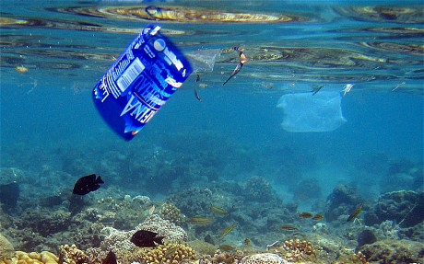
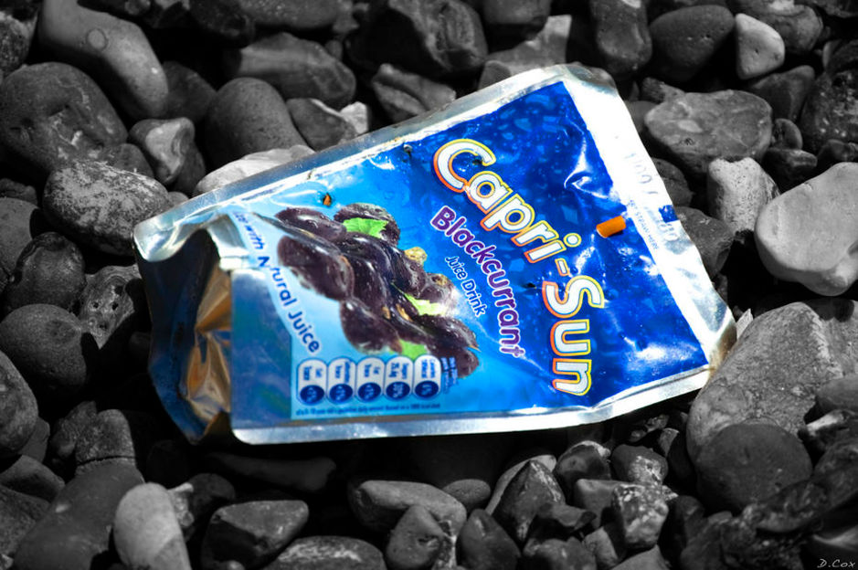
Plastic goes into the ocean.
http://www.psmag.com/nature-and-technology/consumers-love-squeezable-plastic-pouches-for-foodtoo-bad-recyclers-hate-them
www.telegraph.co.uk

Slide 4
Plastic breaks up into little pieces.
www.theguardian.com
www.fauna-flora.org

Slide 5
Animals can eat the plastic.
www.hercampus.com
http://news.discovery.com/earth/the-immense-scale-of-ocean-plastics.htm

Slide 6
Animals can get caught up in the plastic.
www.hercampus.com
http://news.discovery.com/earth/the-immense-scale-of-ocean-plastics.htm
margaretmunro.wordpress.com

Slide 7
Animals can die.
https://www.pinterest.com/bewusterzijn/zwerf-afval/
www.seathos.org

Slide 8
How much plastic is in the ocean?
It is estimated that there is 315 billion pounds of plastic in the ocean.
That’s a BIG number!
315,000,000,000

Slide 9
Where is this plastic floating?
www.dailymail.co.uk

Slide 10
What is your solution to the problem of having plastic in the ocean?
Draw
Picture of how we can clean up our oceans.

Slide 11
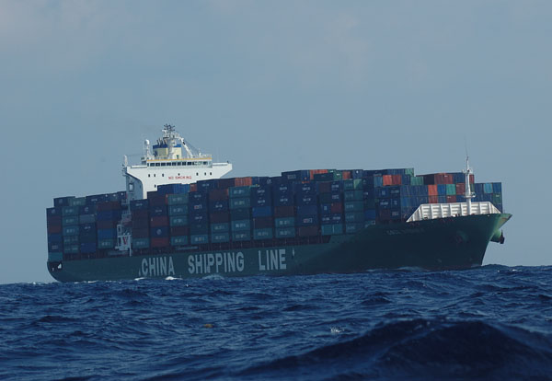
Did you draw a ship?
Remember that BIG number?
You'd need 630 big ships with nets to collect all of the plastic in the ocean.
315,000,000,000
pounds of plastic
630 ships the size of this one
www.alaska-in-pictures.com
www.southfloridabirding.com

Slide 12
Did you draw a picture of people collecting the plastic in bags?
johnsonohana.org
www.maritime-executive.com

Slide 13
Did you draw a machine that could take the plastic out of the ocean?
https://www.youtube.com/watch?v=ROW9F-c0kIQ
Notes:
The boy at the right is the inventor Boyan Slat. The video at the YouTube address is very interesting for older students.
The link is given in the credits above. It is also listed in the Sources section of the lesson plan.

Slide 14
Did you make laws to keep people from putting plastic in the ocean?
sni.scholastic.com
quotesgram.com

Slide 15
Did you come up with a way to recycle the plastic?
http://www.takepart.com/article/2015/12/12/adidas-ocean-plastic
http://www.elkharttruth.com/news/michigan/2016/01/11/Detroit-school-creates-art-as-part-of-earth-friendly-efforts.html

Slide 16
Did you come up with a way to recycle the plastic?
www.demilked.com
https://www.plasticsmakeitpossible.com/plastics-at-home/home-garden/home-improvement/low-maintenance-plastic-composite-decking-for-your-home/
Play this video
https://www.plasticsmakeitpossible.com/plastics-at-home/home-garden/interior-design-decor/sustainable-plastic-furniture-at-dwell-on-design/

Slide 17
Other Ideas?
www.djgelner.com

Slide 18
Writing Assignment
What do you know about plastic in the ocean? How we can we fix this problem?

