Slide 1
Wonders of the World: Exploring Living Creatures Classification Activity

Slide 2
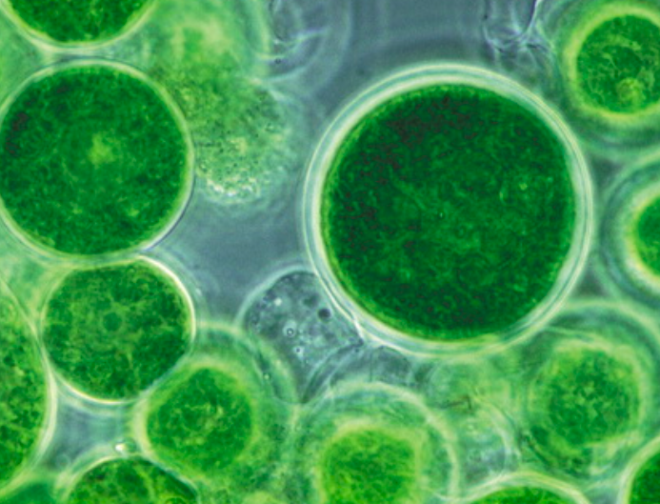
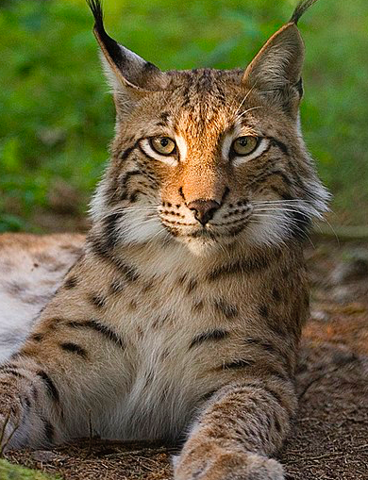
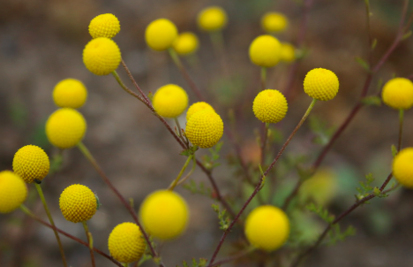
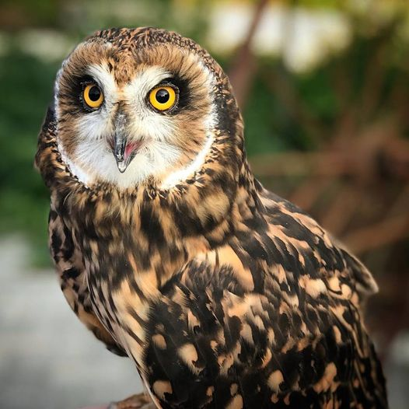
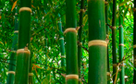
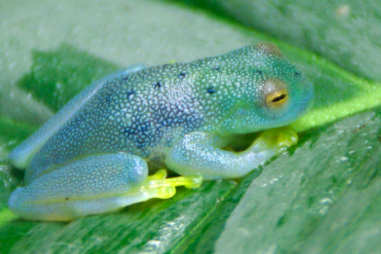
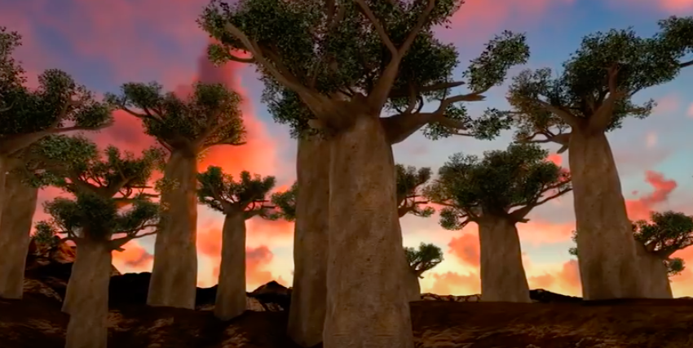
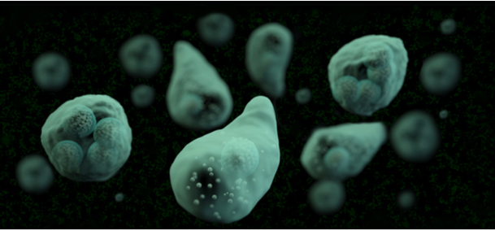
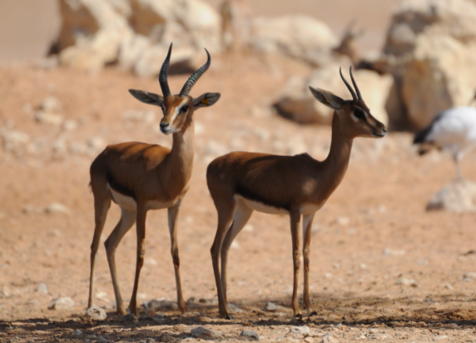
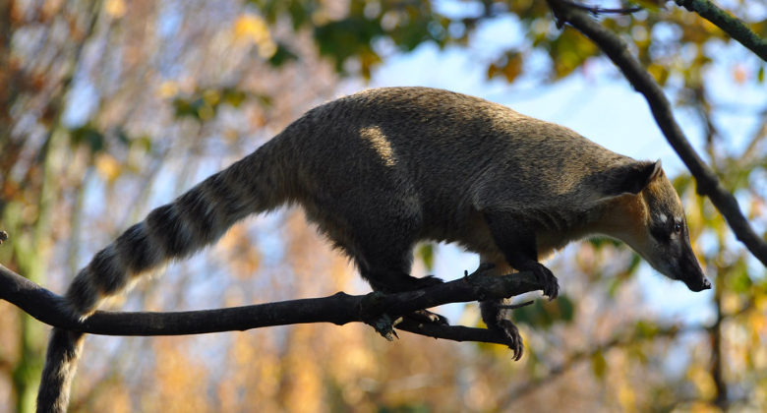
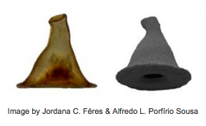
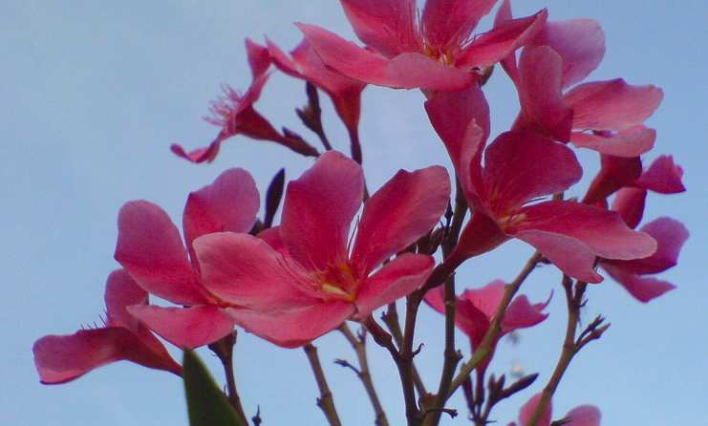
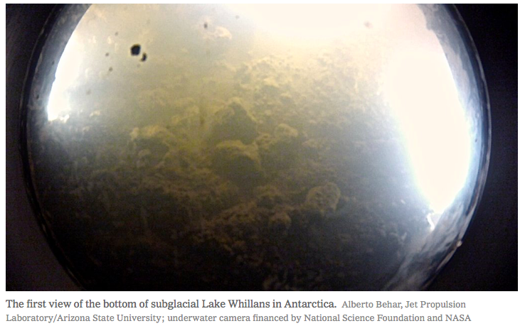

Slide 3
Wonders of the World Map Classification Worksheet
Organism Name and Image | Where is it found? (continent, country, or area) | Unicellular or Multicellular | Micro- or Macro- Organism | Autotroph or Heterotroph | Carnivore, Herbivore, Omnivore, or NA
Stinknet or Globe Chamomile plant | the Americas, North America, United States, Arizona | Multicellular | Macro-Organism | Autotroph | NA

Slide 4
Wonders of the World Map Classification Worksheet
Organism Name and Photo Description | Where is it found? (continent, country, or area) | Unicellular or Multicellular | Micro- or Macro- Organism | Autotroph or Heterotroph | Carnivore, Herbivore, Omnivore, or NA

Slide 5
Wonders of the World Map Classification Worksheet
Organism Name and Photo Description | Where is it found? (continent, country, or area) | Unicellular or Multicellular | Micro- or Macro- Organism | Autotroph or Heterotroph | Carnivore, Herbivore, Omnivore, or NA

Slide 6
Wonders of the World Map Classification Worksheet
Organism Name and Photo Description | Where is it found? (continent, country, or area) | Unicellular or Multicellular | Micro- or Macro- Organism | Autotroph or Heterotroph | Carnivore, Herbivore, Omnivore, or NA

