Slide 1
Wonders of the World: Exploring Living Creatures
Lesson PowerPoint

Slide 2
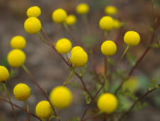
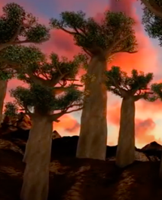
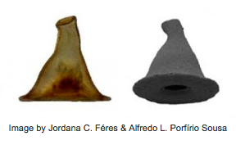
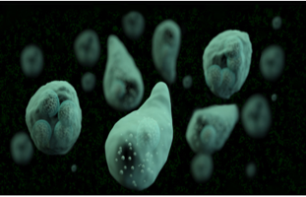
Characteristics of Living Things
Made of Cells
Need Energy to Survive
Respond to Stimuli
Reproduce
Respiration
Movement
Grow and Develop
Remove Waste
Maintain Homeostasis
Genetic Material
Adapt
Evolve

Slide 3
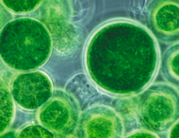
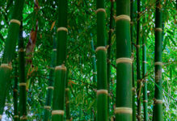
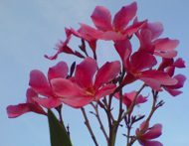
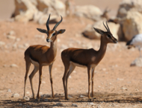
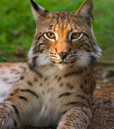
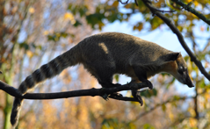
Classification List
Autotroph:
Organisms that obtain their energy from solar energy.
Photosynthesis
Ex. algae, plants, trees.
Heterotroph:
Organisms that obtain their energy from their environment.
Herbivores, Carnivores, Omnivores.

Slide 4
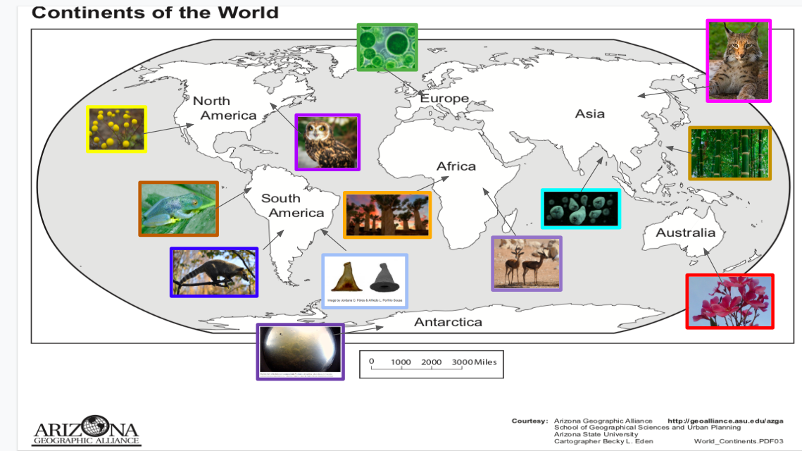

Slide 5
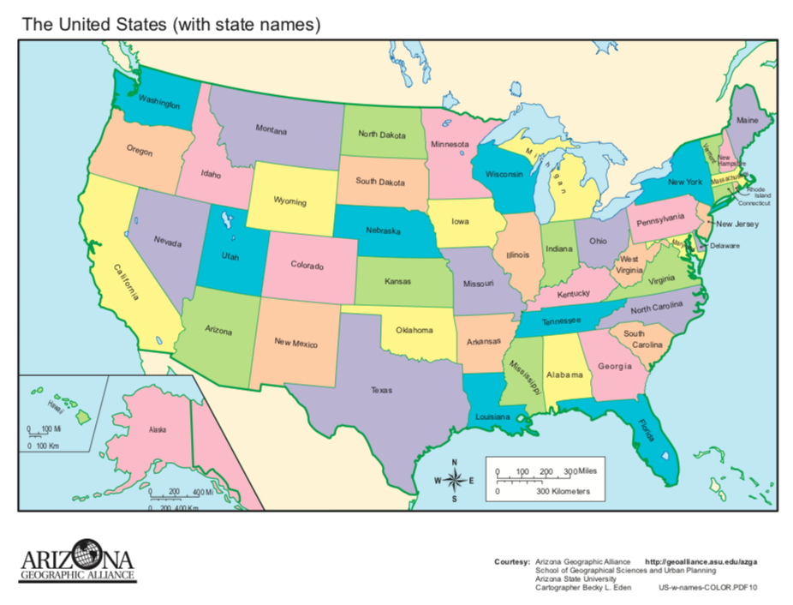
United States of America
In North America, the USA is a country with 50 states, a diverse flora and fauna. Many plants and animals.
What a Wonder!

Slide 6
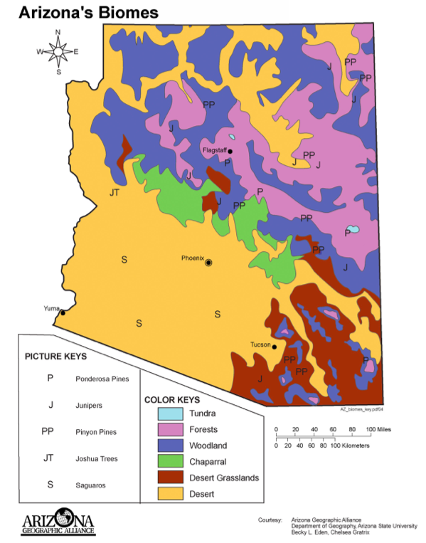
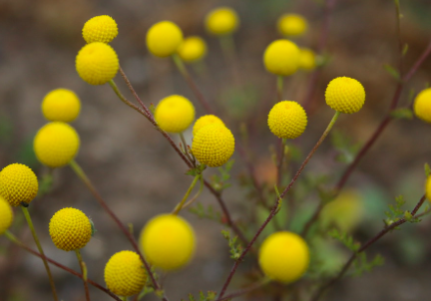
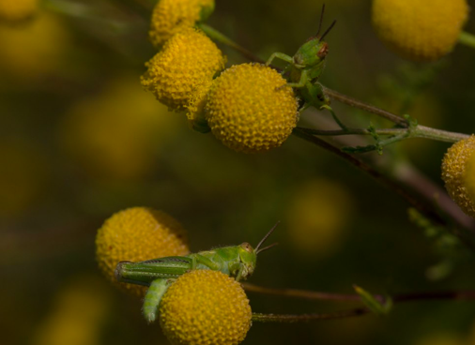
Stinknet or Globe Chamomile
Arizona has wonderful biomes. Stinknet or Globe Chamomile is a beautiful yellow flower.
Stinknet Reading

Slide 7
Wonders of the World
-Let’s do one together, Stinknet or Globe Chamomile
-Use the 3-2-1 Strategy
ONE photograph or drawing of the organism
TWO geographical points where the organism is located
THREE characteristics or adaptations of the organism
(1- ONE) Name of Organism Photograph or Drawing | (2- TWO) Geographical Points where it is located (Water or Land and Continent, Country, or Area)
(3-THREE) Characteristics or Adaptations of the organism that are unique for their survival.

Slide 8
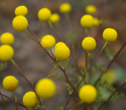
Wonders of the World
-Let’s do one together, Stinknet or Globe Chamomile
-Use the 3-2-1 Strategy
ONE photograph or drawing of the organism,
TWO geographical points where the organism is located,
THREE characteristics or adaptations of the organism
(1- ONE) Name of Organism Photograph or Drawing | (2- TWO) Geographical Points where it is located (Water or Land and Continent, Country, or Area)
Stinknet or Globe Chamomile, plant | The Americas, North America, United States, Arizona
(3-THREE) Characteristics or Adaptations of the organism that are unique for their survival.
Multicellular, Macro organism, Autotroph Grows and invades (takes over space from other plants). Has a bad taste so animals do not eat it.

Slide 9
Directions for World Classification Worksheet
Using the Wonders of the World Map, click on 1-2 images to learn about these organisms.
Classify the organisms by common name, a brief description of what they are, and an illustration of each
Identify where the organisms are found? Water or Land and Continent, Country, or Region
Describe the organisms as
  Unicellular or Multicellular
  Micro or Macro
  Autotroph or Heterotroph
  Carnivore, Herbivore, or Omnivore
You will be sharing your findings with the class. As others share their findings, you will complete the worksheet.

Slide 10
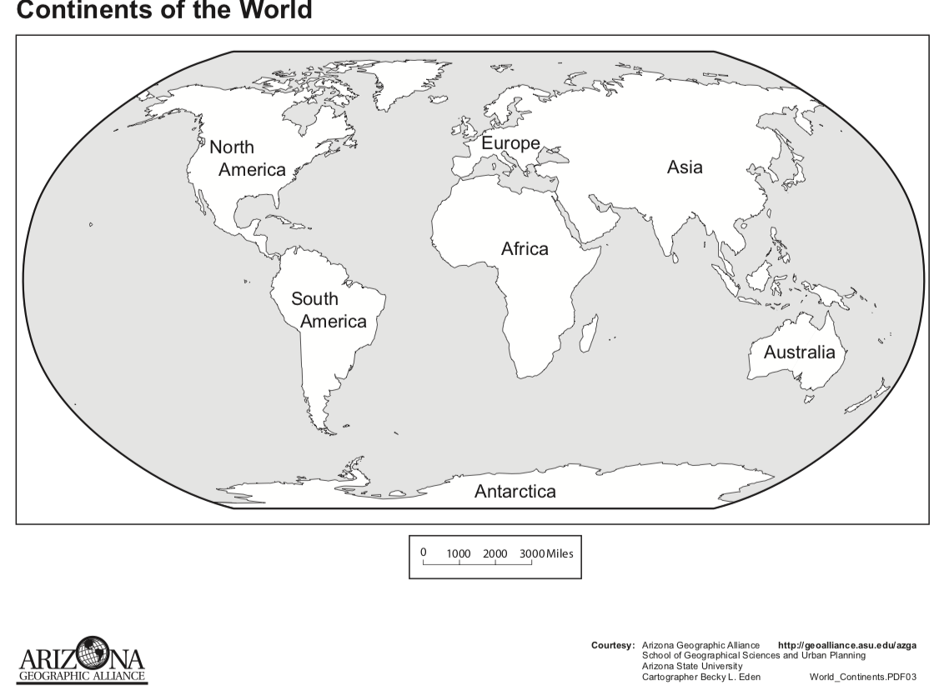

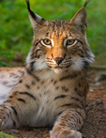












Slide 11

Wonders of the World Map Classification Worksheet
Organism Name, Plant or Animal, and Image or Illustration | Where is it found? (continent, country, or area) | Unicellular or Multicellular | Micro- or Macro- Organism | Autotroph or Heterotroph | Carnivore, Herbivore, Omnivore, or NA
Stinknet or Globe Chamomile plant | the Americas, North America, United States, Arizona | Multicellular | Macro-Organism | Autotroph | NA

Slide 12
Answers to World Map Classification Worksheet

Slide 13
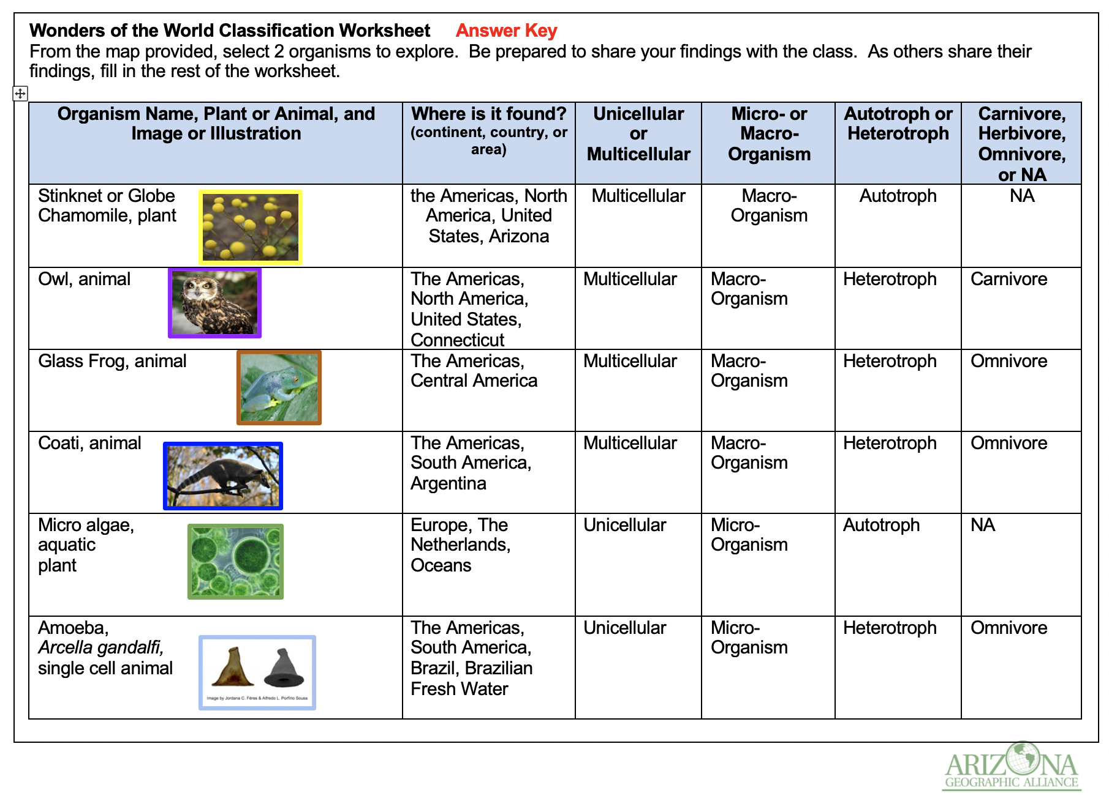
Wonders of the World Map Classification Worksheet Answer Key

Slide 14
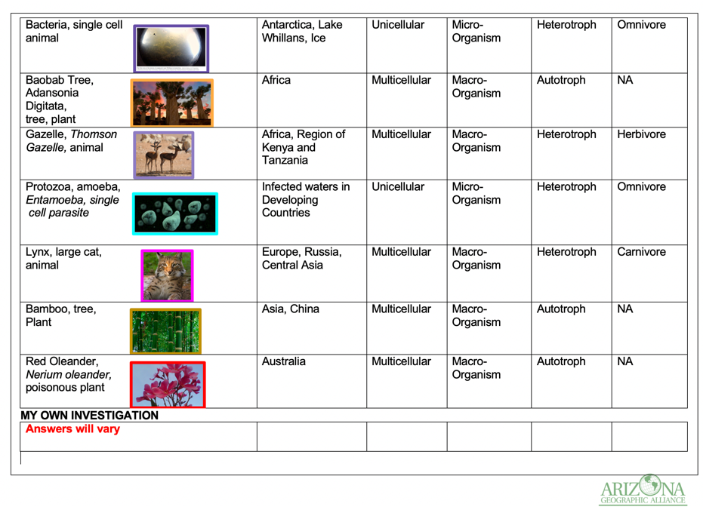
Wonders of the World Map Classification Worksheet Answer Key

