Slide 1
What is Geography? By Gale Olp Ekiss
Notes:
This presentation will discuss What is Geography from the perspective of the classroom teacher.
First, take a minute and jot down your definition of What is Geography.
Please do not use any books, dictionary, or the internet. What are some of your key ideas?

Slide 2
What is Geography?
MacMillian Dictionary: the study of the characteristics of particular places on the surface of the earth, and of all the physical and cultural factors affecting these characteristics
Notes:
If we look at a middle school level definition, you will see that a definition of geography
will include the terms of places on Earth.
It divides the world into two realms: physical (created by nature like rivers, forests,
deserts) and cultural (created by humans like roads, cities, dams, windmills).
How does your definition compare to this one? Thumbs up or down?

Slide 3
What is Geography?
National Geographic Society: the science that deals with the earth and its life--especially descriptions of land, sea, air, and the descriptions of plant and animal life including man and his industries with reference to the mutual relations of these diverse elements
Notes:
The definition from National Geographic Society was created for
well-schooled individuals. So you can see from their definition, we
have raised the level of understanding. Did your definition include
science, land, sea, air, plants, animals, and man and his industries?
Thumbs up, thumbs down.

Slide 4
What is Geography?
Pat Gober, Past-President of Association of American Geographers: Geography is more than a repository of place facts. It encompasses the dynamic interactions that give character to places, the spatial organization of human activity and natural processes on the surface of the Earth, and the influence that places have on a wide range of natural and human events.
Notes:
Pat Gober is an emeritus Professor of Geography at ASU.
I like Pat Gober’s definition because it clarifies that geography
is NOT factoids: the highest mountains, the longest rivers,
capitals of nations, etc. Many of you may have had a teacher
that made geography a game of where is this located…like a
Jeopardy game with one-word answers. Don’t be that teacher.
Instead, it is the spatial organization of human activity and
natural processes on Earth. Take notice of the
word “spatial.” This is super important. And I will explain
spatial next

Slide 5
What is Geography?
College Textbook: study of the interaction of all physical and human phenomena at individual places and of how interactions among places form patterns and organize space
Notes:
The college textbook brings in the idea of what is spatial thinking.
Geography looks at patterns and how space is organized.
The patterns can be in natural processes (where volcanoes are
formed) or in human activity (where people will migrate to in the
next century). Look at your room right now. How is it organized?
Is there storage in a certain spot? Is there technology in
a central area? Is there a sitting area? How is the space of your
room organized? Geographers do this for the world. How
were these landforms created? Why do these cultures hold
certain beliefs? Where can we use renewable resources to
improve our world? For the next set of slides, we will look
at spatial thinking. What patterns do we see, and how is
our world organized? If I say 1 billion people, what
image comes to mind? Do you see lots of people or
do you see regions of the world or something else entirely?

Slide 6
1,000,000,000 people
Notes:
What do you think of when I say 1 billion people?

Slide 7
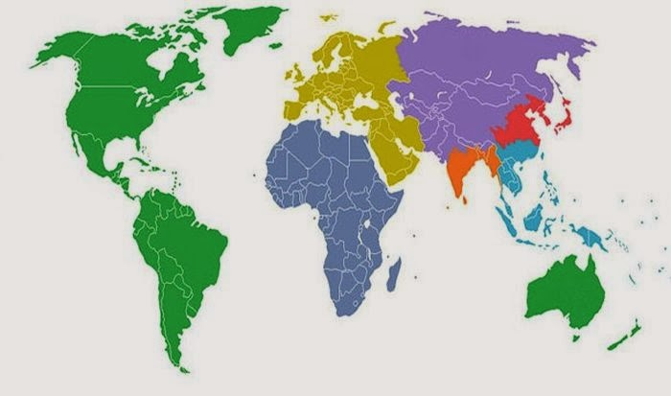
Each Color Equals 1 Billion People
Notes:
This is how a geographer might express 1B people.
What patterns do you see? It takes all of North America,
South America, Greenland, Iceland, Australia and New
Zealand to make 1B. While it is only part of Asia
to make 1B people.

Slide 8
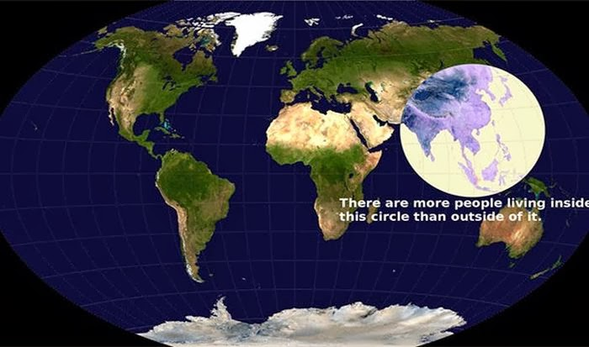
Where do People Live?
Notes:
Here is another way to look spatially at Earth’s population.

Slide 9
Joseph Kerski—works for ESRI (major GIS software company) & past president of NCGE
Why is it where?
The Whys of Where (10 min)
https://www.youtube.com/watch?v=cBEPZ1Yoirg
Notes:
Joseph Kerski has coined the phrase to remind us
of spatial thinking: Why is it where?
To ask this question is to dig deeper and look for patterns.
He has a TED talk that might interest you at the link given.

Slide 10
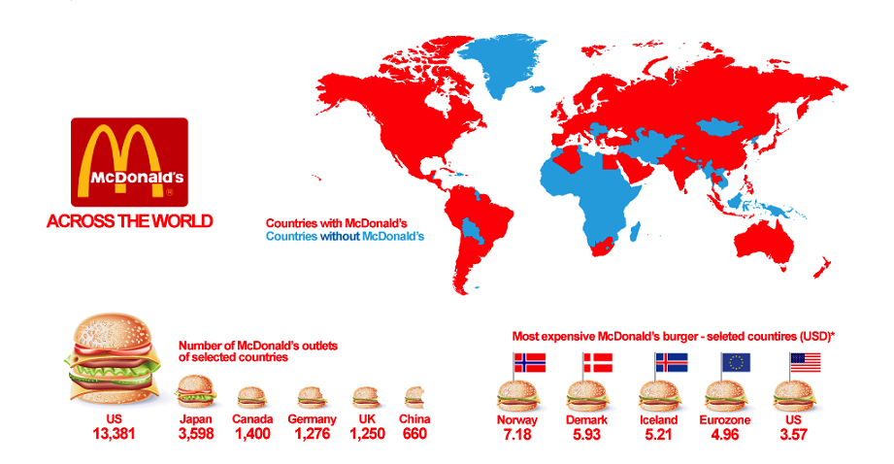
Countries with and without McDonalds
Notes:
Why do 232 countries not have McDonalds?
(Vegetarians? Hate hamburgers? Don’t eat beef?)
More likely the answer is McDonalds are found where
people have enough extra income to buy restaurant food
or where there is enough population to support the business.
Now you are spatially analyzing the world by economic
or population factors.
For the next slide, think of the Mississippi River.
Where does it flow? Where does it get its water?

Slide 11
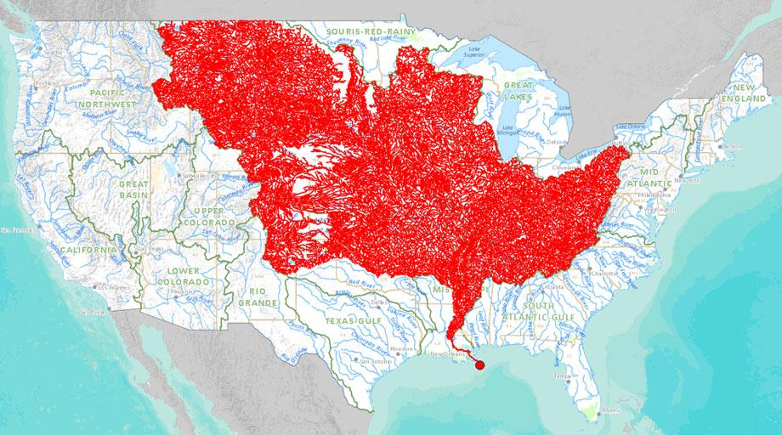
Rivers that Feed into the Mississippi River
Notes:
Are you surprised? A look at our physical world shows
that all of these rivers flow into the Mississippi River.
That is a huge part of the U.S. river systems draining
into the Miss R. And why is the mouth (end of the river)
so narrow when there are so many tributaries feeding into it?

Slide 12
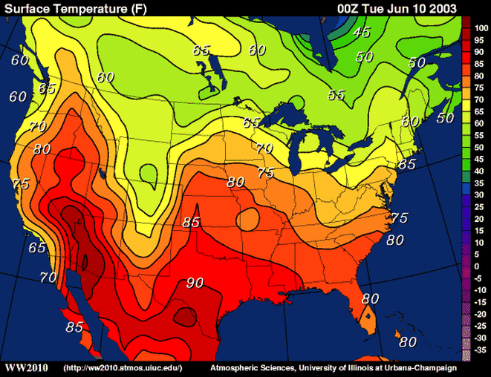
Temperature
Notes:
There is also a spatial pattern to weather and climate.
Look how the bars link similar temperatures and the
colors show the spatial pattern of hot and cold.

Slide 13
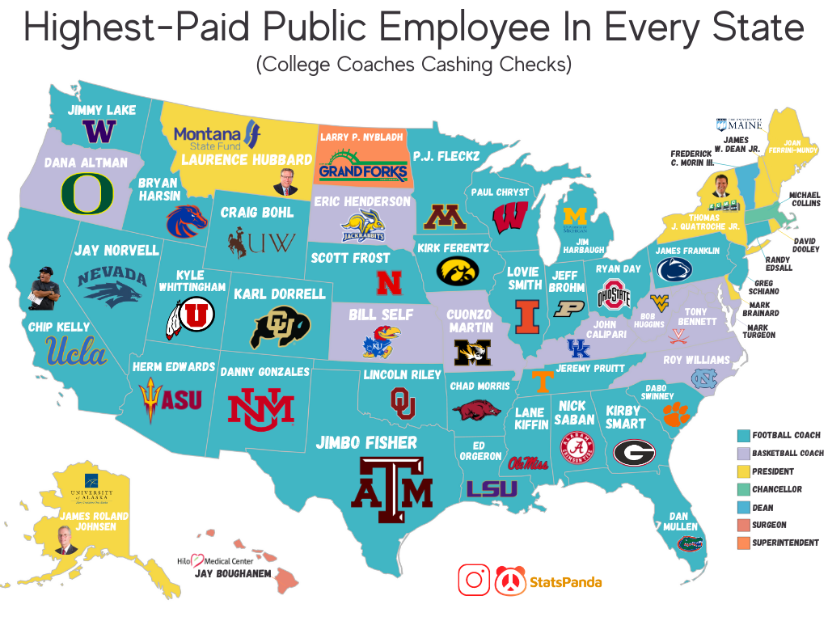
Highest Paid Public Employee
Notes:
And what does this say about American sports?
Only a few of the highest paid public employees are not coaches.
BTW, Herm Edwards salary is 3.5M according to Google.

Slide 14
What is Geography?
Junior High Textbook:
Geography is the study of earth and all of its variety.
Physical geography includes land, water, plants and animals.
Human geography includes where people live, how they live, how they change and are influenced by their environment and how different groups compare to one another.
Notes:
Geography really does encompass just about anything
you wish to teach. That is what makes the teaching
of geography so fun.

Slide 15
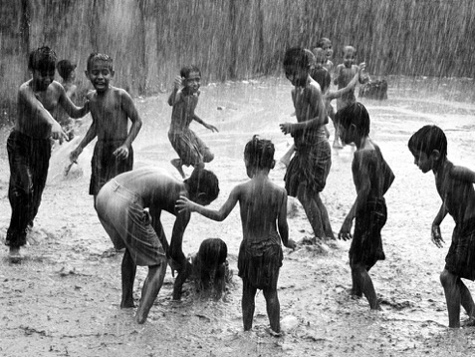
What is Geography?
Yi-Fu Tuan (1991)
“Geography is the study of Earth as the home of people.”
Notes:
This is an excellent definition to give students in grades K-2.

Slide 16
Three Dimensions to Geography
Geography Methods Human Geography
GIS-Cartography Economic
Field Studies Political
Statistics Cultural
Remote Sensing Historical
Demographics
Physical Geography
Climate
Plants and Animals
Geology
Land
Water
Notes:
There are three dimensions to geography.
Geography Methods are tools used by geographers.
So let’s clarify something. Maps are not geography.
Maps are a tool for understanding.
A map helps you understand concepts in a visual way.
I equate maps to a fork or spoon for eating.
They are often necessary to get the full pleasure out of a meal.
In order to understand the spatial distribution of something or
the need for change, a map might be necessary.
Traditionally, you find professional geographers divided into
Human Geographers or Physical Geographers. In the K-12
classroom, geography is usually taught in social studies and
science classes, but geography can be easily used to teach
other subjects especially reading and writing. In fact, a 2020
study by the Fordham Foundation shows that teaching more
social studies improves reading scores more than spending
more time in language arts classes.

Slide 17
Social Studies Instruction and Reading Comprehension: Evidence from the Early Childhood Longitudinal Study (Fordham Institute 2020) https://fordhaminstitute.org/national/resources/social-studies-instruction-and-reading-comprehension
Though surely well intended…spending extra time on teaching ELA may not yield much in the way of reading improvement.
Instead, elementary schools should consider making more room for high-quality instruction in history, civics, geography, and the other knowledge-rich—and engaging—subjects that comprise social studies.
A focus on academic content—not generalized reading skills and strategies—will equip students with the background knowledge they need to comprehend all sorts of texts and make them truly literate.

Slide 18
Why Study Geography?
to be a good traveler
to use the tools of geographers
to understand dominant characteristics of places
to be literate, “to know”
to make sense out of current events
to relate to other people
to link history, economics, civics, and geography together
Notes:
Geography is an important subject in a students” lives.
It can shape their patterns of behavior.
It can prepare students for the world of work.
It can enhance students’ economic well-being.
It can improve their reading ability.
And it allows students to see the connections between
school subjects and real life.

Slide 19
Photo Credits
Slide 6 https://www.zmescience.com/other/feature-post/worlds-14-maps/
Slide 7 https://slideplayer.com/slide/10721640/
Slide 8 https://www.reddit.com/r/MapPorn/comments/1pex6s/map_of_mcdonalds_around_the_world_769x577/
Slide 10 https://ww2010.atmos.uiuc.edu/
Slide11 https://www.reddit.com/r/MapPorn/comments/lnir2v/oc_the_highestpaid_public_employee_in_every_state/
Side 13 and 15 https://www.nationalgeographic.com/photography

