Slide 1
What If There Were No Trees?
How do people adapt to an environment where there are no trees?

Slide 2
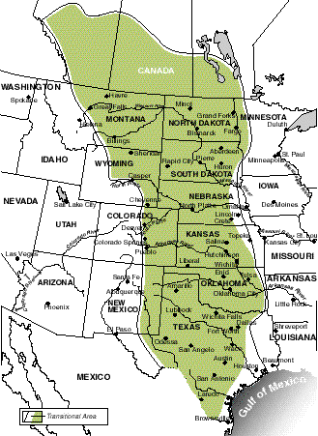
The Great Plains tribes of North America lived in a physical region known as a prairie.
www.usa.usembassy.de/etexts/outgeogr/map10
Notes:
www.usa.usembassy.de/etexts/outgeogr/map10
www.usa.usembassy.de/etexts/outgeogr/map10
www.usa.usembassy.de/etexts/outgeogr/map10

Slide 3
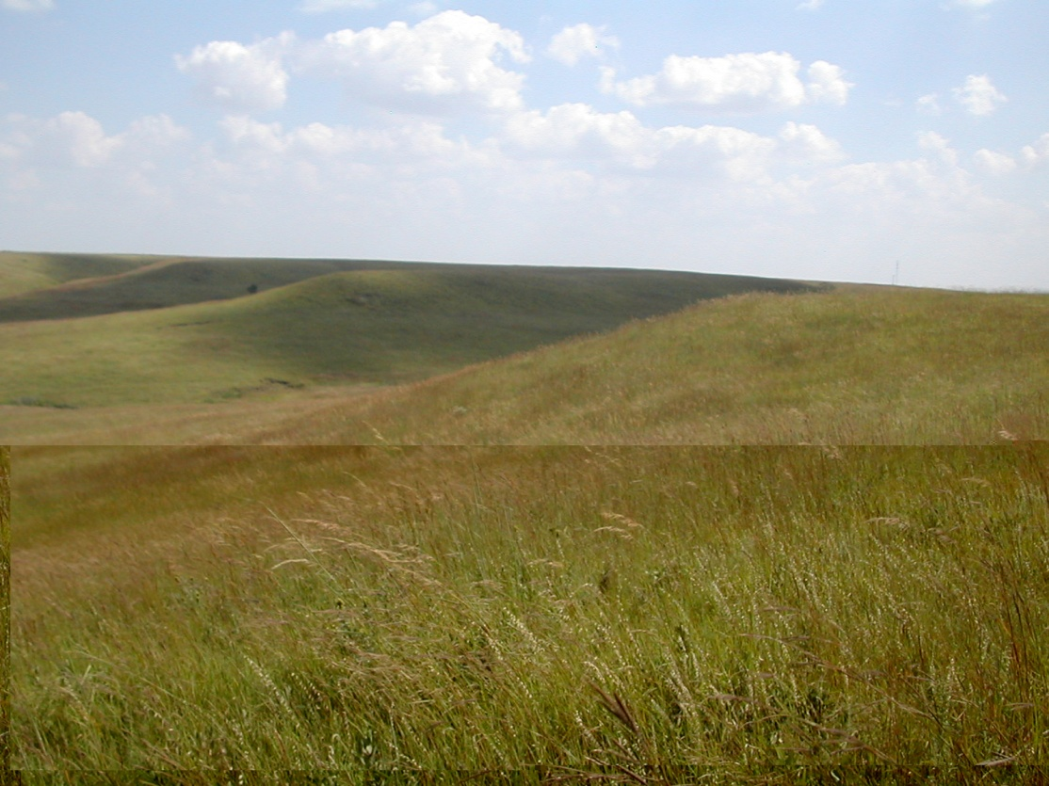
A prairie is a region of rolling hills and grassland with few trees except for along rivers and streams.
www.esa.org/tiee/vol/v5
Notes:
www.esa.org/tiee/vol/v5

Slide 4
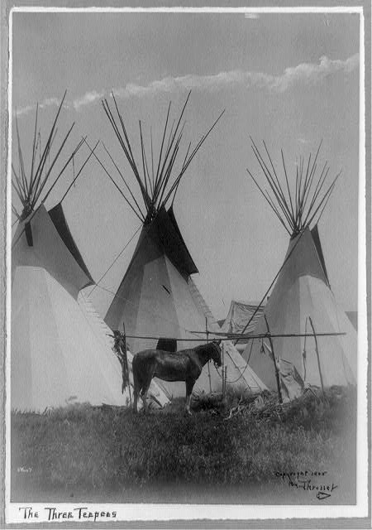
Many of these tribes built moveable shelters called a tipi. It was easily put up and taken down.
http://www.loc.gov/pictures/item/91481043/
Notes:
http://www.loc.gov/pictures/item/91481043/

Slide 5
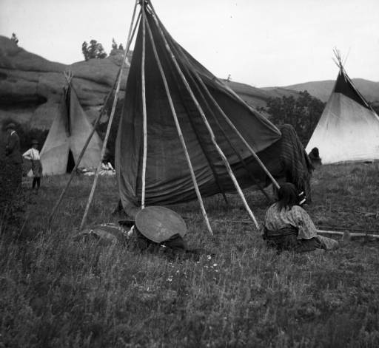
They were made of wooden poles leaned together and covered with buffalo hides. The interior floor was lined with animal furs with a fire pit in the center.
http://cdm15330.contentdm.oclc.org/u?/p15330coll22,22515
Notes:
http://cdm15330.contentdm.oclc.org/u?/p15330coll22,22515

Slide 6
The Plains Tribes main food source was the buffalo. However, they also hunted antelope, rabbit, and grouse.

Slide 7
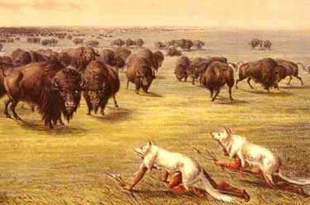
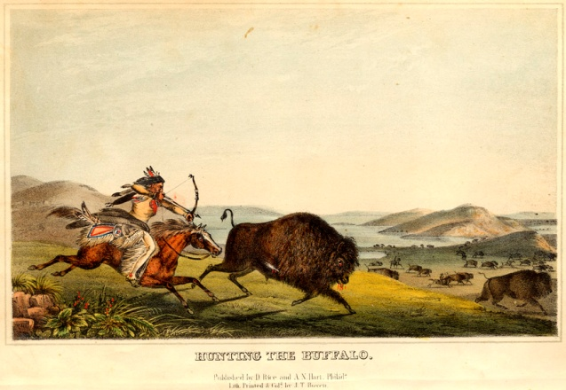
At first they hunted on foot. When the horse arrived, they used it.
www.depassejones.com/20/people-hunting-buffalo
www.allaboutshoes.ca
Notes:
www.depassejones.com/20/people-hunting-buffalo
www.allaboutshoes.ca

Slide 8
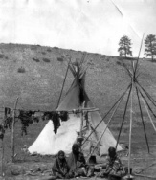
The meat was either cooked or dried for future use.
http://cdm15330.contentdm.oclc.org/u?/p15330coll22,38036
Notes:
http://cdm15330.contentdm.oclc.org/u?/p15330coll22,38036

Slide 9
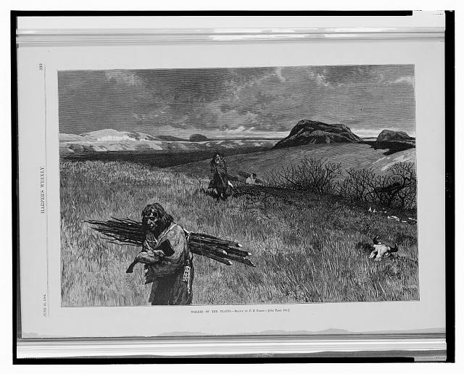
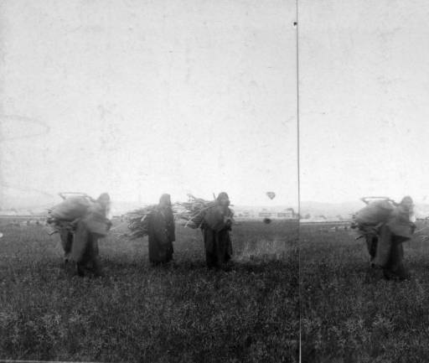
Buffalo dung was the main fuel source. Wood was gathered when available.
http://www.loc.gov/pictures/item/2003675414/
http://cdm15330.contentdm.oclc.org/u?/p15330coll22,27193
Notes:
http://www.loc.gov/pictures/item/2003675414/
http://cdm15330.contentdm.oclc.org/u?/p15330coll22,27193

Slide 10
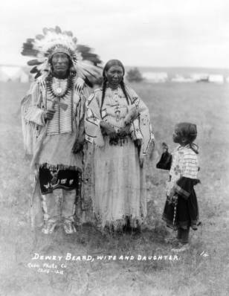
These tribes used buffalo and antelope hides to make clothes. They added feathers, animal fur, and glass beads for decoration.
http://cdm15330.contentdm.oclc.org/u?/p15330coll22,33194
Notes:
http://cdm15330.contentdm.oclc.org/u?/p15330coll22,33194

Slide 11
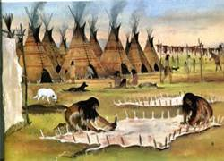
The hides were cleaned and stretched in the sun to tan them.
www.majesticview1.com/NAIDs/History.htm
Notes:
www.majesticview1.com/NAIDs/History.htm

Slide 12
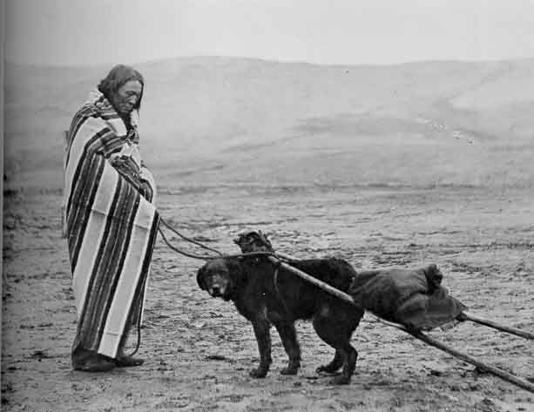
For transporation, they used a travois. This was a type of sled that a dog pulled. Later, horses were used.
www.Dfk9.wordpress.com/2010/12/11/the-travois
Notes:
www.Dfk9.wordpress.com/2010/12/11/the-travois

Slide 13
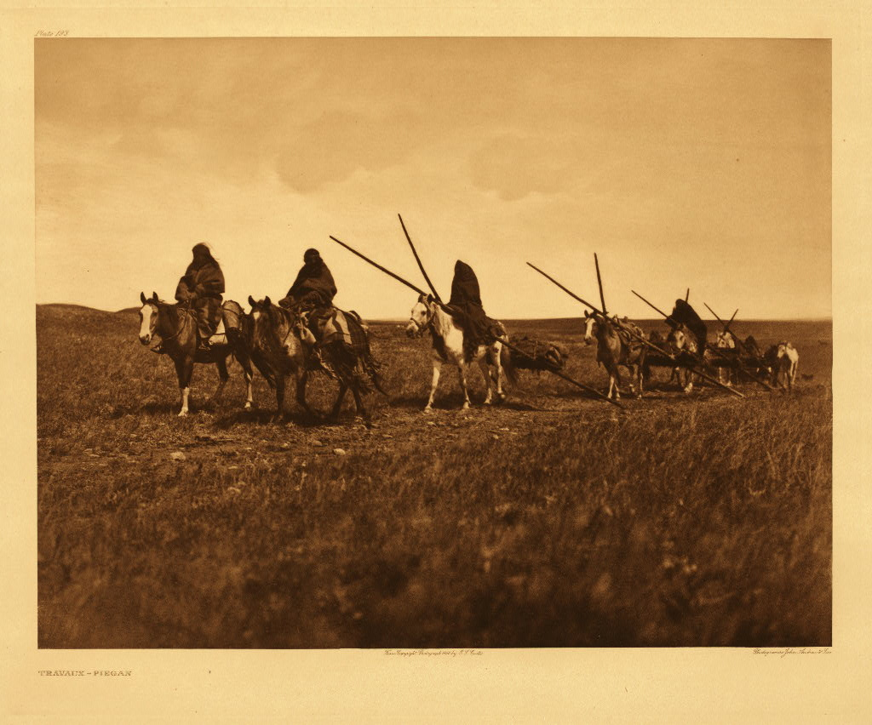
Travaux-Piegan (The North American Indian; v.06)
Notes:
Travaux-Piegan (The North American Indian; v.06)

Slide 14
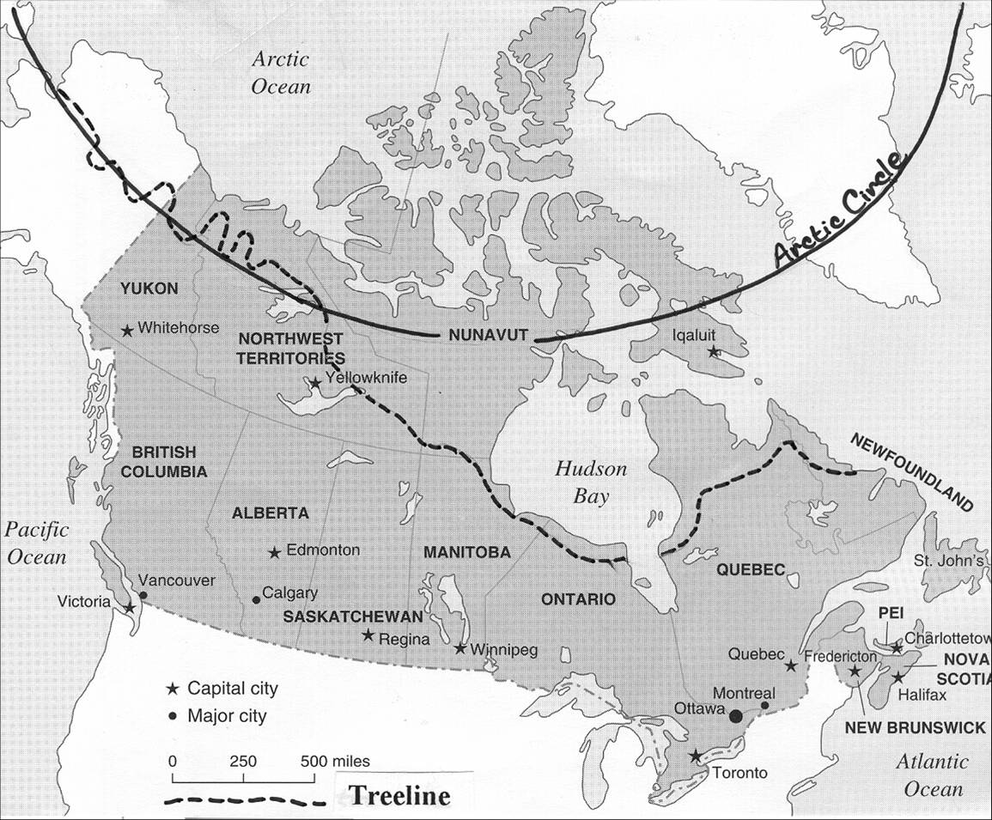
The Inuit live in Northern Canada above the tree line. They are the only people to live in such a place.
www.courses.washington.edu/polarnor/maps.shmtl
Notes:
www.courses.washington.edu/polarnor/maps.shmtl

Slide 15
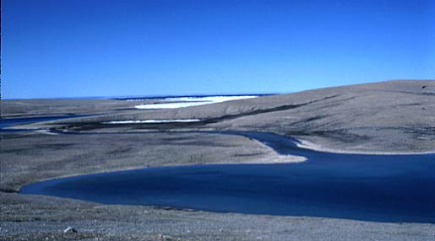
This is a land of no trees,
www.geography.ridley.on.ca
Notes:
www.geography.ridley.on.ca

Slide 16
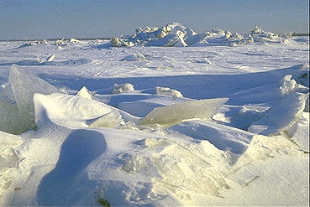
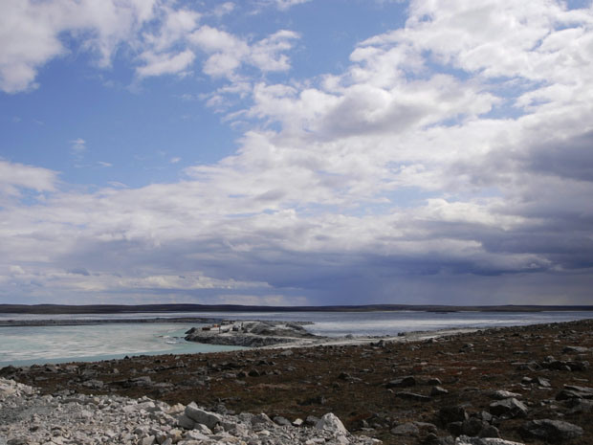
snow, ice, and water.
www.thecanadianencyclopedia.com
www.polarprince.com
Notes:
www.thecanadianencyclopedia.com
www.polarprince.com

Slide 17
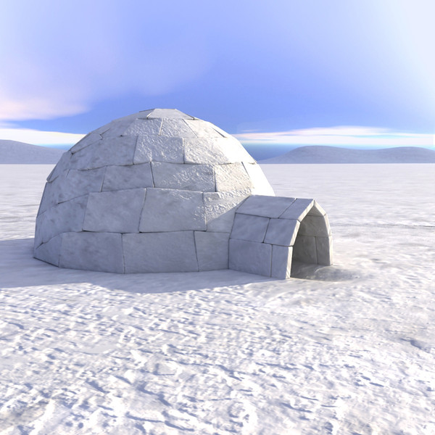
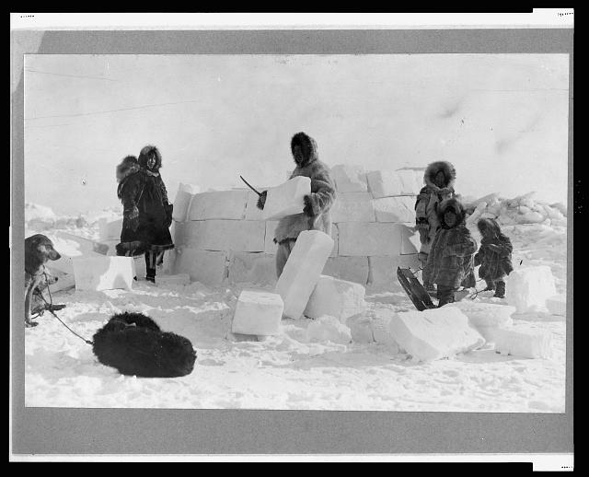
During the winter, the Inuit built shelters from blocks of snow called an igloo (iglu).
www.app-aid.com/cgi/eskimo-and-igloo
http://www.loc.gov/pitcures/item/2005691861/
Notes:
www.app-aid.com/cgi/eskimo-and-igloo
http://www.loc.gov/pitcures/item/2005691861/

Slide 18
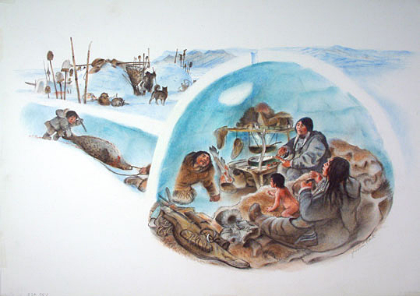
The interior was lined with animal hides and had a raised plaform for a fire.
www.frederickback.com/illutrateur/edition/media_igloo
Notes:
www.frederickback.com/illutrateur/edition/media_igloo

Slide 19
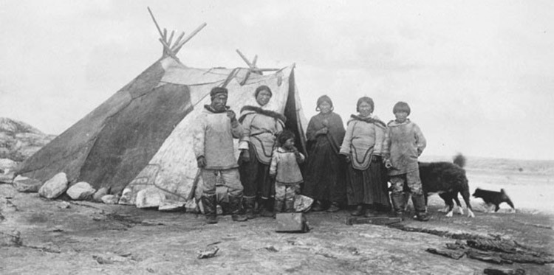
In the summer, they built tent homes called tupiq. They were a bone or drift wood frame covered with animal hides.
www.asapautorepair.net/images/inuit-tribe-homes
Notes:
www.asapautorepair.net/images/inuit-tribe-homes

Slide 20
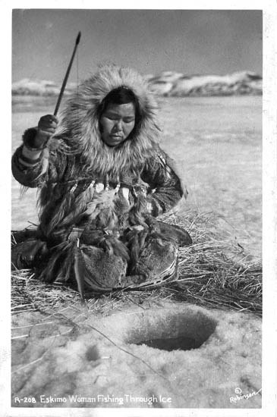
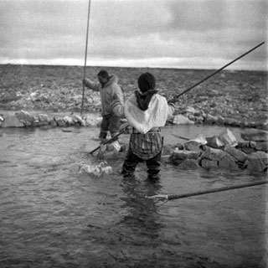
One way the Inuit got food was by fishing.
www.caperfrashers.wordpress.com
www.glenbow.org
Notes:
www.caperfrashers.wordpress.com
www.glenbow.org

Slide 21
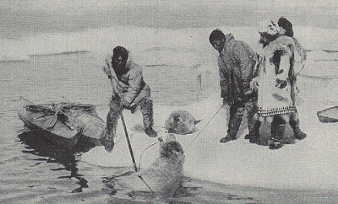
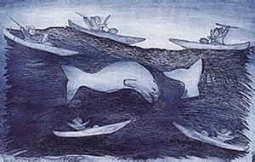
They also hunted seals, walrus, whales,
www.thesealofnam.org/seal-hunts
www.inmgroup.net/tivi/francais/catalog/c5_p2.html
Notes:
www.thesealofnam.org/seal-hunts
www.inmgroup.net/tivi/francais/catalog/c5_p2.html

Slide 22
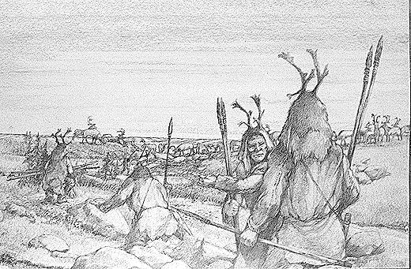
caribou, and foxes.
www.umanitoba.ca
Notes:
www.umanitoba.ca

Slide 23
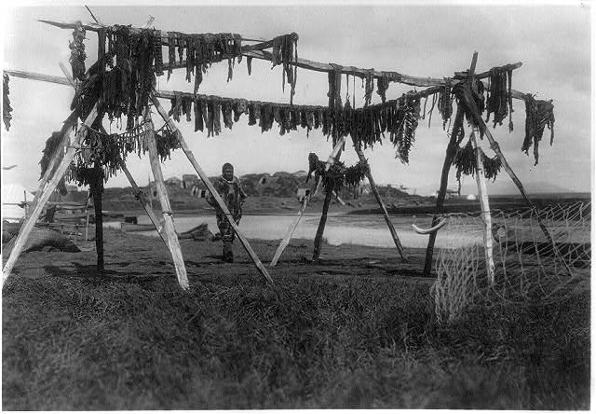
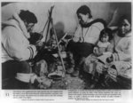
The Inuit ate their food raw, boiled it, or dried it for future use.
http://www.loc.gov/pictures/item/2006679127/
http://www.loc.gov/pictures/item/2004665525/
Notes:
http://www.loc.gov/pictures/item/2006679127/
http://www.loc.gov/pictures/item/2004665525/

Slide 24
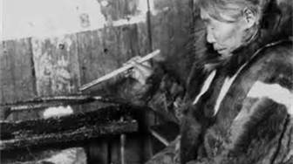
For fuel, they primarily used seal or whale oil. Drift wood and animal dung were also used when available.
www.thegoldensmith.blogspot.com
Notes:
www.thegoldensmith.blogspot.com

Slide 25
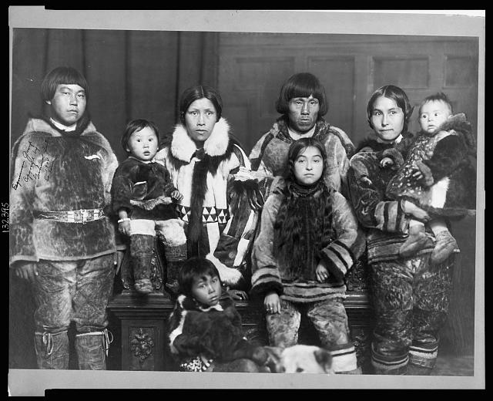
Inuit clothing was made of sealskin, caribou hide, and polar bear, fox, and wolf fur.
http://www.loc.gov/pictures/item/00652923/
Notes:
http://www.loc.gov/pictures/item/00652923/

Slide 26
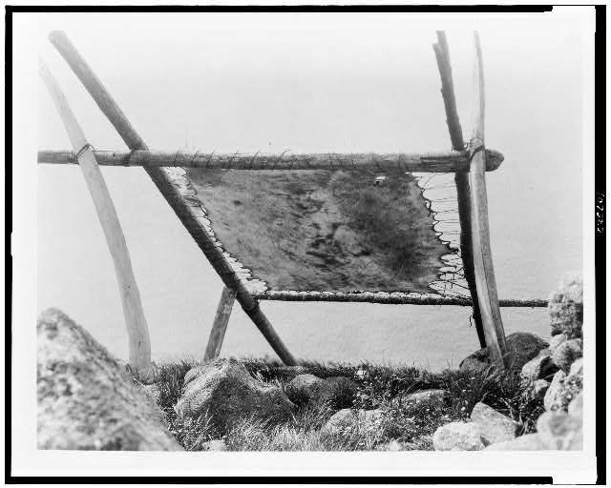
The hides were cleaned and stretched out to dry before using.
http://www.loc.gov/pictures/item/00652923
Notes:
http://www.loc.gov/pictures/item/00652923

Slide 27
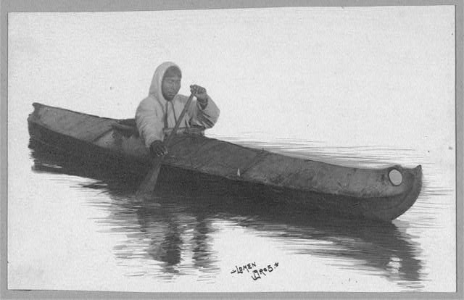
At sea, the Inuit used a kayak (qujaq), which they invented. It is made of sealskin over a drift wood or whale bone frame.
http://www.loc.gov/pictures/item/99615161/
Notes:
http://www.loc.gov/pictures/item/99615161/

Slide 28
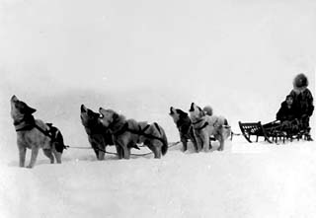
On land, they used the dog sled (qumutiq). It is also made of seal skin over a drift wood or whale bone frame.
www.snowlion.org/origins.html
Notes:
www.snowlion.org/origins.html

Slide 29
Now that you have seen how the Plains Tribes and the Inuit adapted to their treeless environment, how are they alike? How are they different?

