Slide 1
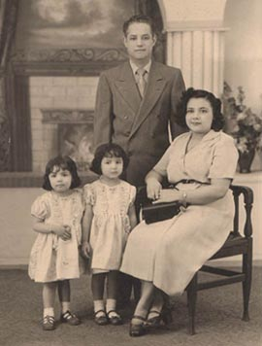
The Puerto Rican Experience
http://latinony.blogspot.com/2009_09_01_archive.html

Slide 2
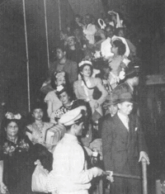
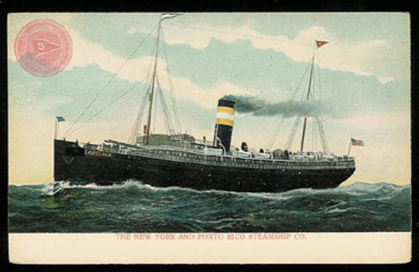
Coming to America
http://www.latinamericanstudies.org/pr-us.htm
The first Puerto Ricans arrived by ship. This was a long and expensive trip.

Slide 3
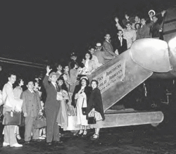
Later, airplanes made the trip quicker and less expensive.
https://www.linkedin.com/pulse/why-puerto-ricans-baby-boomers-coming-back-rico-daniel-ruiz-mba

Slide 4
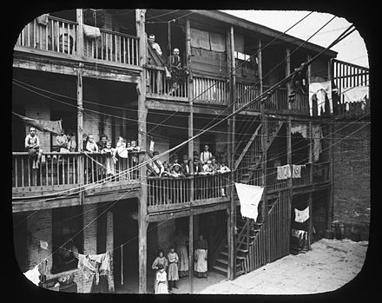
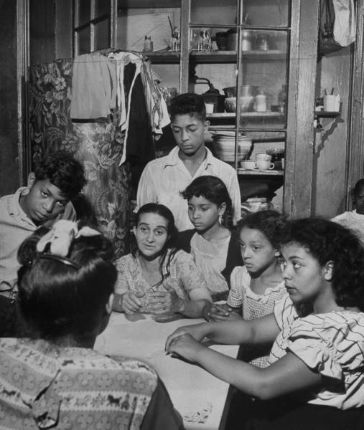
Many of the new arrivals settled in tenements, the only housing they could afford or that was available to them.
https://en.wikipedia.org
https://www.pinterest.com/pin/523332419170775123/

Slide 5
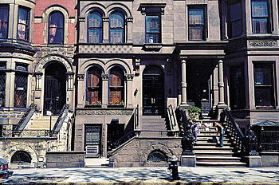
Wealthier Puerto Ricans moved into brownstone row houses.
https://jenfelton.wordpress.com/2011/08/

Slide 6
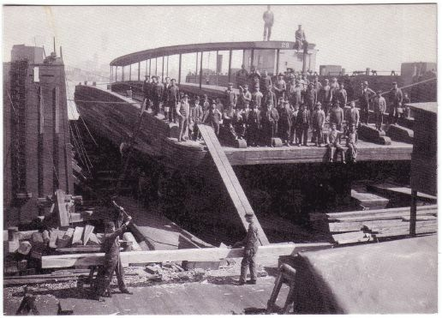
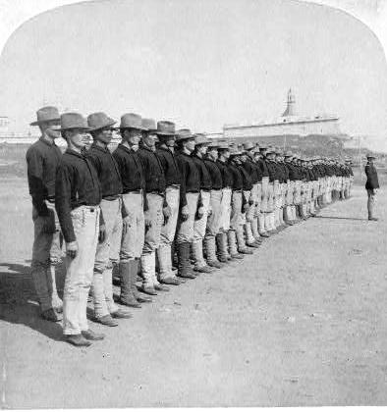
The next task was to find employment.
Men found work on the docks, in factories, or joined the military.
http://hoboken.pastperfectonline.com/byrelated?id=2B346BDD-72E5-4A57-8706-238956398440
http://latinbusinesstoday.com/tendencia/inspirational-latinos/2013/11/honor-and-fidelity-65th-infantry-regiment

Slide 7
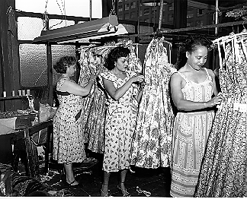
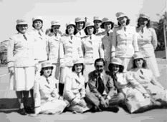
Women found work as domestics, in factories, or also joined the military.
http://americanhistory.si.edu/sweatshops/history/2t79.htm
https://www.nps.gov/heritageinitiatives/latino/latinothemestudy/military.htm

Slide 8
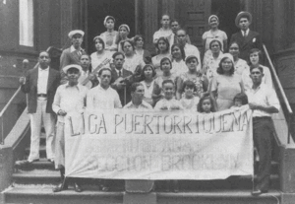
In time, Puerto Ricans created vibrant neighborhoods that reflected their culture.
http://www.latinamericanstudies.org/pr-us.htm

Slide 9
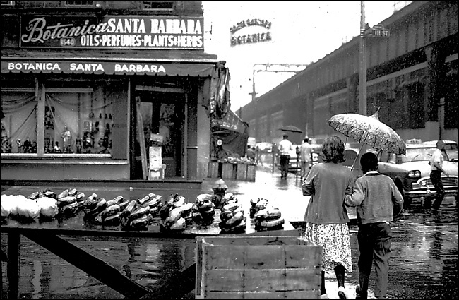
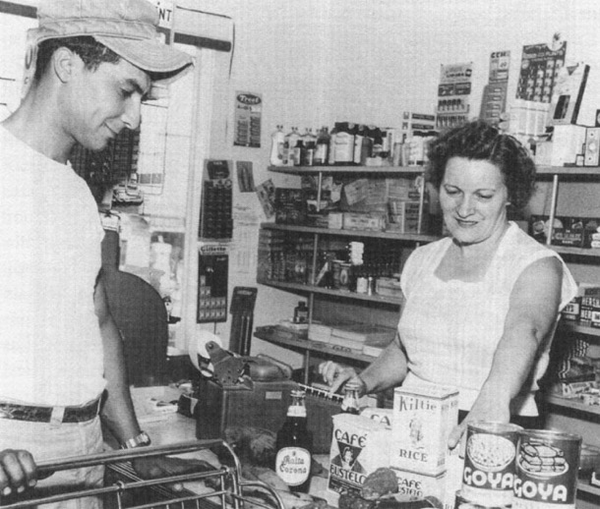
http://www.nytimes.com/slideshow/2005/04/19/arts/20050422_BARRIO_SLIDESHOW_4.html
http://www.latinamericanstudies.org/pr-us-1.htm

Slide 10
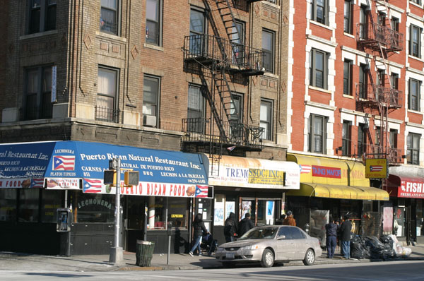

Slide 11

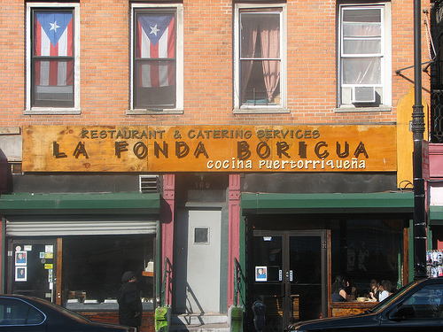
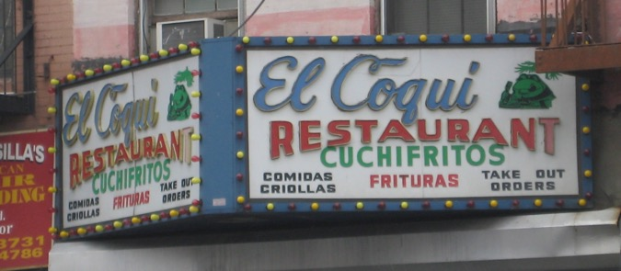
http://www.imagekind.com/art/stunning/boricua/artwork-on/fine-art-prints
http://www.latinamericanstudies.org/pr-us.htm
https://ephemeralnewyork.wordpress.com/tag/el-coqui-restaurant/

Slide 12
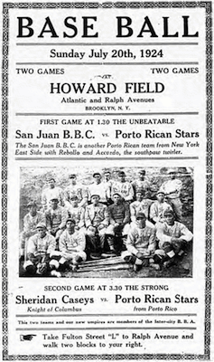
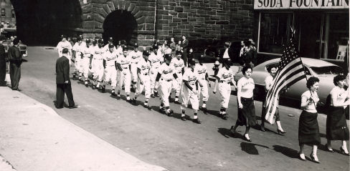
http://www.latinamericanstudies.org/pr-us.htm

Slide 13
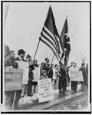
Throughout this experience, Puerto Ricans faced discrimination.
They protested and demanded their civil rights on many occasions.
https://www.loc.gov/teachers/classroommaterials/presentationsandactivities/presentations/immigration/cuban4.html

Slide 14
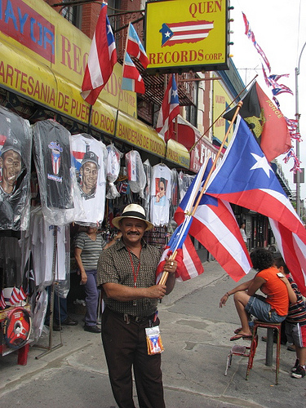
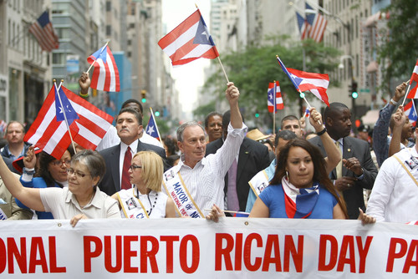
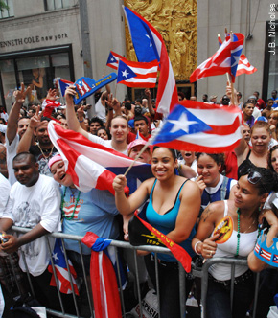
Today, Puerto Rican-Americans exhibit pride in their heritage
http://newyork.cbslocal.com/guide/a-guide-to-the-2011-puerto-rican-day-parade/

Slide 15
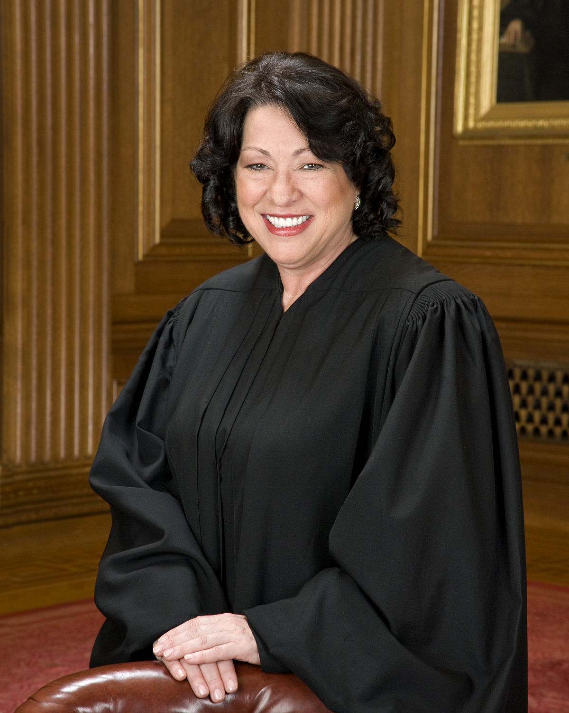
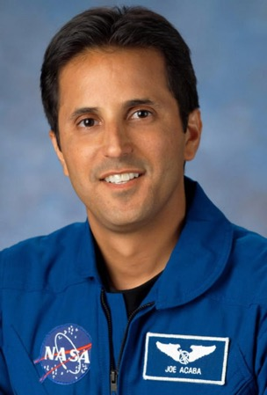
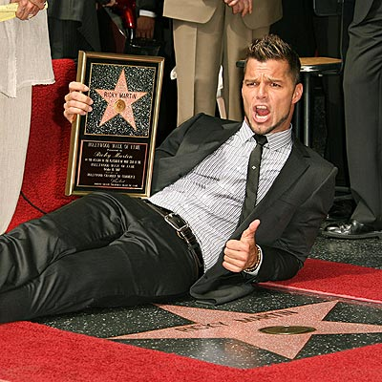
and enrich the United States.
https://en.wikipedia.org
https://www.nasa.gov/vision/space/preparingtravel/ascan_bio_acaba.html
http://puzzles-games.eu/puzzle-ricky-martin-195.html

