Slide 1
The Amazing Khmer
DENNIS Rees
Arizona Geographic Alliance Teacher-Consultant

Slide 2
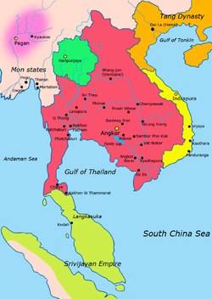
Map of Khmer Kingdom at its height
www.wikipedia.org
Notes:
www.wikipedia.org

Slide 3
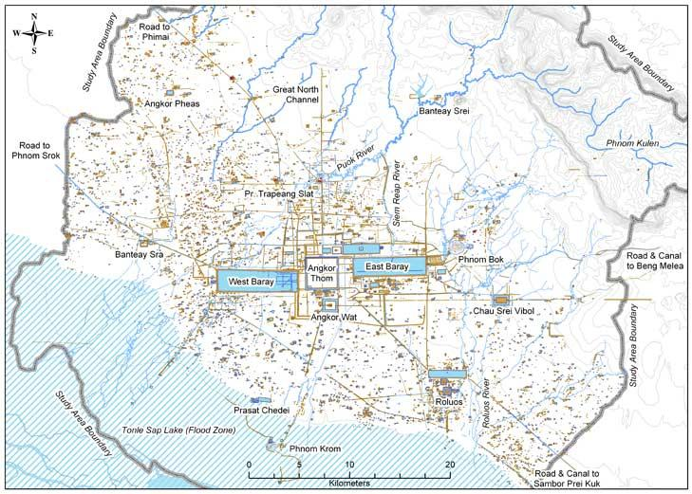
Map of the city of Angkor
www.treehugger.com
Notes:
www.treehugger.com

Slide 4
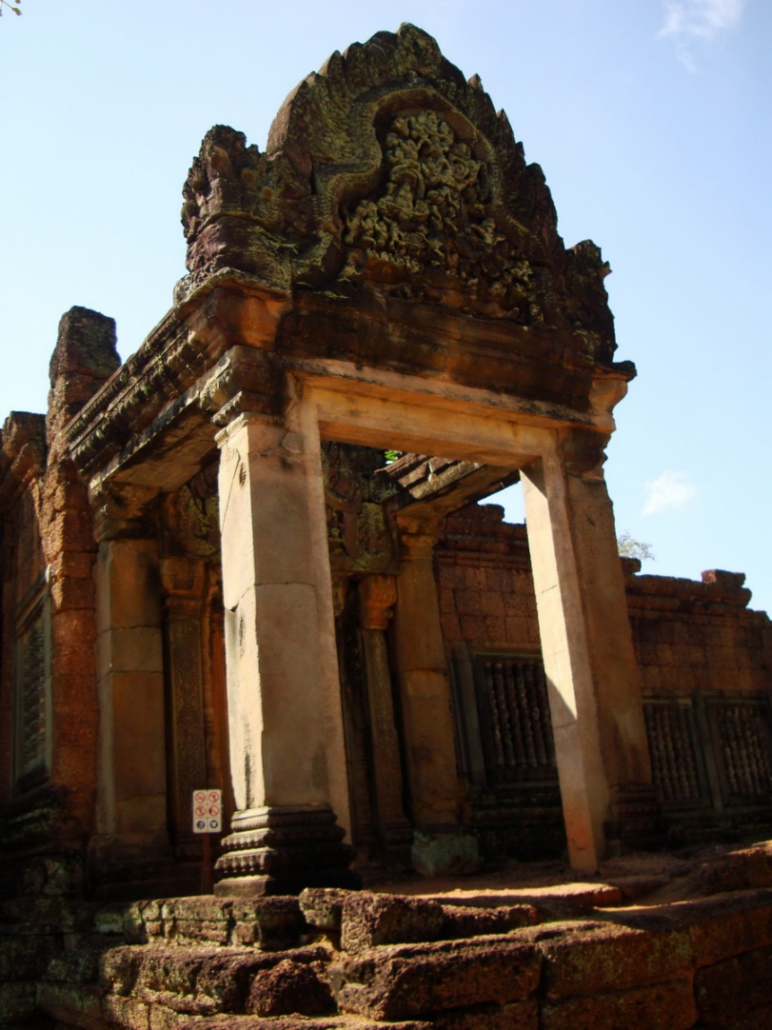
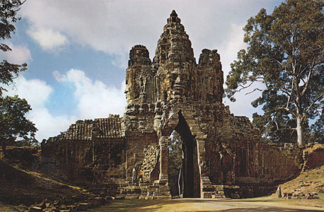
Examples of important buildings in Angkor
www.britannica.com
www.asiabiz.com
Notes:
www.asiabiz.com

Slide 5
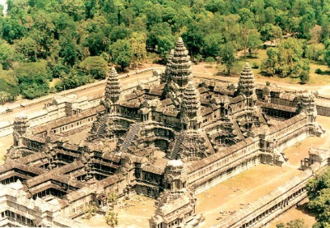
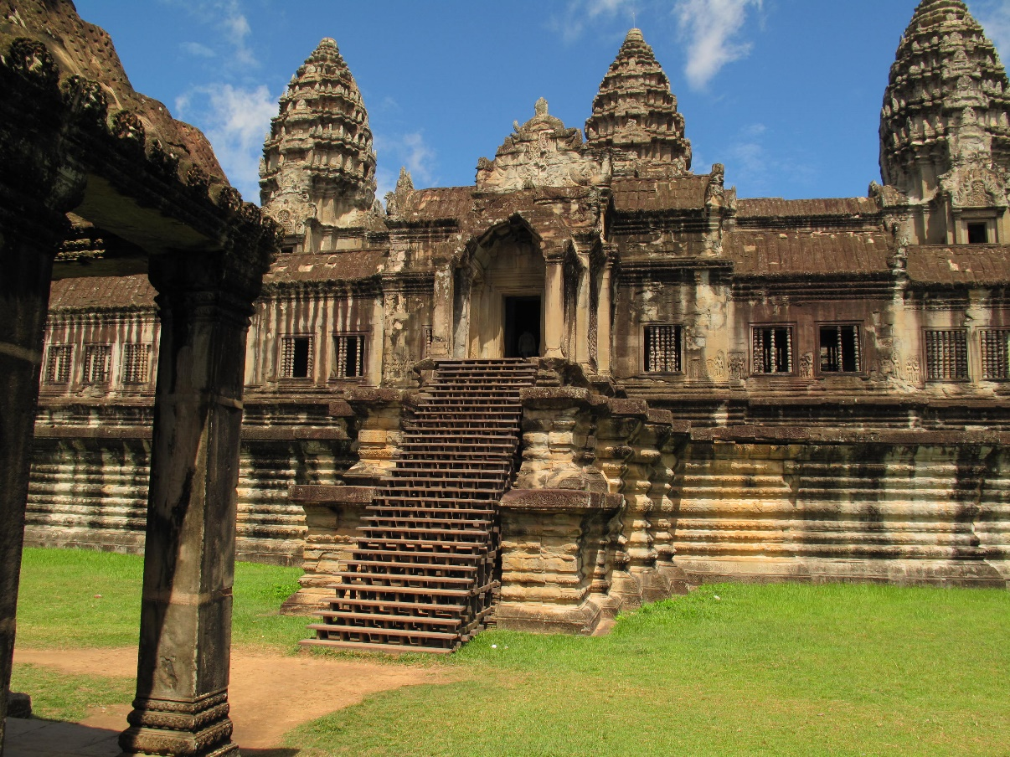
www.wallpapersinfo.blogspot.com
www.rajivawijesinha.wordpress.com
Notes:
www.rajivawijesinha.wordpress.com

Slide 6
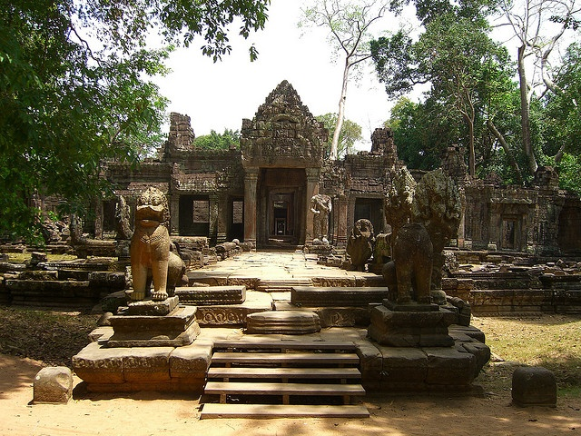
www.pinterest.com
Notes:
www.pinterest.com

Slide 7
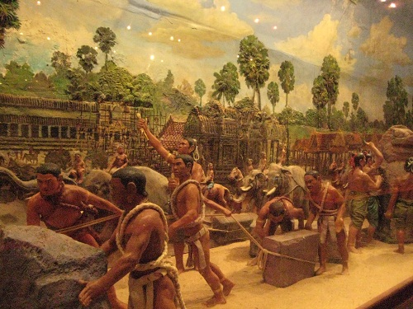
Moving stone blocks
www.phuonamstarcambodia.net
Notes:
www.phuonamstarcambodia.net

Slide 8
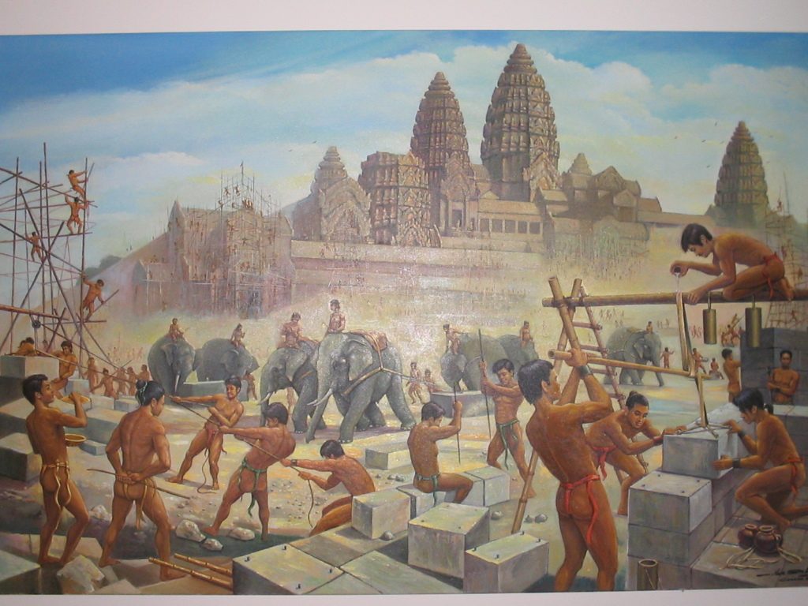
Construction techniques
www.freewebs.com
Notes:
www.freewebs.com

Slide 9
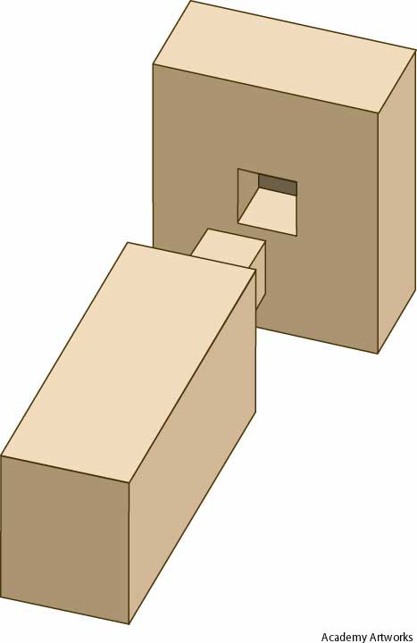
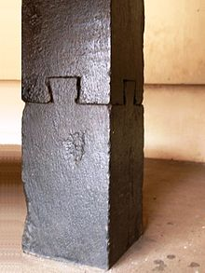
This is what a tenon and mortise joint looks like.
www.yourdictionary.com
www.wikipedia.org
Notes:
www.wikipedia.org

Slide 10
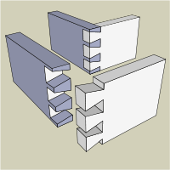
This is an example of a dovetail joint.
www.wikipedia.org
Notes:
www.wikipedia.org

Slide 11
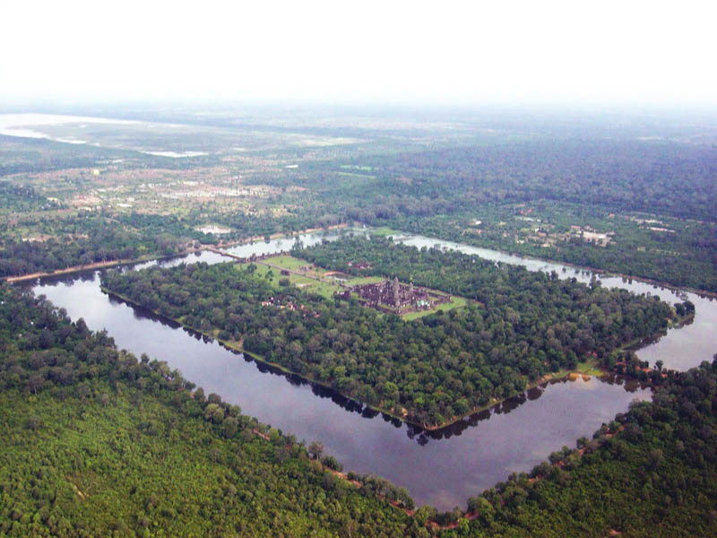
Temple moat
www.voyagerloin.com
Notes:
www.voyagerloin.com

Slide 12
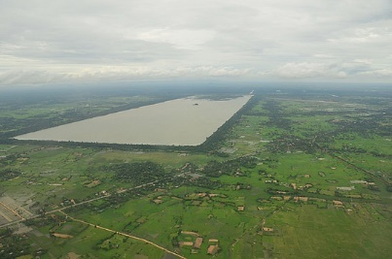
Baray
www.travelpod.com
Notes:
www.travelpod.com

