Slide 1
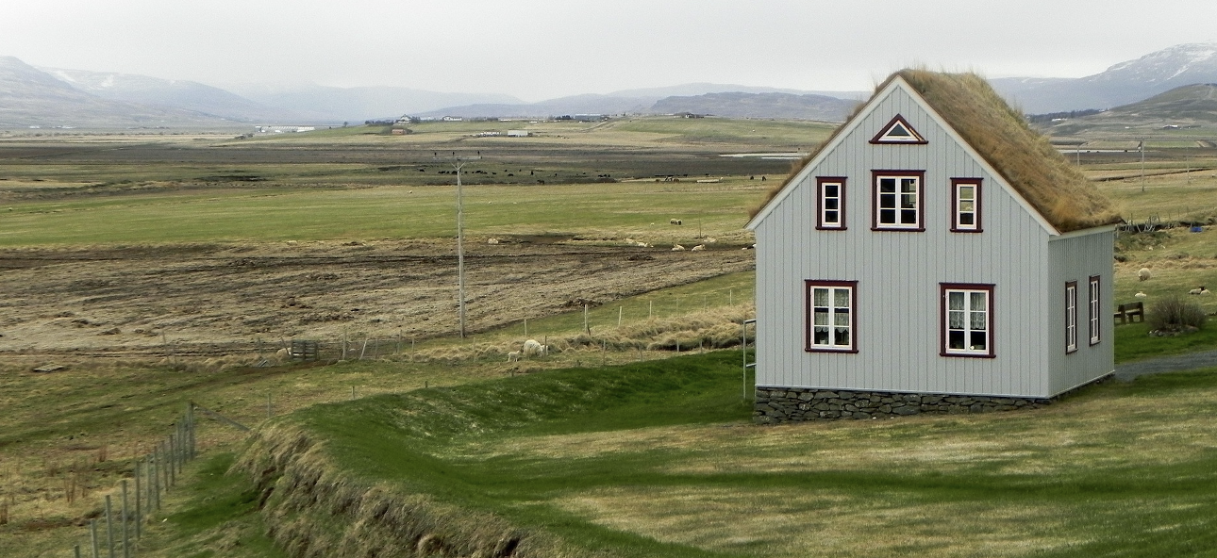
How Green Is My Place? Evaluating Sustainability with Student Created Scorecards

Slide 2
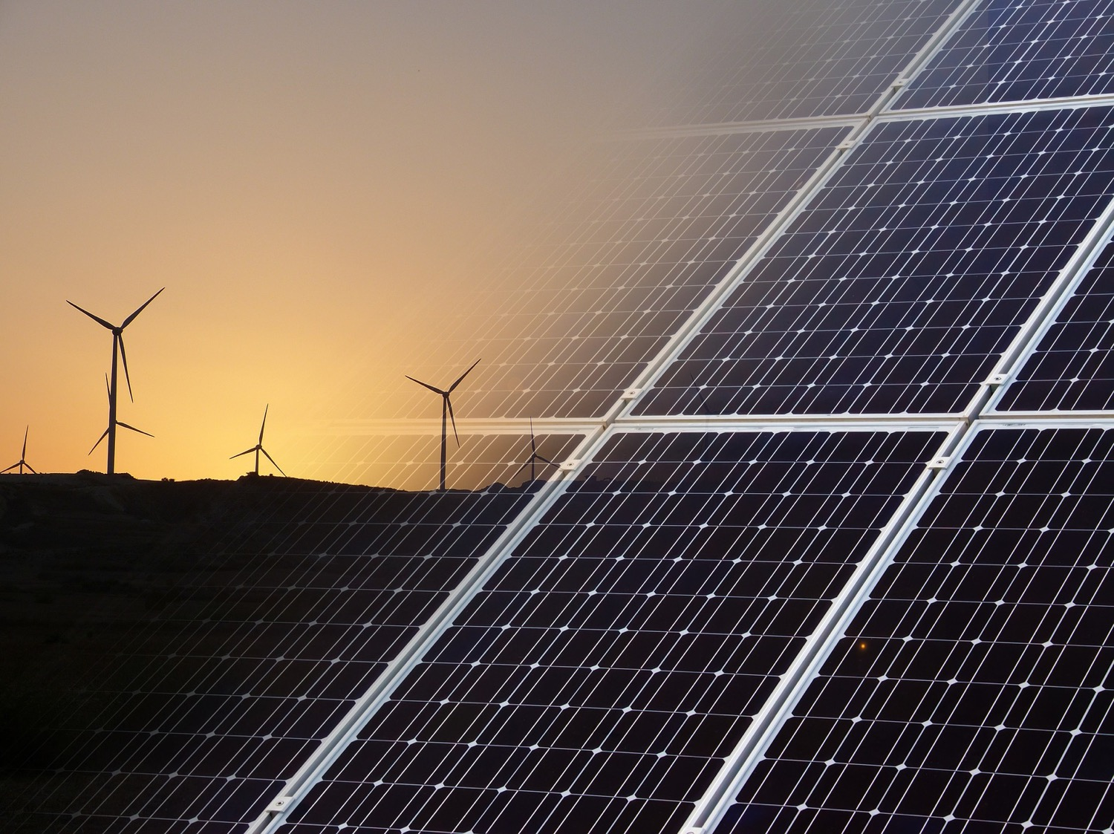
What is sustainability?
Notes:
How would people in your community answer these questions? In what ways could you educate your community (school, workplace, neighborhood) about sustainability?

Slide 3
How is sustainability evaluated?
Notes:
How would people in your community answer these questions? In what ways could you educate your community (school, workplace, neighborhood) about sustainability?

Slide 4
What are the social aspects of sustainability?
Notes:
How would your viewpoint change about sustainability if your basic needs, such as clean water, food, shelter, and safety, could not be met?

Slide 5
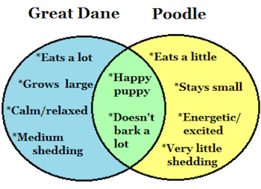
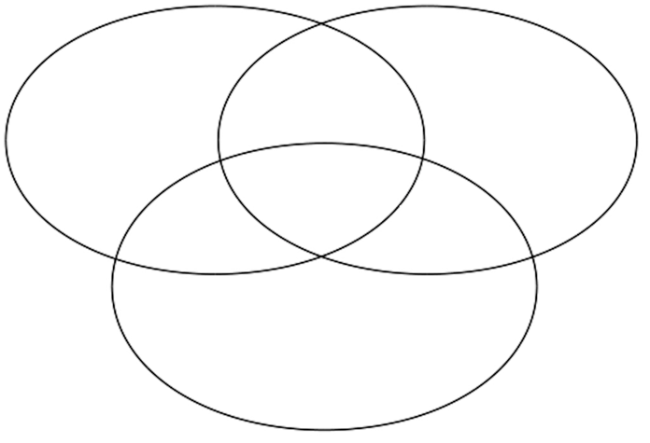
Venn Diagrams
What does it mean when you get to the middle?

Slide 6
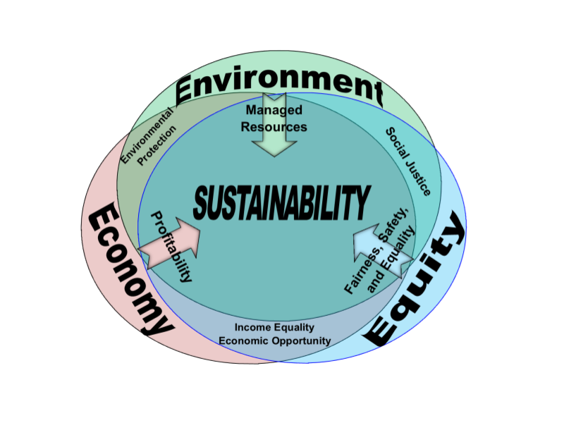
What 3 factors must be considered to reach the middle of the diagram?

Slide 7
Vocabulary

Slide 8
Vocabulary

Slide 9
Vocabulary

Slide 10
3Es Word Cloud

Slide 11
Vocabulary Practice

Slide 12
Sustainability becomes a balancing act between the city, the people, and environment.

Slide 13
Three
E’s
Environment
Economy
“Equity” Social
Work through the slides and reflect on reaching the balance between the 3 e’s.
Speaker notes are provided to help on some slides.
http://www.education4sustainability.org/2013/02/25/the-social-side-of-sustainable-development/
Notes:
What are the other layers of the sustainability wheel interacting?

Slide 14
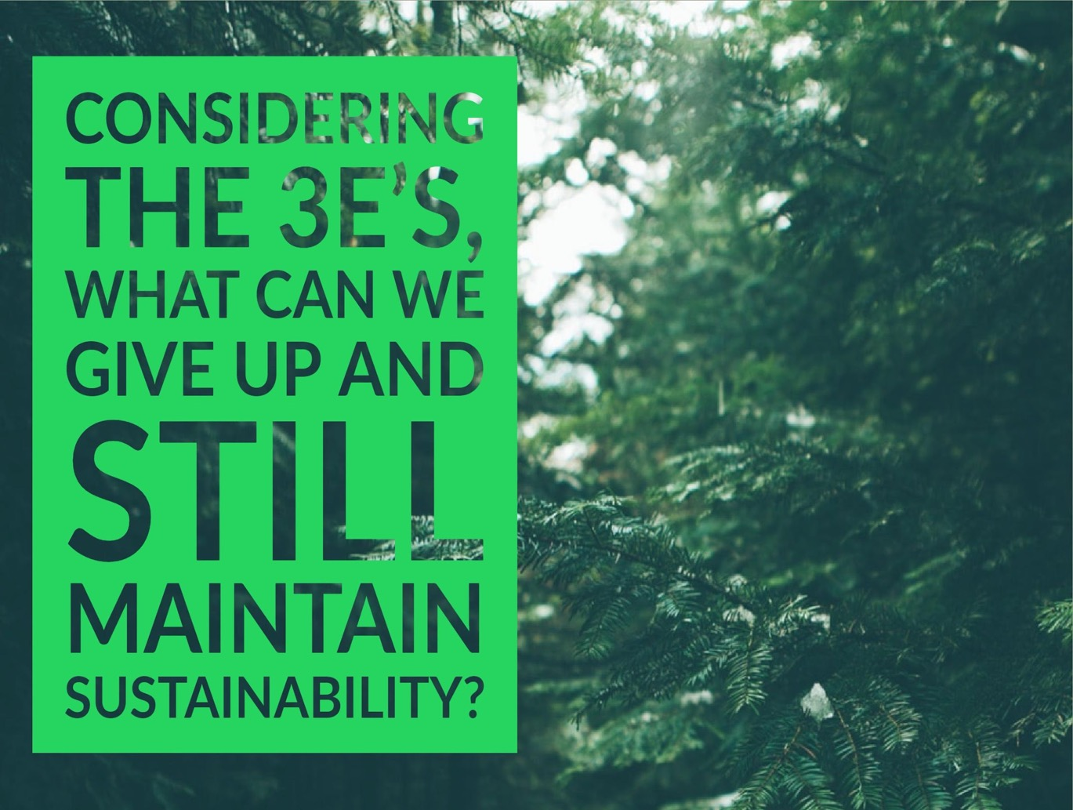

Slide 15
Reflecting on the three E’s, how can we evaluate sustainability?
Consider the following examples.

Slide 16
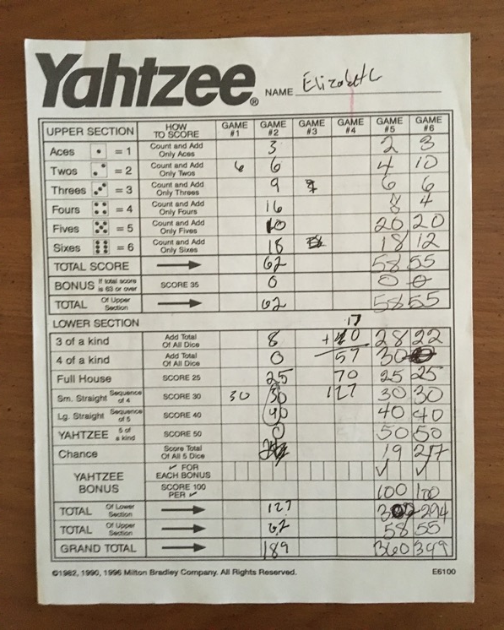
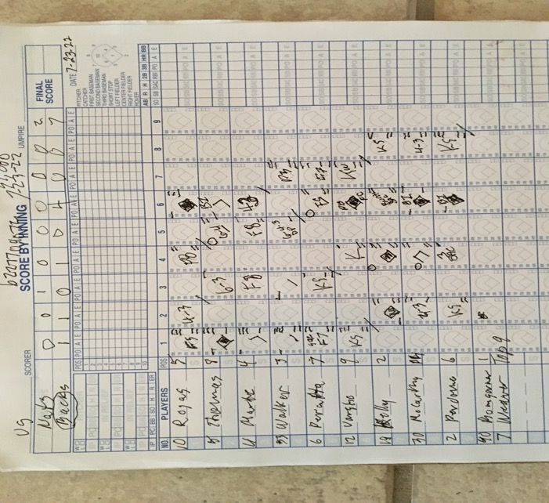
Ways to Measure

Slide 17
Ways to Measure
Notes:
Source: Proctor and Gamble: https://www.slideshare.net/scmgreen/sustainability-scorecard-training-module-1/7?src=clipshare

Slide 18
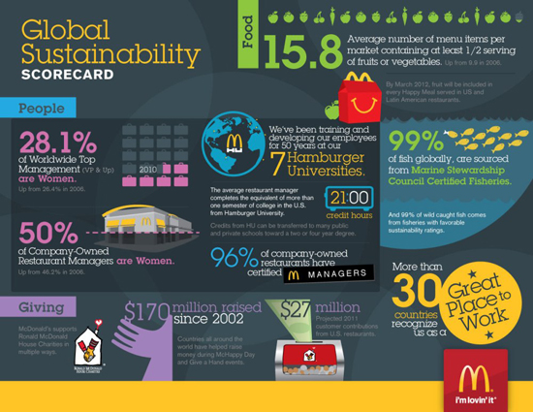
Ways to Measure
Notes:
Source of Scorecard: Brady S. (2012, January 3). McDonald’s Releases 2011 Sustainability Scorecard. Retrieved from [Blog Post] Brandchannel https://www.brandchannel.com/2012/01/03/mcdonalds-releases-2011-sustainability-scorecard/.

Slide 19
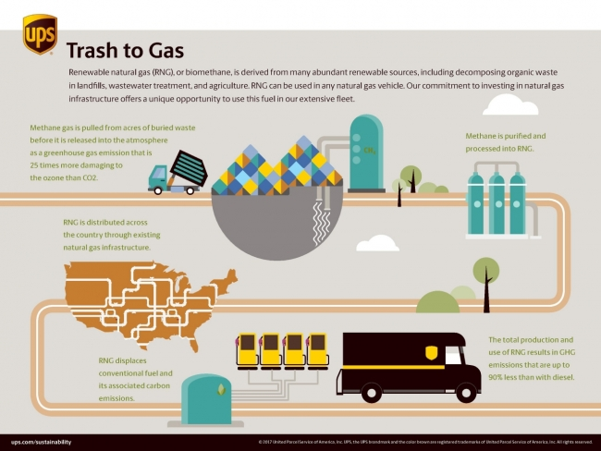
Ways to Measure
Notes:
Source of Scorecard “Trash to Gas Infographic” Cheeseman, G-E. (2017, December 1).
UPS DRASTICALLY INCREASED THE USE OF RENEWABLE NATURAL GAS [Blog post]. Retrieved from http://justmeans.com/blogs/ups-drastically-increased-the-use-of-renewable-natural-gas.

Slide 20
Consider: Appreciative Inquiry and Life Cycle Assessment as factors in your area of study.
Goal: Each group will work to design a scorecard that could be used to improve the sustainability of their home, community, or school based on balancing the 3 Es--Ecology, Economics, and Equity.

Slide 21
Assignment

Slide 22
Color Coding Example

Slide 23
Plotting a Score on the Scale Example

Slide 24
Grading the Group Work

