Slide 1
Prior Vocab 1
Geography terms about the world that we should know
Cartographer: A person who makes maps
Compass rose: A symbol on a map that indicates directions
Scale: Information on a map that indicates distances or sizes
Equator: An imaginary line around the middle circumference of the earth
Northern Hemisphere: The lands and waters of the earth above the equator
Southern Hemisphere: The lands and waters of the earth below the equator
North pole: The top of the earth on the earth’s axis
South pole: The bottom of the earth on the earth’s axis
Continents: The largest land masses on earth
Islands: Smaller land masses surrounded by water
Ocean: Salt water that surrounds all of the earth’s major land masses and islands
Europe: A major continent (see map)
Asia: A major continent (see map)
Africa: A major continent (see map)
North America: A major continent (see map)
South America: A major continent (see map)

Slide 2
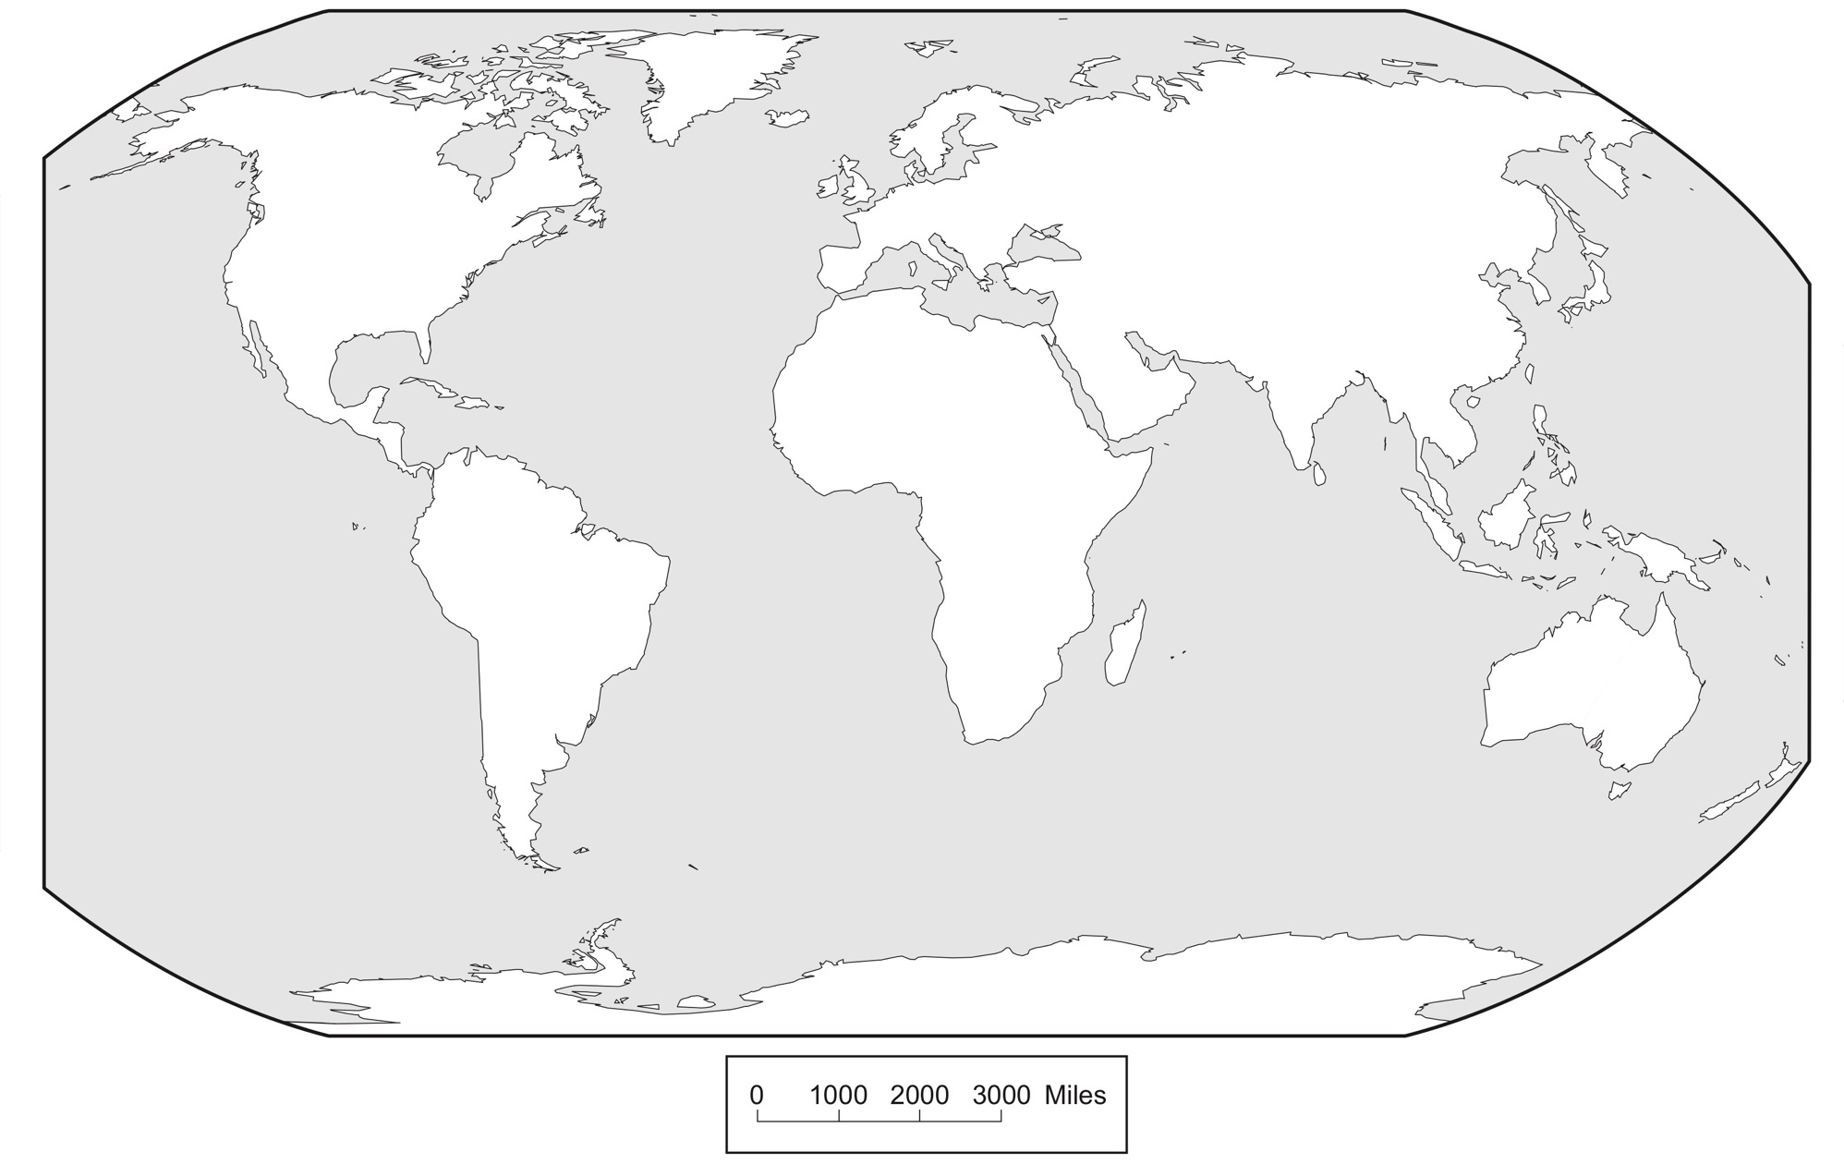
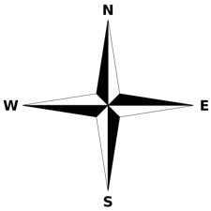
Prior Vocab 2
The largest land (white) areas on the map are known as
__________________
4. Continents
5. Europe
9. North
America
8. Asia
7. Africa
6. South
America
1. Compass Rose
North, East, South, West
10. Australia
3. Ocean
(all of the grey areas)
11. Antartica
2. Scale
Arizona Geographic Alliance geoalliance.asu.edu/azga

Slide 3
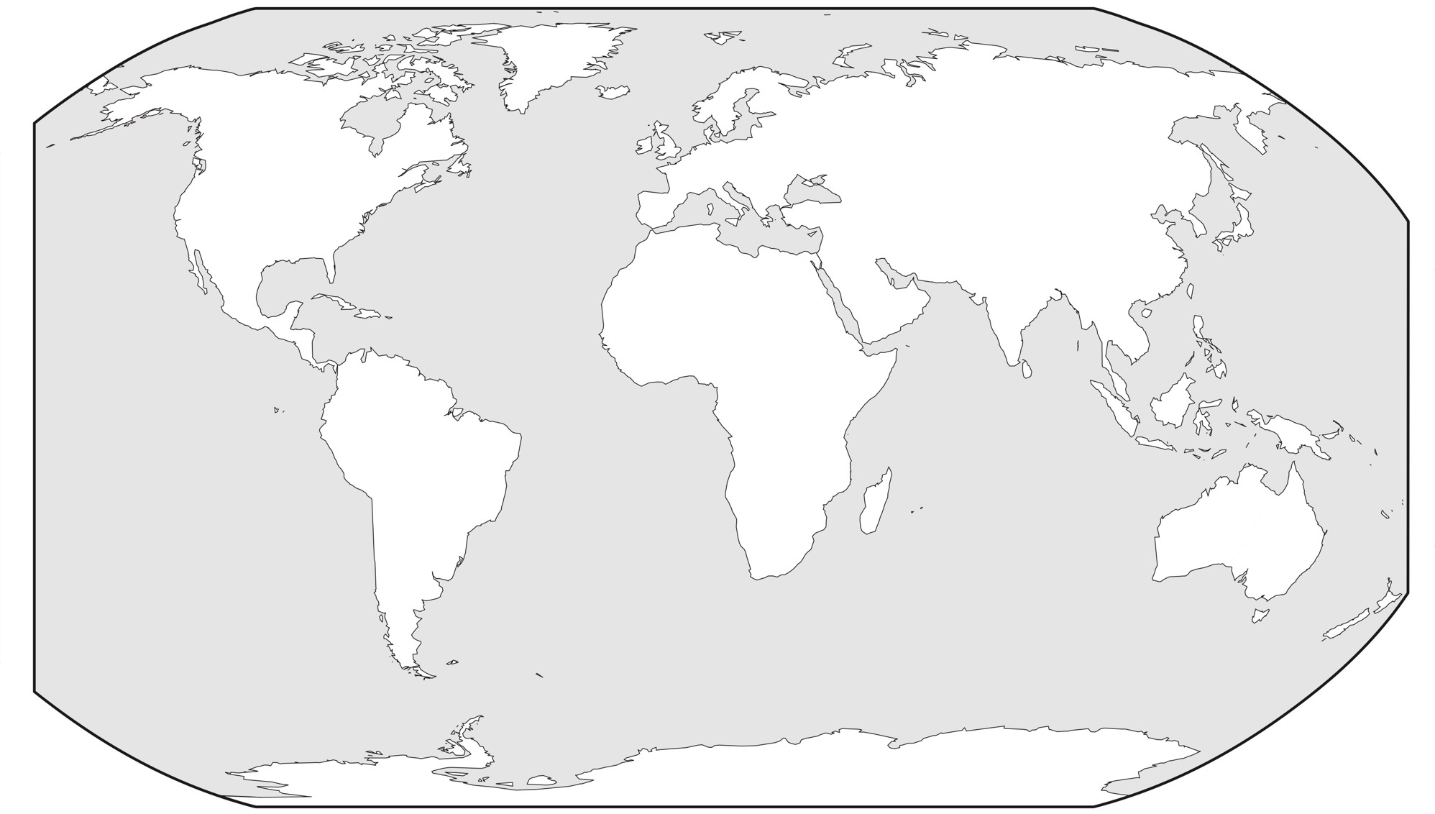
Prior Vocab 3
The world is often thought of as having
a northern half (hemi-) and a southern half (hemi-)
13. North Pole
Europe
North
America
Asia
16. Northern Hemisphere
North
Africa
14. Equator
South
America
South
Australia
12. Southern Hemisphere
Ocean
(all of the grey area)
Antartica
15. South Pole
Arizona Geographic Alliance geoalliance.asu.edu/azga

Slide 4
Prior Vocab 4
Geography Describes Our World!
North Pole (the “top” of the world)
Northern Hemisphere
Equator
Southern Hemisphere
South Pole (the “bottom” of the world)
http://www.urbanexile.net/wordpress/wp-content/uploads/2014/01/earthtut_render_006.png

Slide 5
Prior Vocab 5
Geography
Study of the physical features of earth and atmosphere
topography such as mountains, oceans, deserts, forests, rivers
weather, climate
Maps where and how humans are organized
- cities, states, countries, territories…
The BIG Question!
How do the earth’s physical features influence where and how humans organize?

Slide 6
New Geography Vocabulary!
The Silk Road: a trade route between Asia, Europe and Africa that started out as a route to get silk fabrics from China to willing (and wealthy!) buyers in Europe and Africa (see “The Silk Road” map for more details)
India, China, the East Indies (islands): Asian lands that had very desirable trade goods that attracted trade from Europe and Africa (see “The Silk Road” and “Now What, Europe? maps)
virtual representation: presenting information about things by drawings, maps or digital displays such as Google maps and
windy. com
prevailing winds: the direction a wind usually blows in any given area. Prevailing winds can be generally predicted by where you are located within prevailing wind bands that are caused in part by how the sun heats the earth.
ocean gyres: major current directions of water flow in the oceans that can effect ocean navigation
navigation: planning and tracking directions of travel. Sailing ships have navigators to guide them safely across oceans by knowing where they are on maps (via nightly celestial observations in the 15th-17th centuries) and by taking into account effects of weather, prevailing winds and ocean gyres.

Slide 7
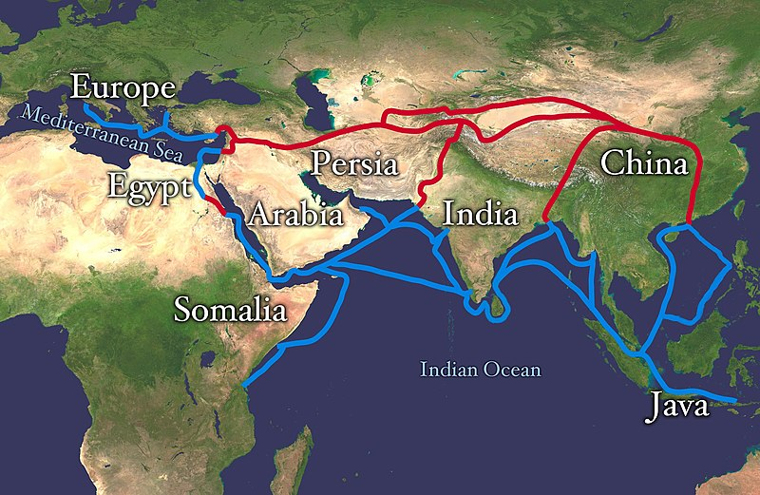
The Silk Road
…Major West/East Relations in the 1300’s
(~700 years ago)
silk, jade, precious metals, spices, grain, glassware, porcelain, horses, gunpowder, weapons, armor, textiles, ideas, culture…
The Silk Road
Retrieved 7/13/2019 from: https://en.wikipedia.org/wiki/Silk_Road#/media/File:Silk_route.jpg

Slide 8
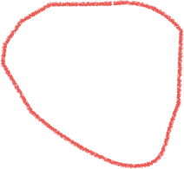
Now What, Europe?
The Silk Road
Trade is Broken!
Europe
North
America
Asia
China
India
Africa
Indies
equator
South
America
1. Compass Rose
North, East, South, West
Australia
Ocean
(all of the grey areas)
Antartica
Scale
Arizona Geographic Alliance geoalliance.asu.edu/azga

Slide 9
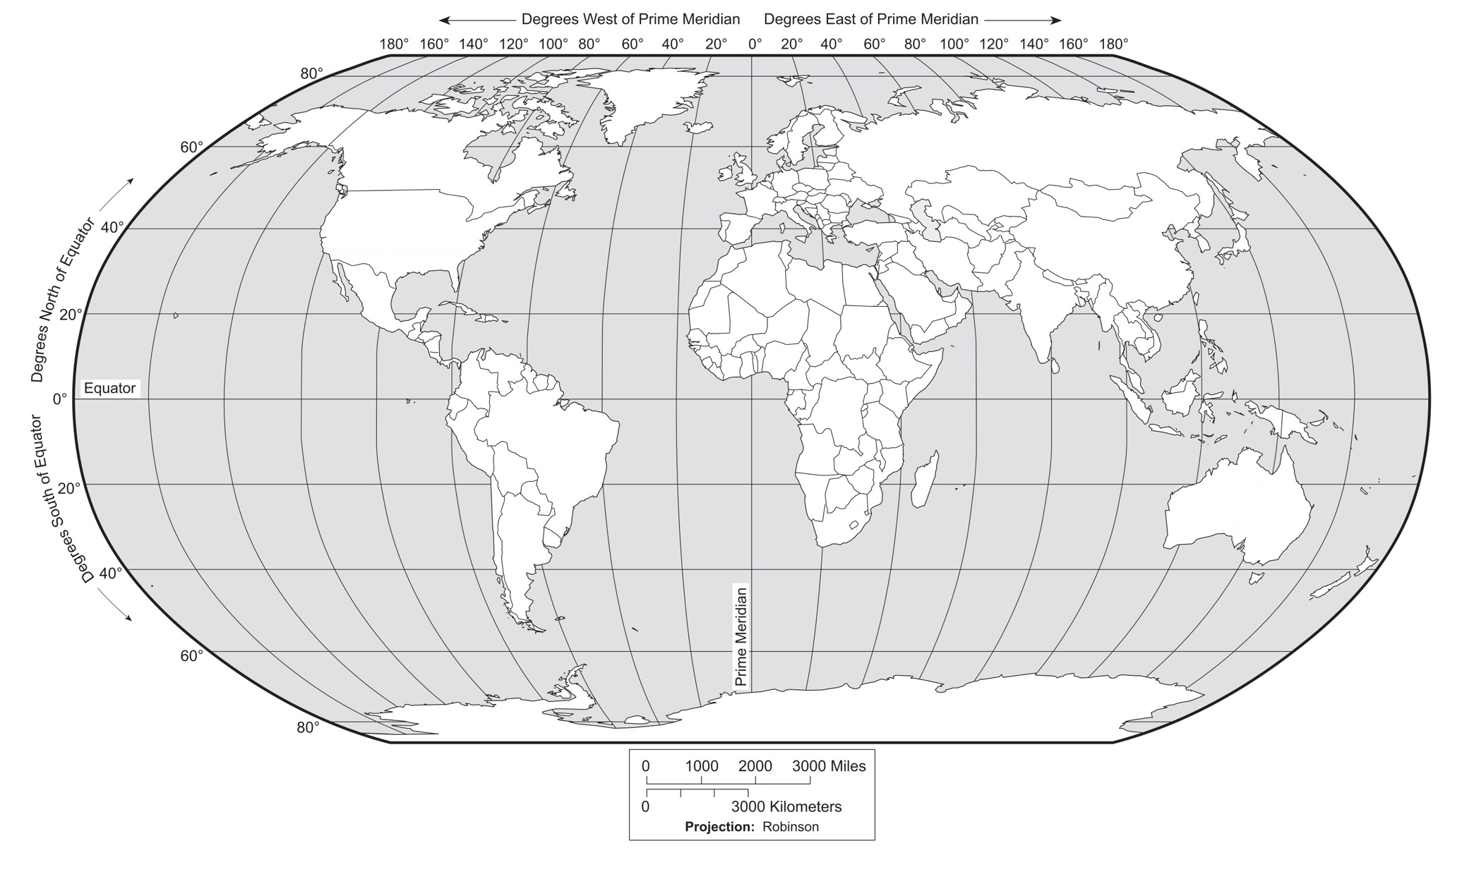
Prevailing Winds (greatly simplified)
Prevailing Westerly Wind
adapted from Arizona Geographic Alliance geoalliance.asu.edu/azga
Prevailing Easterly Wind

Slide 10
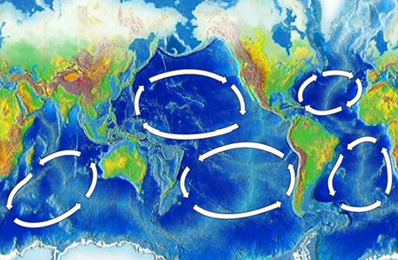
Major Ocean Gyres (simplified)

Slide 11
Continents-blank
The largest land (white) areas on the map are known as
__________________
Arizona Geographic Alliance geoalliance.asu.edu/azga

