Slide 1
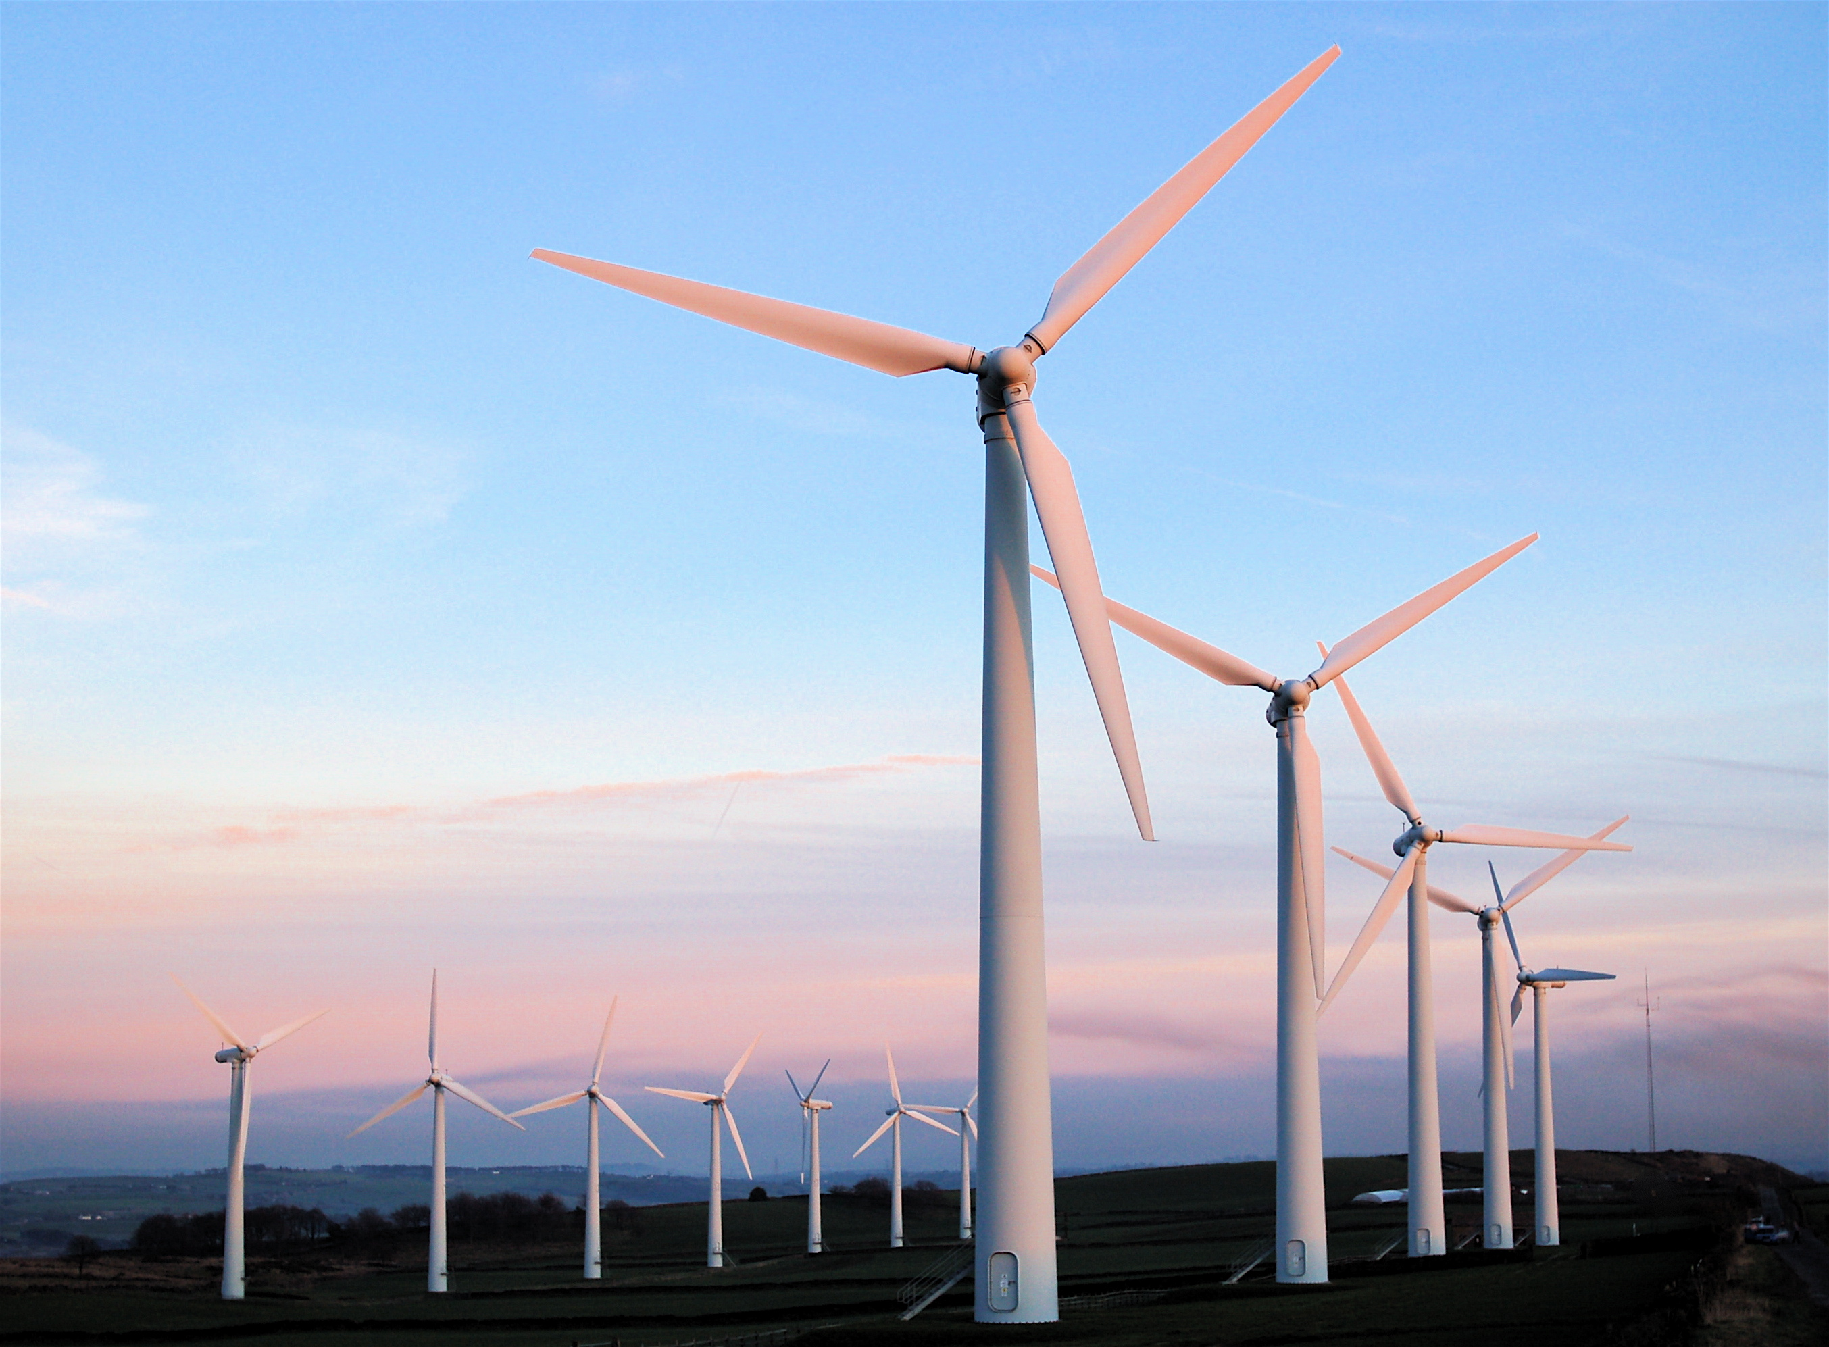
Wind Energy

Slide 2
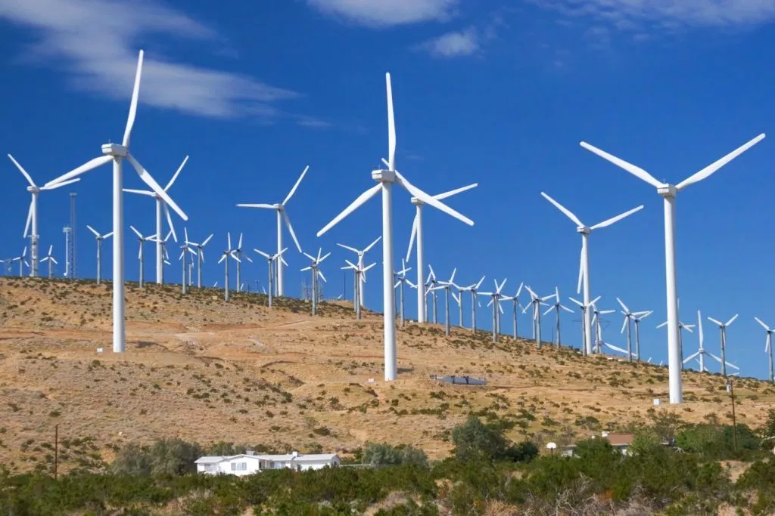
Learning Objectives
Learn about how energy is transferred in moving objects
Explore the best places to build a wind farm
Design and construct a wind turbine with materials given
Test your wind turbine and evaluate its performance
Research the benefits of wind energy
Support claims with evidence

Slide 3
Wind energy vocabulary

Slide 4
Wind energy vocabulary

Slide 5
Wind energy vocabulary

Slide 6
What makes up a wind turbine?
The wind hits the blades
Shaft leads to a gearbox whose output leads to a generator to make electricity
Usually has 2-3 blades

Slide 7
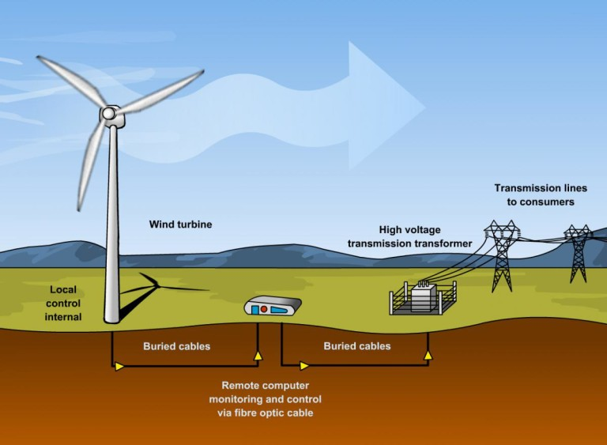
How is energy transferred?
Wind energy turns the blades
Energy travels to gears
Energy travels to generator and becomes electricity
Electric energy goes to transformer
Energy travels to consumers over power lines
http://www.duqlawblogs.org/energy/2016/04/19/wind-power-on-the-rise-in-the-united-states/

Slide 8
How does a wind turbine work?
https://www.youtube.com/watch?v=SQpbTTGe_gk
https://www.youtube.com/watch?v=Z5c50-_hcD0

Slide 9
The best places to build wind farms
http://hint.fm/wind/
https://eerscmap.usgs.gov/uswtdb/viewer/#3.54/36.83/-97.07
https://www.energy.gov/articles/new-interactive-map-shows-big-potential-america-s-wind-energy-future

Slide 10
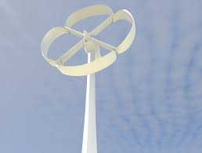
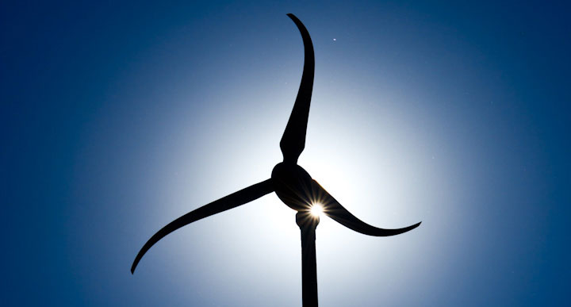
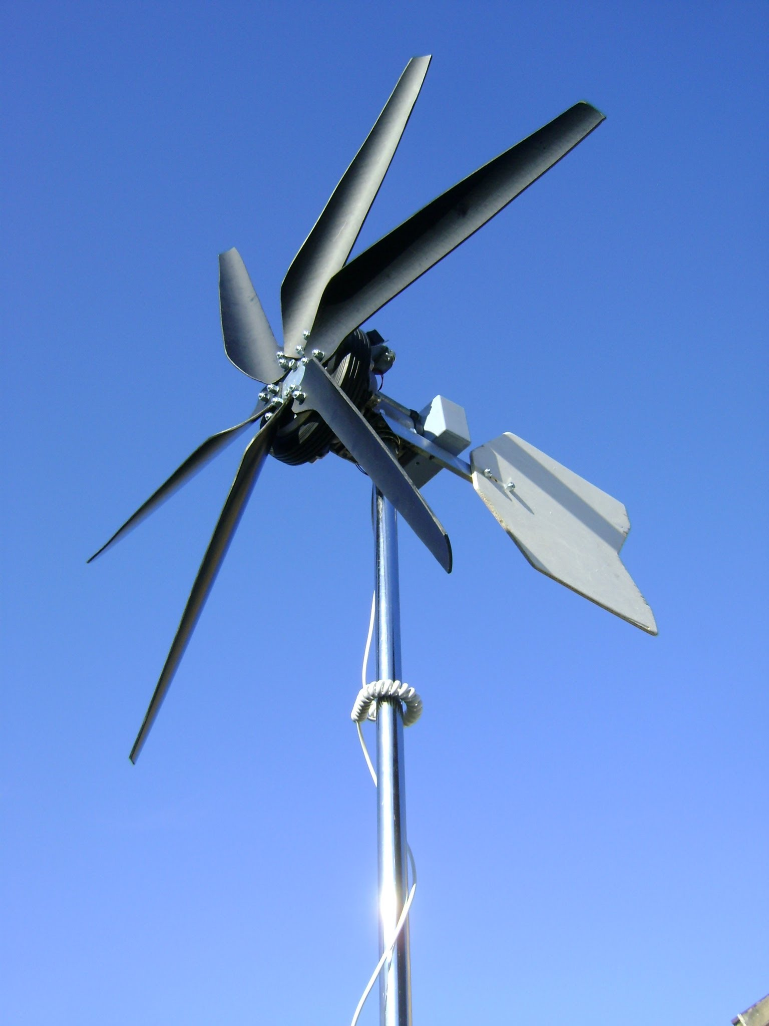
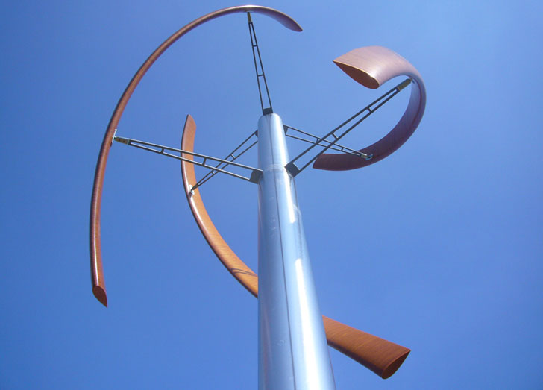
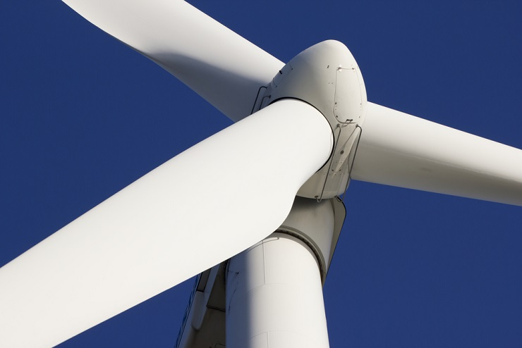
Different Blade designs

Slide 11
Exit Ticket for Today
With your partner, complete the following exit ticket.
Describe how energy is transferred in a wind turbine and a wind farm.
What are 3 ways that wind power benefits society?

Slide 12
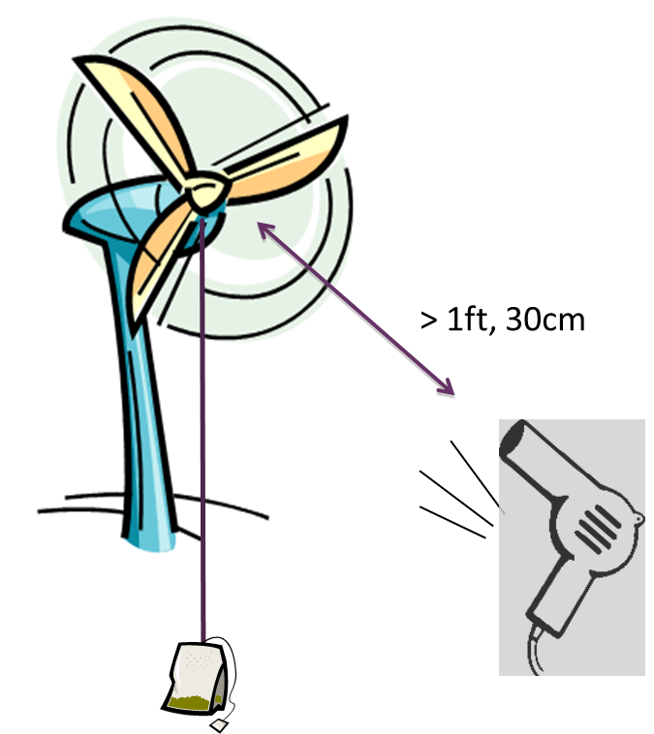
Your assignment
Team of 2
Design, construct and test your own wind turbine
Goal is to lift a weight (pencils taped together)
as quickly as possible
Maximum of 1 minute
No human interaction
Blow dryer must be at least 1 foot away

Slide 13
Wind turbine requirements
Must be free standing not being held by any student--NO human interaction
Must have a rotor shaft around which to wind up a cup
Must use only materials provided
Must collaborate on each part of the
assignment

Slide 14
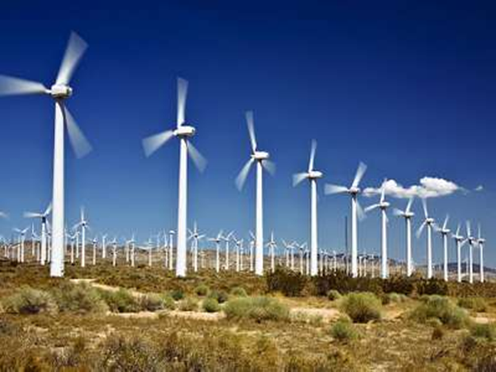
Materials provided (nothing else)
Wooden (popsicle) sticks
Bendable wire
String
Paperclips
Rubber bands
Toothpicks
Aluminum foil
Tape
Wooden dowels
Paper, cardboard
Hair Dryer
Glue gun
I will furnish the weight.
You cannot practice with the weight.

Slide 15
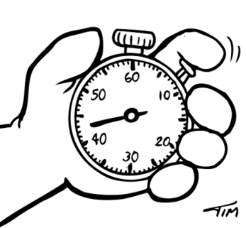
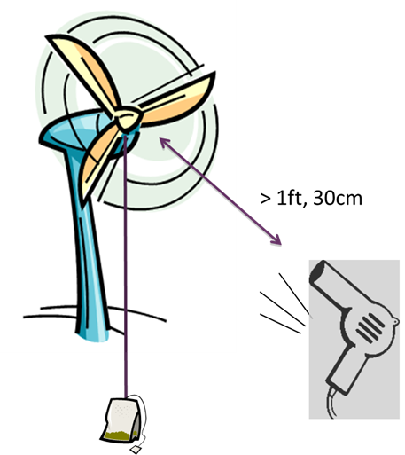
Testing Procedure
Blow dryer must be at least 1 foot away from turbine
Attach weight around rotor
1 minute or less to wind up the cup
Record time to wind up weight

Slide 16
Assignment Sheets

Slide 17
Self-Assessment
Notice some features are worth
more points.

Slide 18
Assessment

