Slide 1
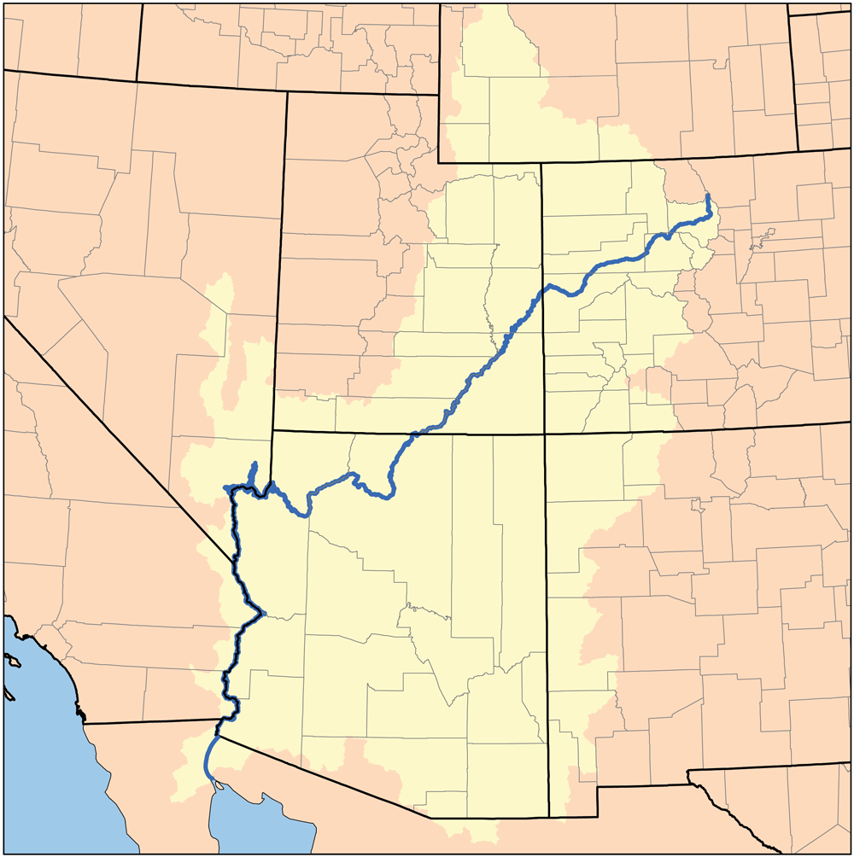
Arizona and the Colorado River

Slide 2
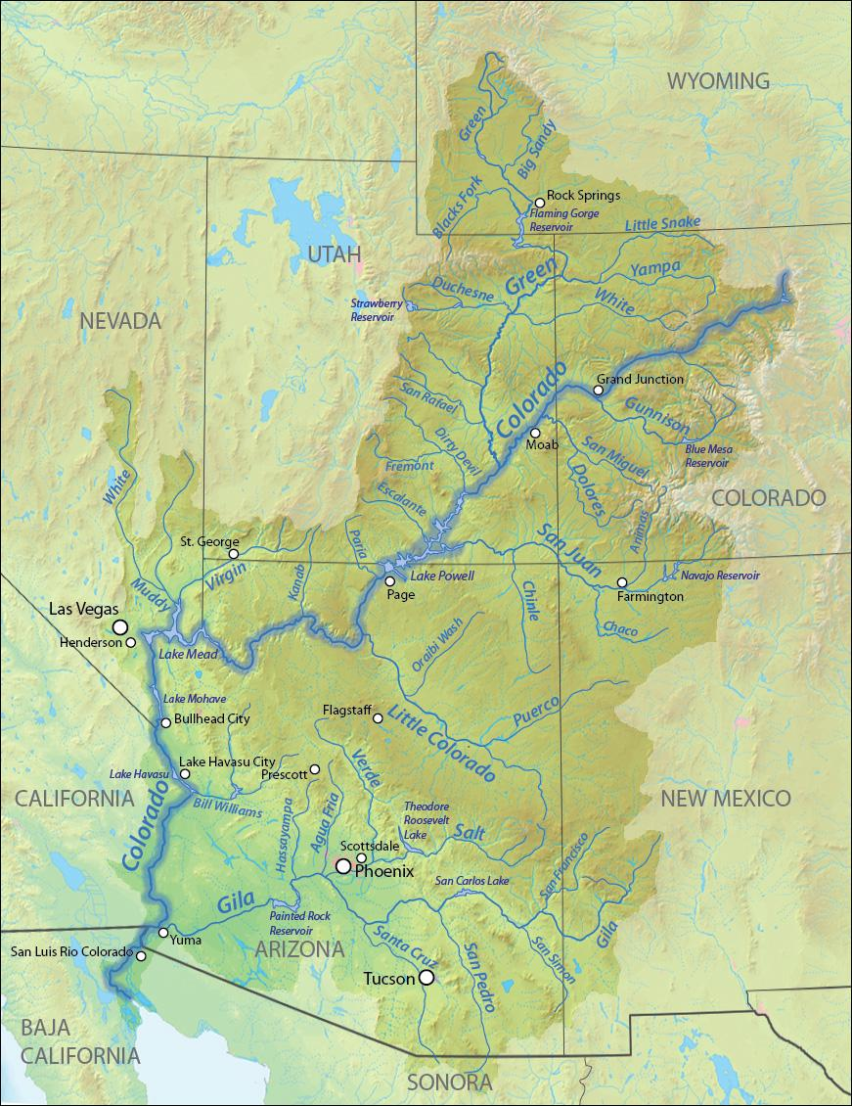
Where does the Colorado River Start?
If you ask Colorado, they say the headwaters for the Colorado River are in the Rocky Mountains at La Poudre Lake in northern Colorado.
If you ask Wyoming, they claim the headwaters for the Colorado River begin at the Green River.

Slide 3
How does the Colorado River get to Arizona?
The river flows southwest through the Colorado Plateau of western Colorado, through southeastern Utah and through northwestern Arizona where it flows through the Grand Canyon. It turns south near Las Vegas, Nevada, forming the Arizona–Nevada border at Lake Mead and the Arizona–California border a few miles below Davis Dam.

Slide 4
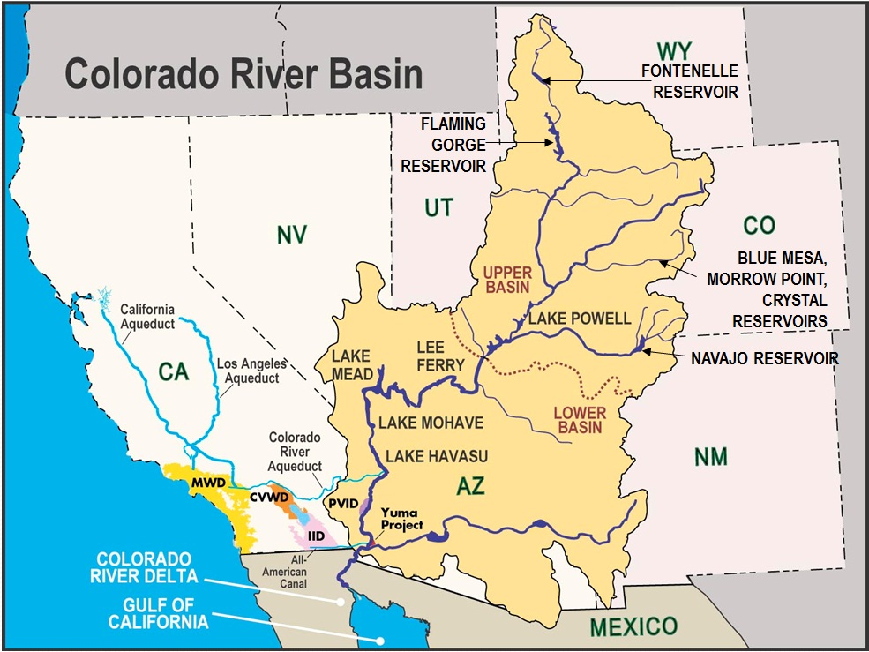
What are the two basins of the Colorado River?

Slide 5
What are the objectives for today’s activity?
You will:
Identify the locations of important dams along the Arizona portion of the Colorado River.
Identify prominent cities/towns along the Colorado River as it borders Arizona.
Identify and locate types of recreation found on the Arizona portion of the Colorado River.
Describe how hydrology of the Colorado River has influenced the character of Arizona.

Slide 6
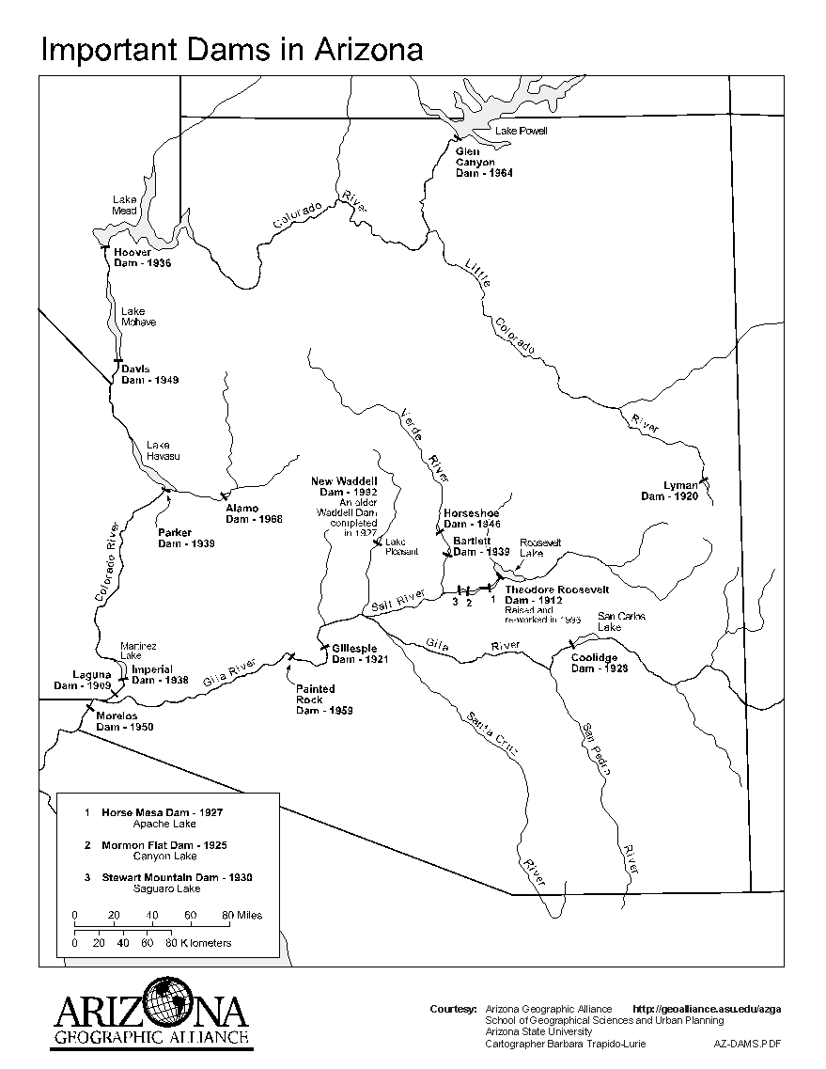
What are the major dams on the AZ portion of the Colorado River? blue cubes
What are the major cities on the AZ portion of the Colorado River? red cubes

Slide 7
Why was the dam built? What are its current uses?
Yellow cube = electric power
Green cube = agriculture/farming
Brown cube = diverting water into canals
Gray cube = fishing
White cube = prevent flooding
Orange cube = desilting, desalting
Black cube = other uses

Slide 8
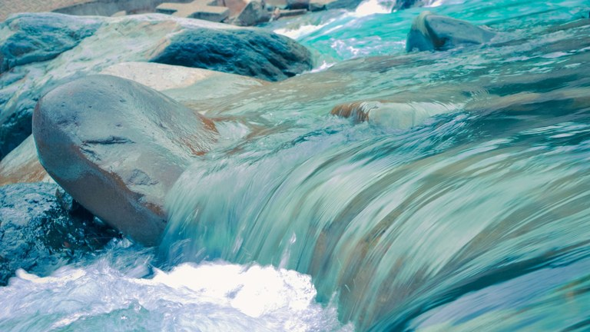
Vocabulary Word | Definition | Illustration
hydrology | science dealing with water on and below the earth’s surface and in the atmosphere
surface water | water found on the top of the earth’s surface
groundwater | water found within the earth
reclaimed water | water restored to previous natural state
Notes:
https://ncar.github.io/hydrology/
https://www.eea.europa.eu/airs/2017/natural-capital/copy_of_surface-waters
https://www.groundwater.org/get-informed/basics/groundwater.html
https://www.tucsonaz.gov/water/apply-for-reclaimed-water-service

Slide 9
Discussion Questions: What types of controversy surround this dam? Examples could be: loss of native species, loss of communities, historical issues, ecological issues, rights of Native Americans, rights of other states, quality of the water, decrease of wildlife, etc. In Arizona, how has hydrology influenced the natural character of a place? What human actions are directly related to the Colorado River?
Notes:
Not sure if this slide is needed.

